Slide 1
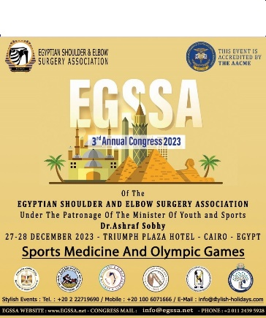
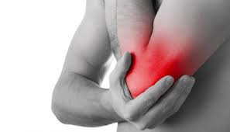

The supra and intercondylar elbow fractures: which posterior surgical approach to which type of fracture?
Dr. KAMOUN HAITHEM
ORTHOPEDIC SURGERY DEPARTEMENT
SECURITY FORCES HOSPITAL - TUNISIA

Slide 2
INTRODUCTION
rare fractures = 2% of all fractures in adults.
poor prognosis
complex and difficult management
Solid osteosynthesis requires good exposure

Slide 3
SEVERAL POSTERIOR APPROACHES
INTERRUPTING THE EXTENSOR SYSTREM
PARATRICIPITAL
TRANSTRICIPITAL

Slide 4
PURPOSE
What influence does the posterior approach used have on the final postoperative functional outcome?
Which approach should be used for which type of fracture?
Can we establish a protocol for the choice of approach in order to standardize management?

Slide 5
METHODS
retrospective comparative study
From 2010 to 2018
42 adult patients with supra and inter condylar fractures of the elbow. same osteosynthesis (2 PLATES)
via different posterior approaches
INCLUSION CRITERIA | EXCLUSION CRITERIA
Age over 15 years. Patients operated on via a posterior approach. Patients with osteosynthesis of both columns. Complete pre- and postoperative radiological work-up. | Patients treated orthopedically. Patients treated with percutaneous pinning. Patients treated with external fixator. Patients operated on using a non-posterior approach.

Slide 6
WE STARTED BY ANATOMICAL DATA COLLECTION :
AGE
GENDER
DOMINANT SIDE
OCCUPATION
AFFECTED SIDE
MEDICAL BACKGROUND
CIRCUMSTANCE OF OCCURANCE

Slide 7
CLINICAL DATA COLLECTION :
SKIN LESION : GUSTILO AND ANDERSON CLASSIFICATION
VASCULAR LESION
ASSOCIATED LOCAL LESIONS
STAGED UPPER LIMB TRAUMA
ASSOCIATED TRAUMA(THORACIQ,CRANIAL,ABDOMINAL..)

Slide 8
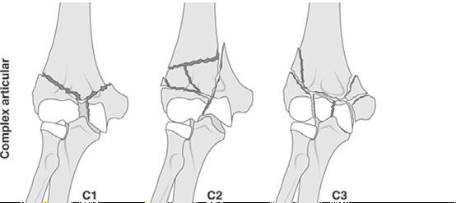
RADIOLOGY DATA COLLECTION
AO CLASSIFICATION BY MULLER AND ALLGOWER

Slide 9
THERAPEUTIC DATA :
OPERATING TIME
INSTALLATION TYPE
TYPE OF ANESTHESIA
TOURNIQUET USE ?
NEUROLYSIS AND TRANSPOSITION

Slide 10
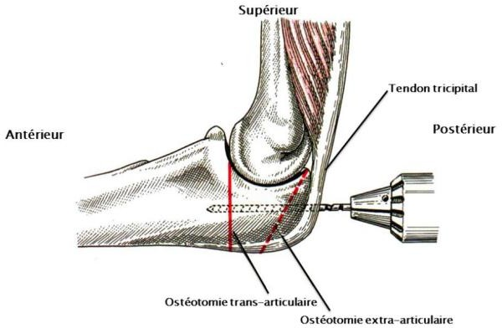
APPROACH USED :
WITH INTERRUPTION OF EXTENSOR SYSTEM : ARTICULAR OR EXTRA ARTICULAR OSTEOTOMY

Slide 11
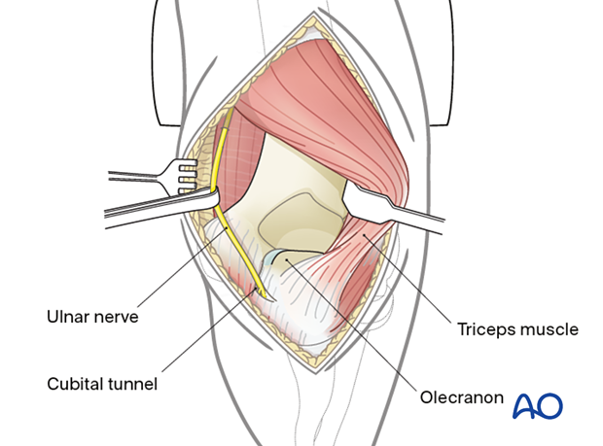
PARATRICIPITAL

Slide 12
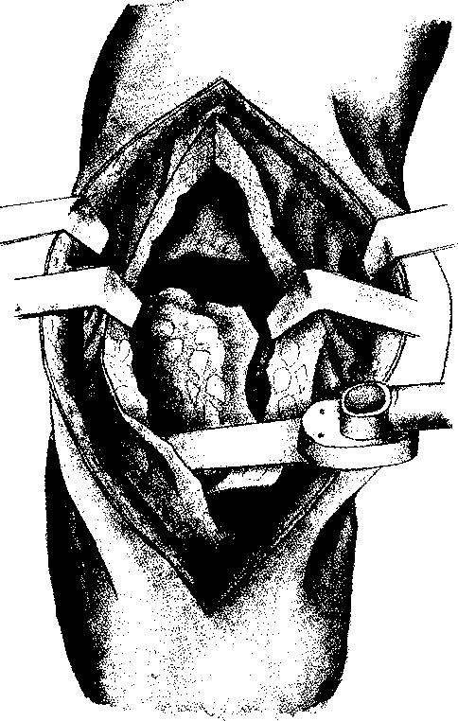
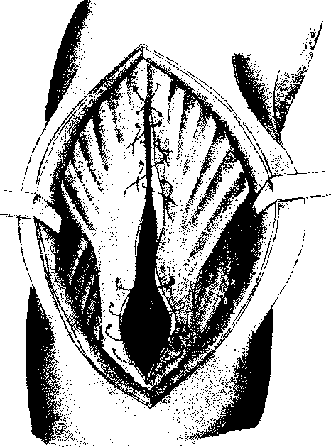
TRANSTRICIPTAL ( GSCHWEND)

Slide 13
POST OPERATIVE DATA
POST OPERATIVE X-RAY AND LAST FOLLOW UP
DURATION OF REHABILITATION
COMPLICATIONS ?
MOBILITY

Slide 14
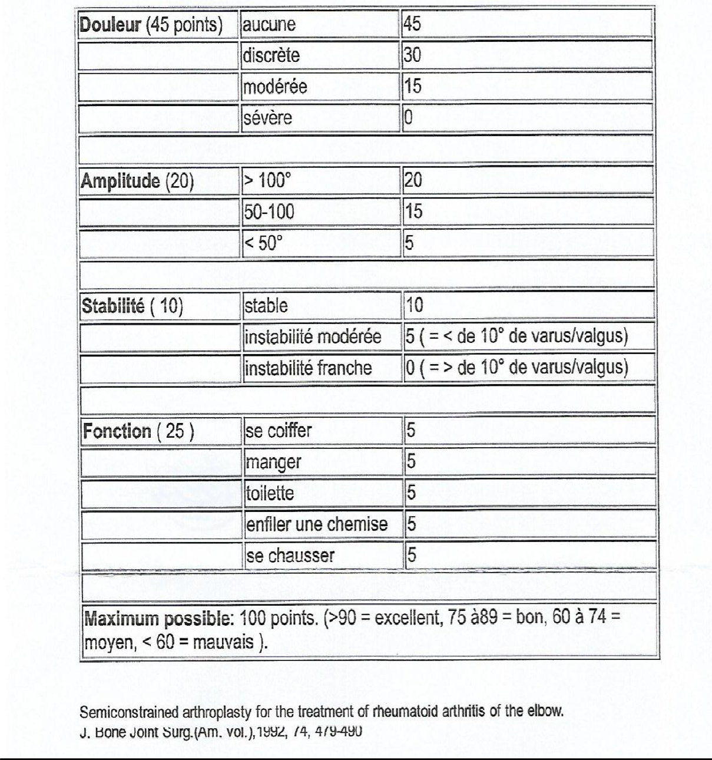
FUNCTIONNAL OUTCOME VIA MAYO CLINIC SCORE

Slide 15
RESULTS
AGE : FROM 17 to 83 years old
AVERAGE : 48 years
RIGHT ELBOW : 26 CASES
LEFT ELBOW : 16 CASES

Slide 16
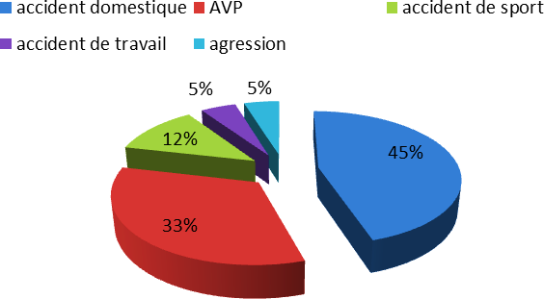
CIRCUMSTANCES
TRAFFIC AND DOMESTIC ACCIDENT ARE CAUSING 78 % OF FRACTURES.
A single case of preoperative radial nerve palsy

Slide 17
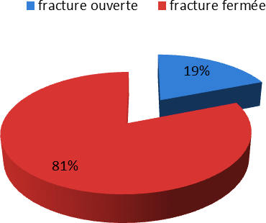
SKIN LESION

Slide 18
FRACTURE TYPE
 | Frequency | Percentage
C1 | 17 | 41
C2 | 6 | 14
C3 | 19 | 45
TOTAL | 42 | 100

Slide 19
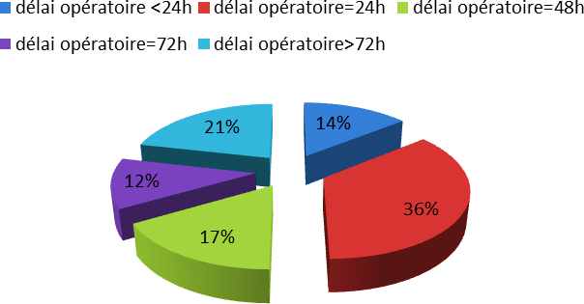
 | THE FIRST 24 HOURS | AFTER 72 HOURS | GENERAL ANESTHESIA | LATERAL DECUBITUS AND FLEXED ELBOW
POURCENTAGE | 57 % | 12 % | 71 % | 88 %

Slide 20
 | TOURNIQUET | TRANSOLECRANIAL APPROACH | PARA/TRANS TRICIPTAL
POURCENTAGE | 64% ( 90 MIN) | 67 % | 33 %

Slide 21
IMMOBILIZATION
93 % BY MAYO CLINIC DURING 21 DAYS
REHABILITATION
73 % OF PATIENTS HAD REHABILITATION FOR VARIABLE DURATION (60 TO 120 DAYS) STARTED IMMEDIATELY IN 33% OF CASES.

Slide 22
COMPLICATIONS
Patients undergoing transolecranial surgery :
ulnar paralysis | 1
ulnar sensory deficit | 1
surgical site infection | 1
postoperative stiffness | 2
olecranon pseudarthrosis | 6
material DISCOMFORT | 10

Slide 23
Complications in patients undergoing paratricipital and transtricipital surgery
radial paralysis | 1
surgical site infection | 2
secondary displacement | 1
algodystrophy | 1
elbow stiffness | 2
humerus pseudarthrosis | 2
material DISCOMFORT | 1
osteoma | 1

Slide 24
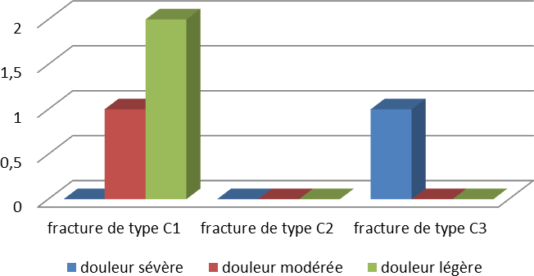
POST OP PAIN ASSESSEMENT
SEVERE POST OP PAIN IS MORE
ASSOCIATED WITH C3 TYPE FRACTURES

Slide 25
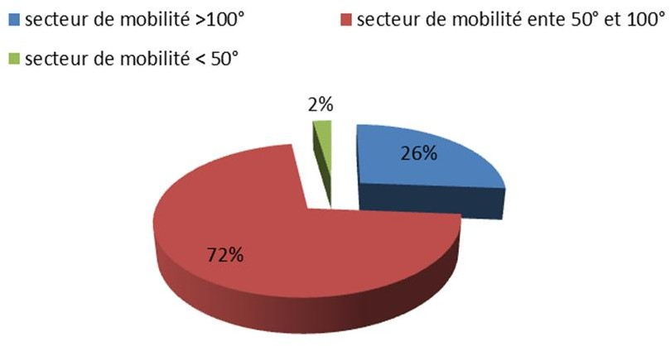
POST OP MOBILITY
 | Secteur >100° | Secteur 50° et 100° | Secteur <50°
Fracture C1 | 18% | 82% | 0%
Fracture C2 | 33% | 67% | 0%
Fracture C3 | 31% | 63% | 6%

Slide 26
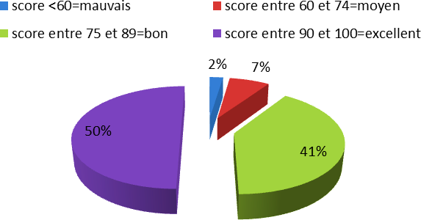
MAYO CLINIC SCORE POST OP
ALMOST 91 % GOOD AND EXCELLENT RESULT.
ONLY 2% BAD RESULT.

Slide 27
RESULTS DEPENDING ON FRACTURE TYPE
 | Olecraniotomy | Without olecraniotomy | Total
C1 | 10 | 7 | 17
C2 | 3 | 3 | 6
C3 | 15 | 4 | 19
TOTAL | 28 | 14 | 42
78,9 % OF C3 FRACTURES ARE TREATED BY OLECRANIOTOMY

Slide 28
MAYO CLINIC SCORE DEPENDING ON FRACTURE TYPE
 | bad | medium | good | excellent | Total
C1 | 0 | 1 | 9 | 7 | 17
C2 | 0 | 0 | 2 | 4 | 6
C3 | 1 | 2 | 6 | 10 | 19
Total | 1 | 3 | 17 | 21 | 42
GOOD AND EXCELLENT RESULTS :
FOR C1 TYPE : 94 %
FOR C3 TYPE : 84 %
FOR C2 TYPE : 100 %

Slide 29
Mobility sectors affected by the approach used
 | Sector > 100°. | Sector between 50° and 100 | Sector<50
Transolecranial | 28% | 68% | 4%
Para//transtricipital | 22% | 78% | 0%

Slide 30
Approach and Mayo Clinic score
Bad |  | Medium | Good | Excellent | Total
olecraniotomy | 1 | 1 | 12 | 14 | 28
Without olecraniotomy | 0 | 2 | 5 | 7 | 14
Total | 1 | 3 | 17 | 21 | 42
93%
86%

Slide 31
GLOBAL FINDINGS
FOR :
C3 TYPE : GOOD AND EXCELLENT RESULTS IS ACHEIVED BY OLECRANOTOMY ( 86% VS 75%)
C1 TYPE : THE OPPOSITE ( 58 % VS 30 % )
C2 TYPE : NO DIFFERENCE

Slide 32
DISCUSSION
Study | Headcount | Male | Female
Mohsni | 34 | 20 | 14
Lahrach | 62 | 44 | 18
J.A Fernàndez | 13 | 4 | 9
Pajarinen | 21 | 8 | 13
Our Study | 42 | 26 | 16
Study | Age average
Mohsni | 42
Pajarinen | 44
EK Goldwasser | 41
G.chen | 44.5
Proust | 61
Lahrach | 39
Our study | 48
Distribution of supra- and inter condylar fractures by sex
Average age for supra- and inter-condylar elbow fractures
Young people -> MALE +++ ( PUBLIC ROAD ACCIDENT)
ELDERY -> FEMALE +++ ( DOMESTIC ACCIDENT)

Slide 33
No relationship between skin lesion and bad functionnal result
Vascular lesion is rare but must be not neglected
Nerve lesion pre operative is rare but must diagnosed before surgery
X ray face and profil is enough for diagnosis but CT scan is necessary for management strategy for most of fractures.

Slide 34
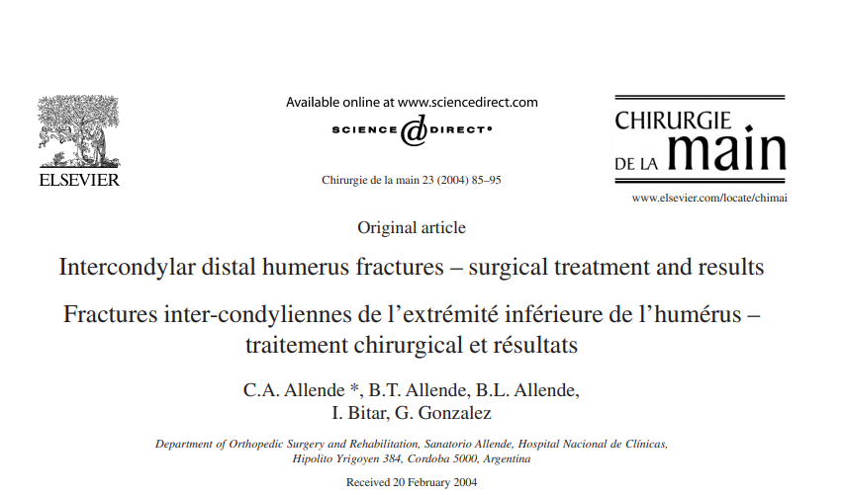
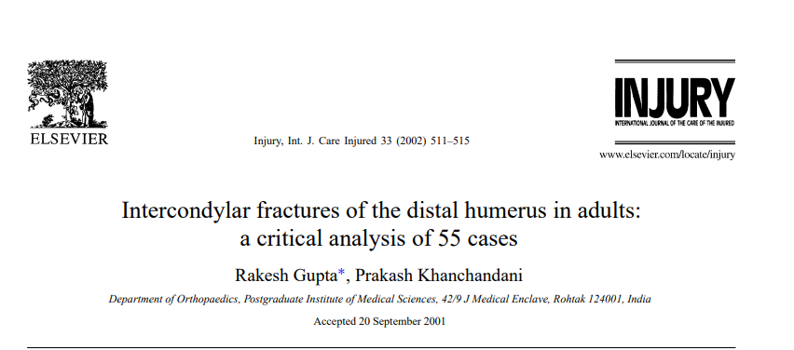
Muller and Allgower's AO classification according to different studies

Slide 35
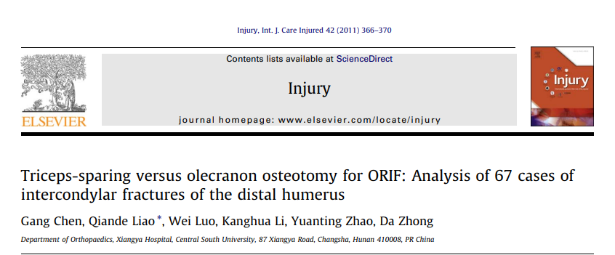
Muller and Allgower's AO classification according to different studies

Slide 36
Muller and Allgower's AO classification according to different studies
Author/type of fracture | C1 | C2 | C3
C.Allend | 9 | 14 | 17
R.Gupta | 18 | 23 | 13
G.Chen | 10 | 28 | 29
Mohsni | 15 | 12 | 7
Our study | 17 | 6 | 19
FRACTURE TYPE -> THERAPEUTIC INDICATION -> FUNCTIONNAL OUTCOME REGARDLESS OF SURGICAL APPROACH
FRACTURE TYPE | C1 | C2 | C3
GOOD AND EXCELLENT RESULTS | 94% | 100% | 80%

Slide 37
WHEN THESE FRACTURES SHOULD BE OPERATED ?

Slide 38
QUICKLY
IN ORDER TO AVOID EDEMA AND FIBROSIS -> DIFFICULT OSTEOSYNTHESIS -> BAD FUNCTIONNAL OUTCOME
IN OUR STUDY AVERAGE TIME WAS 24 H
IN SOME CASES : POLY TRAUMA, DIFFICULT ANESTHESIA, IT EXCEEDS 24H.

Slide 39
WHAT ABOUT TOURNIQUET ?

Slide 40
NO STATISTIC RELATION BETWEEN USE OF TOURNIQUET
AND BAD FUNCTIONNAL RESULT.
BUT
PROLONGED TIME MORE THAN 120 MIN -> NEUROLOGIC
DAMAGE

Slide 41
SURGICAL APPRAOCH
WITH OLECRANOTOMY :
FOR SOME AUTHORS -> GOLD STANDARD -> GOOD EXPOSURE -> GOOD EPIPHYSEAL RECONSTRUCTION
BUT
PSEUDARTHROSIS RISK !!!
MATERIAL DISCOMFORT +++

Slide 42
PARA / TRANSTRICIPITAL :
FOR THE FIRST TIME BY BRYAN AND MORRAY FOR ARTHROPLASTY
IT ALLOWS GOOD EXPOSURE FOR C1 AND SOME C2.
EARLY MOBILIZATION
LOSS OF MUSCLE STRENTGH : TRANS > PARA

Slide 43
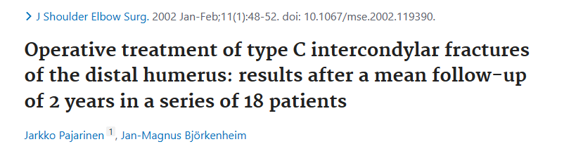
WE FOUND FEW STUDIES ABOUT THESE APPROACHES

Slide 44
WE FOUND FEW STUDIES ABOUT THESE APPROACHES
Study | percentage of fractures operated on via the paratricipital and transtricipital approaches
Mohsni | 0
Pajarinen | 33
Allende | 22,5
Our Study | 33
IT IS ALWAYS UNDER 50 % WHICH CONFIRMES THAT PARA / TRANS TRICIPITAL
APPROACH ARE UNDERUSED THAN OLECRANOTOMY

Slide 45
TYPE OF SYNTHESIS
MOST OF AUTHORS : R.Gupta, Allende, S.Andrew, Bégué recommanded synthesis of both columns by external and internal plates.
The 180 ° assembly is biomechanically more stable
IMMOBILIZATION
IT MUST BE AS SHORT AS POSSIBLE
OUR STUDY : 93 % ( 21 DAYS )
MOST OF AUTHORS (Gupta, Pajarinen, Allende, Ozer...) RECOMMAND
AN EARLY ASSISTED ACTIVE MOBILIZATION

Slide 46
Functional outcomes in complicated pseudarthrosis fractures of the olecranon:
Type of fracture | Surgical revision | Mayo Clinic Score | Final functional outcome
C1 | YES | 95 | EXCELLENT
C1 | NO | 74 | MEDIUM
C1 | NO | 80 | GOOD
C1 | YES | 95 | EXCELLENT
C3 | YES | 80 | GOOD
C3 | YES | 55 | BAD
4 CASES OF C1 FRACTURES ARE COMPLICATED BY PSEUDARTHROSIS !!!! CAN BE AVOIDABLE BY OTHER APPRAOCHES

Slide 47
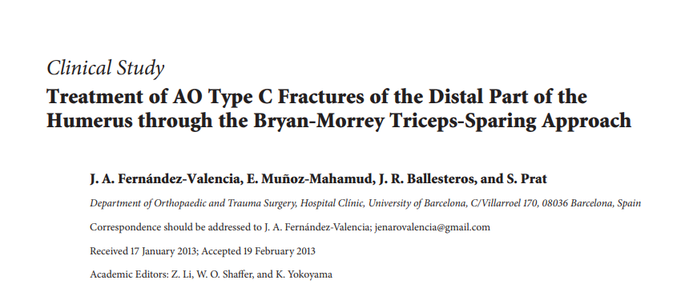
Different functional outcomes according to Mayo Clinic score
2013

Slide 48
Different functional outcomes according to Mayo Clinic score
Auteur | Score used | Excellent and good outcomes | Medium and poor outcomes
Chen | Mayo Clinic | 54 | 13
Fernandez | Mayo Clinic | 12 | 2
Allende | Mayo Clinic | 34 | 6
Our study | Mayo Clinic | 38 | 4
ALTHOUGH DIFFERENCE OF INCLUSION CRITERIA IN THESE DIFFERENT STUDIES, WE NOTICE THAT PROGNOSIS IS IMPROVED BY RAPID MANAGEMENT.

Slide 49
Post op ROM
72 % OF OUR PATIENTS HAVE A ROM [ 50°, 100°]
ROM ARE SIMILAR FOR ALL TYPES OF FRACTURES
SIMILAR ROM FOR DIFFERENT APPROACHES
THE FUNCTIONNAL OUTCOME DEPENDS ON : AGE,BONE QUALITY,FRACTURE TYPE,SURGICAL TECHNIQUE AND APPRAOCH.

Slide 50
Which approach for which type of fracture?

Slide 51
we noted better outcomes for C3-type fractures operated via
olecraniotomy than for those operated via extensor-preserving
approachs.

Slide 52
C1 and C2 fractures are simple, non-comminuted fractures, and can
therefore be treated via a transtricipital or paratricipital approach,
avoiding the complications of osteotomy.

Slide 53
On the basis of these outcomes, we can say that the use of
olecraniotomy has proved its worth for C3 and C2 fractures with
significant joint communition.

Slide 54
TAKE HOME MESSAGE :
Synthesis of the two columns of the humeral palette: GOLD
STANDARD
The major neurological risk: intraoperative ulnar nerve damage

Slide 55
The approach used has a major influence on the functional outcome,
as measured by the Mayo Clinic score.
Olecranon osteotomy is still considered to be the gold standard,
providing the best exposure.

Slide 56
The transolecranial approach should be reserved for complex
comminuted C3 or C2 fractures.
The paratricipital and transtricipital approach have the advantage
Of preserving the continuity of the extensor system.
para / transtricipital approach should always be tried in the case of
simple fractures

