Slide 1


Terrible Triad
Moataz Eldeeb
Assistant leacterur Orthopedic Department
Azhar University-Demitta

Slide 2
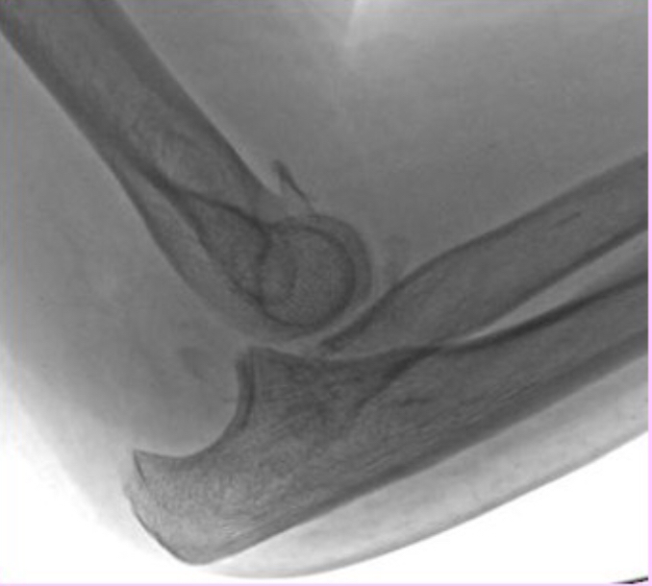
What’s Terrible Triad
Elbow dislocation
Coronoid fracture
Radial head fracture

Slide 3
Why is terrible
Extremely unstable
1- Instability . 2- loss of congruency
Small fragment so difficult to repair
Pt don’t be do well
stiffness
residual instability
Unware magnitude of injury

Slide 4
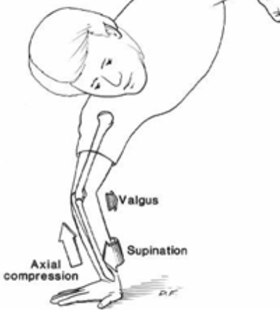
Mechanism of injury
FOOSH Axial load
Relative elbow extension. valgus
Forearm rotation supination
Posterolateral Rotatory Instability

Slide 5
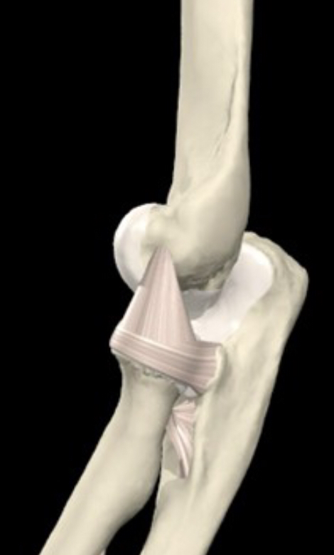
Lateral collateral ligament ( complex)
Redial collateral ligament
Lateral ulnar collateral ligament
Annular ligament

Slide 6
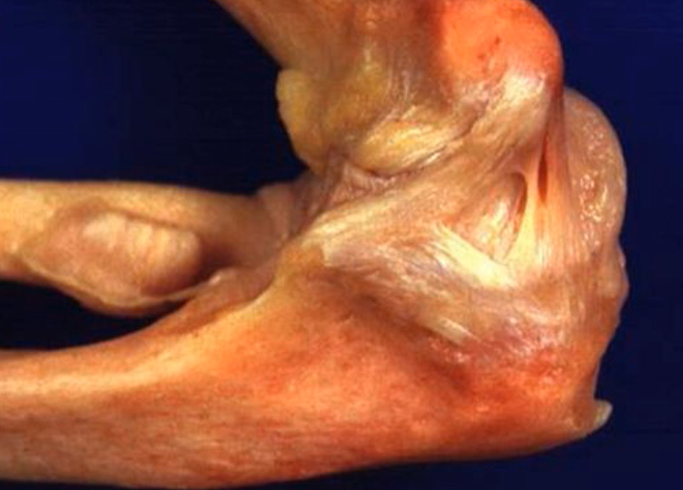
Medial collateral ligament (complex )
Anterior bundle
Posterior bundle
Transverse bundle

Slide 7
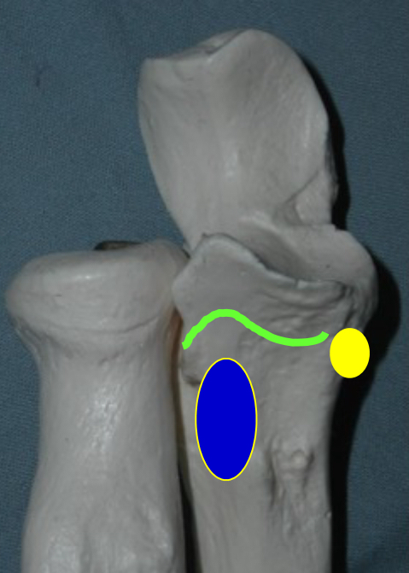
Proximal ulna –anterior cornoid
Anterior capsule.
Brachialis
Anterior bundle of medial collateral ligament

Slide 8
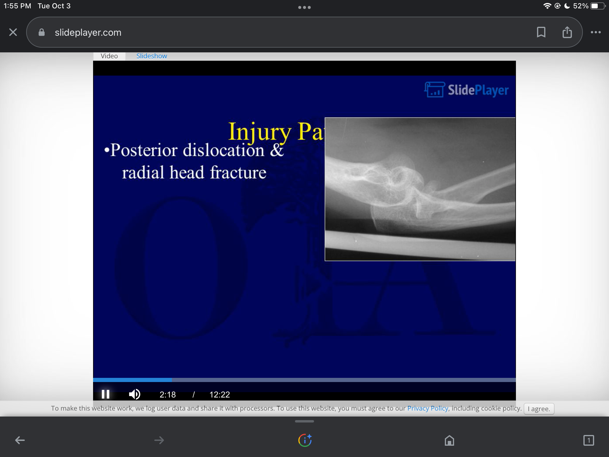
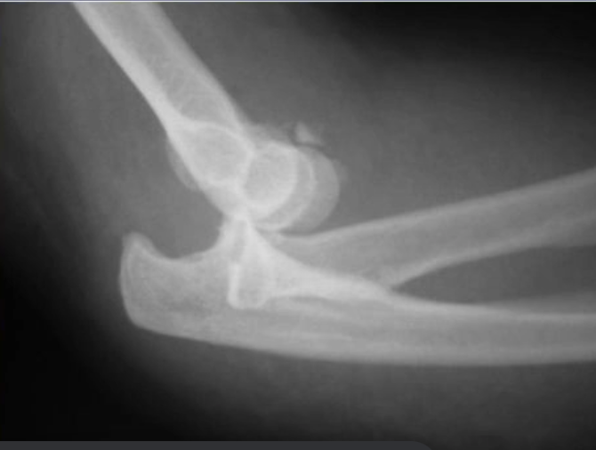
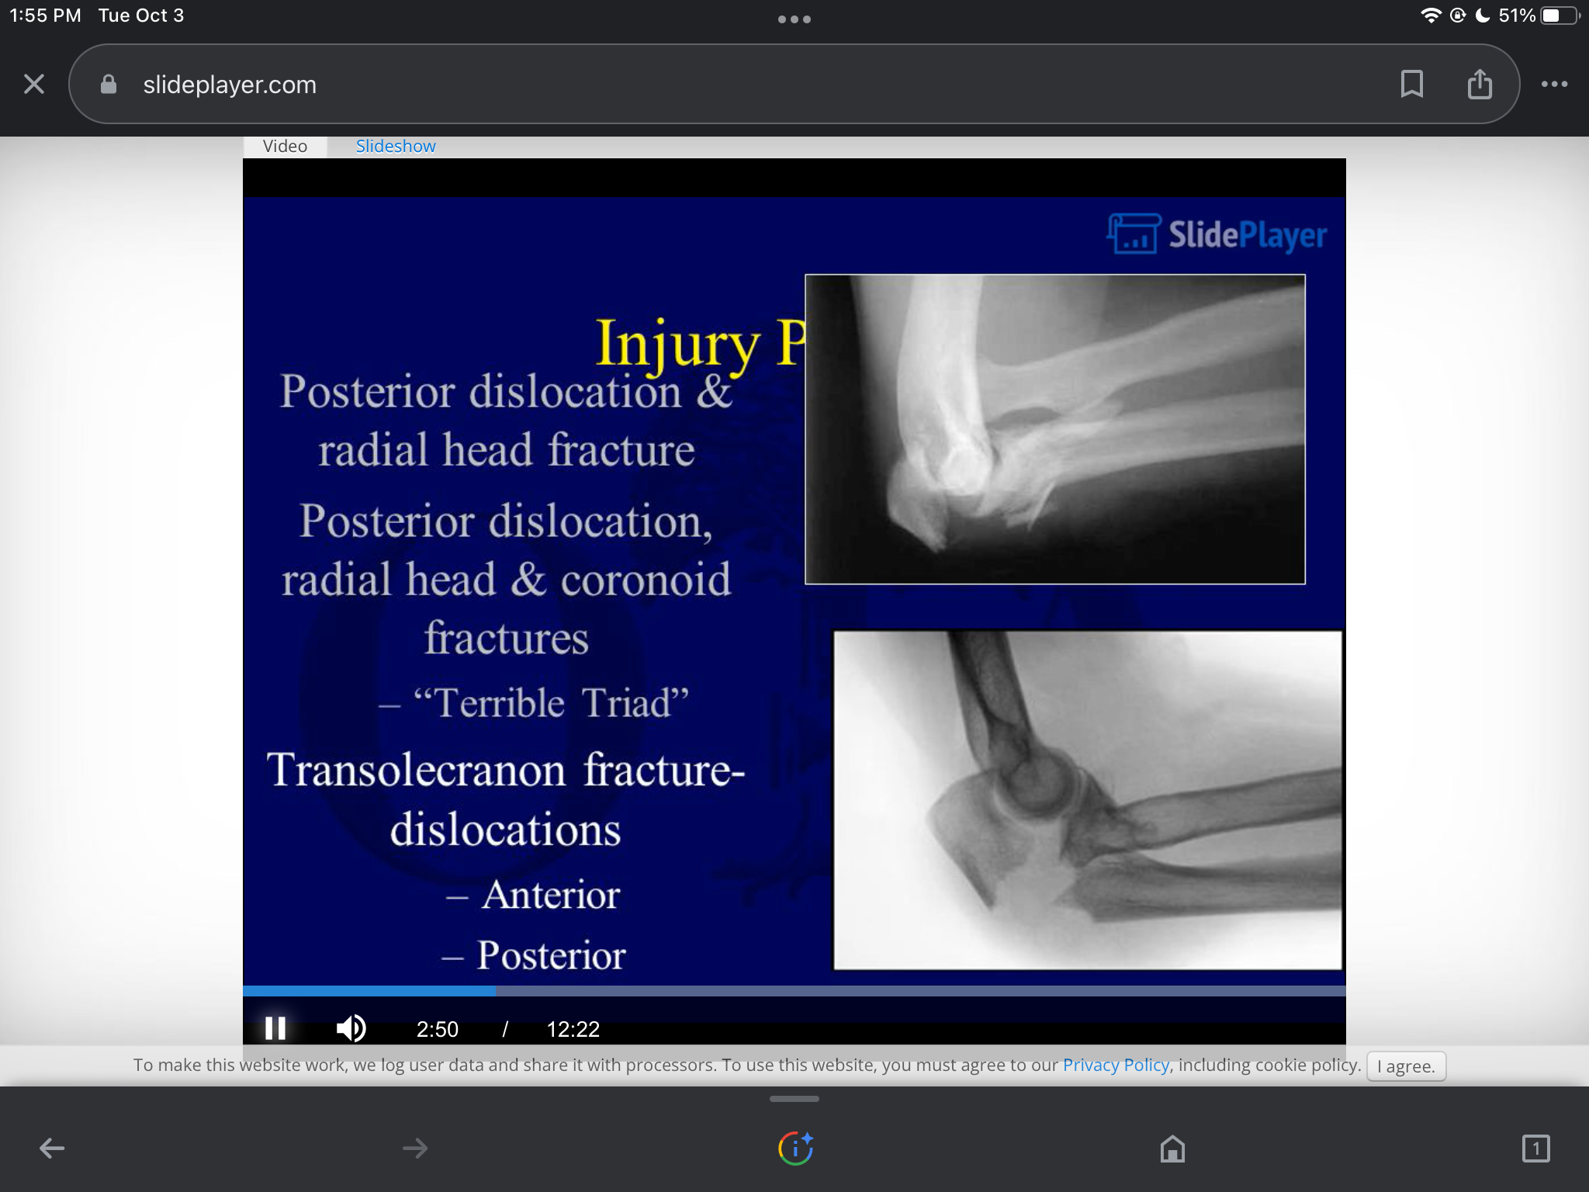
Injury pattern
Posterior dislocation & radial head fracture
Posterior dislocation, coronoid fracture &radial head fracture
Transolecranon fracture dislocation
1- anterior. 2- posterior

Slide 9
Redaial head fracture modified Mason classification
Type I: non displaced. <2mm No block for rotation
Type II : displaced internal fixation
Type III : displaced comminuted irrreperable
Type IV : fracture +dislocation

Slide 10
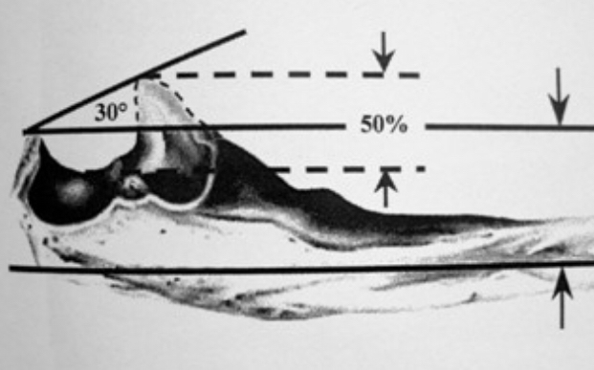
Classification coronoid fracture
Regan &Morrey
Type I : tip
Type II : <50%
Type III >50%

Slide 11
Case presentation
Male pt 60 y manual worker FOOSH supination
X ray after showing diagnosis as:
Posterior dislocation, coronoid fracture &radial head fracture

Slide 12
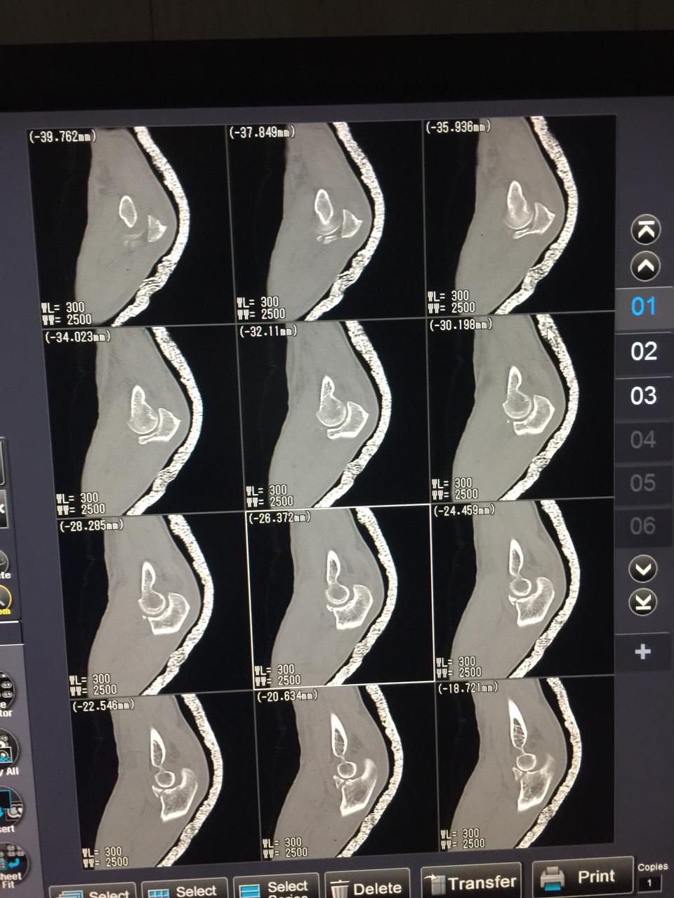
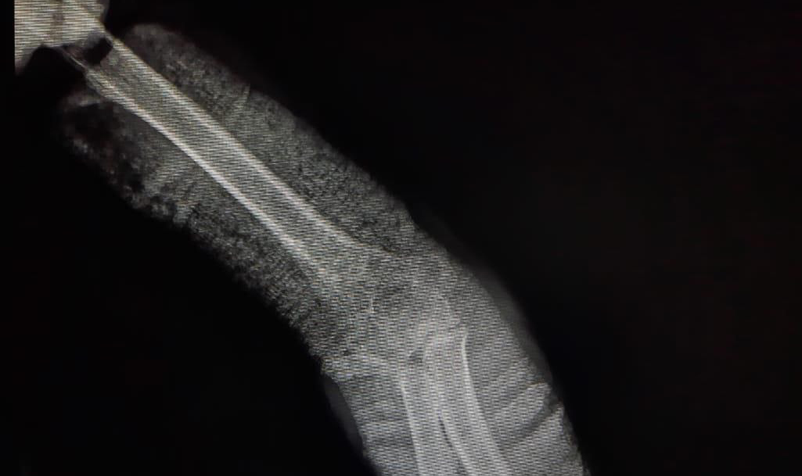
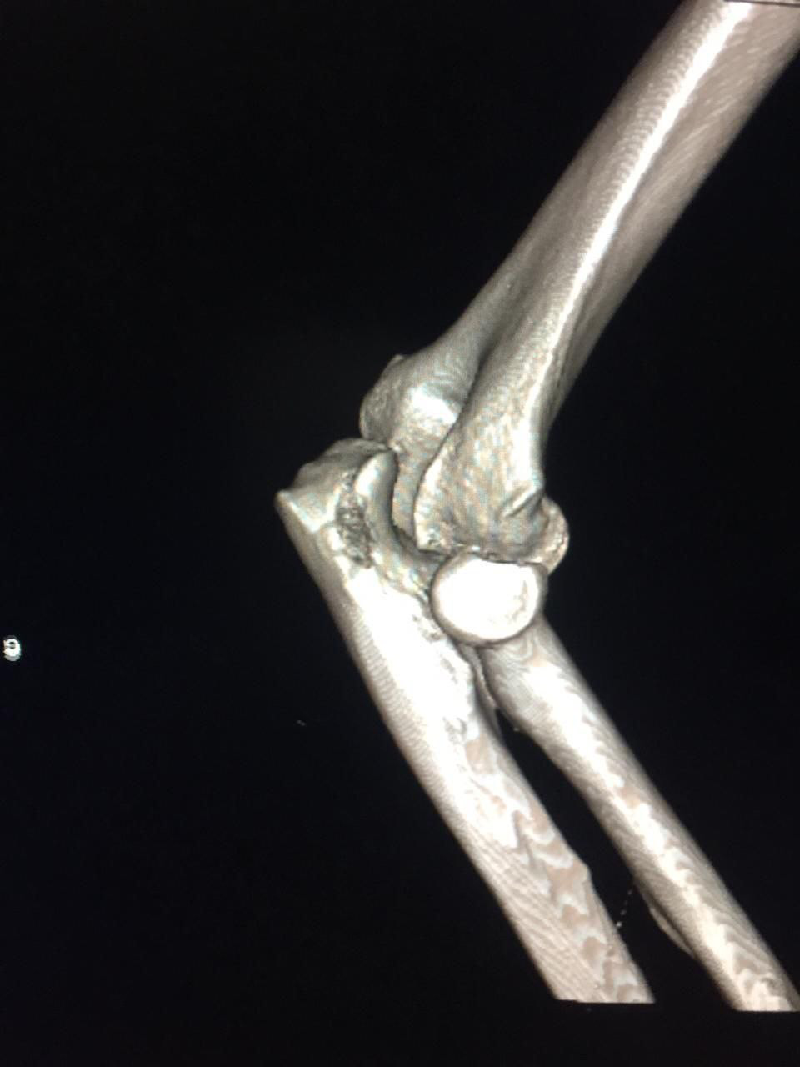
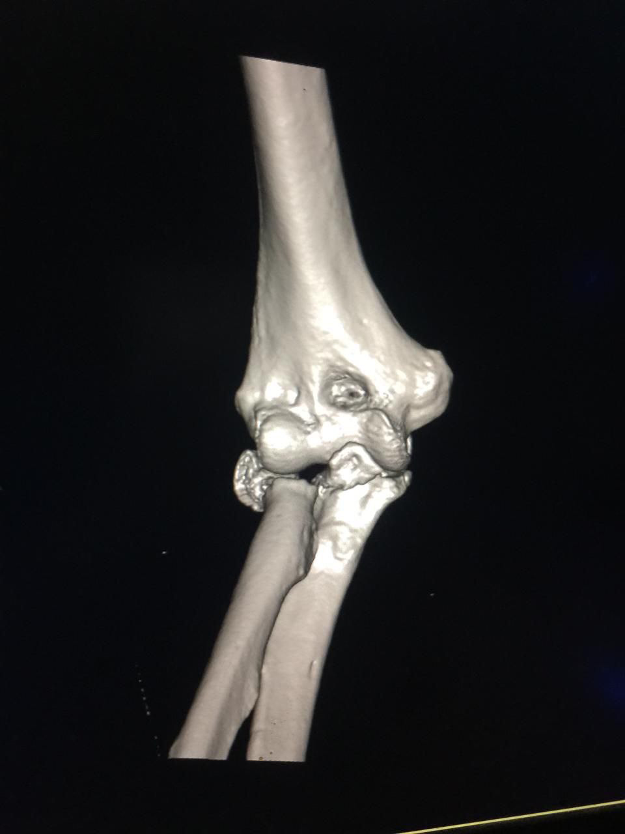
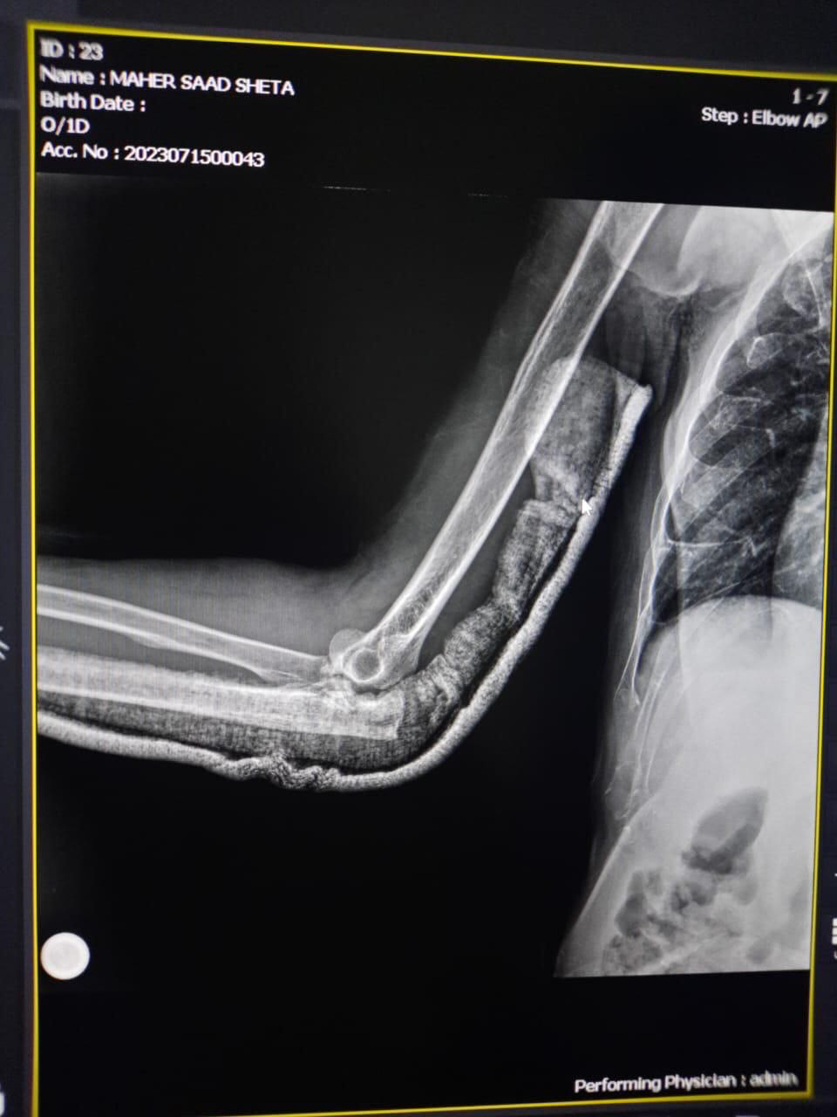
Preoperative radiology

Slide 13
Treatment Protocol
Fix or suture coronoid
Fixation /replace radial head
Repair LCL
IF UNSTABLE repair MCL
IF UNSTABLE hinged ex fix
Mckee ,pugh,schemitsch et,al JBJS (A)04. 36 patient

Slide 14
Operation Steps
One incision kaplan approach
Trans fraction approach of radius reach coronoid and fixed by anchor
Fixation of head Radius by plate
Repair of lateral collateral ligament in lateral numeral epicondyle

Slide 15
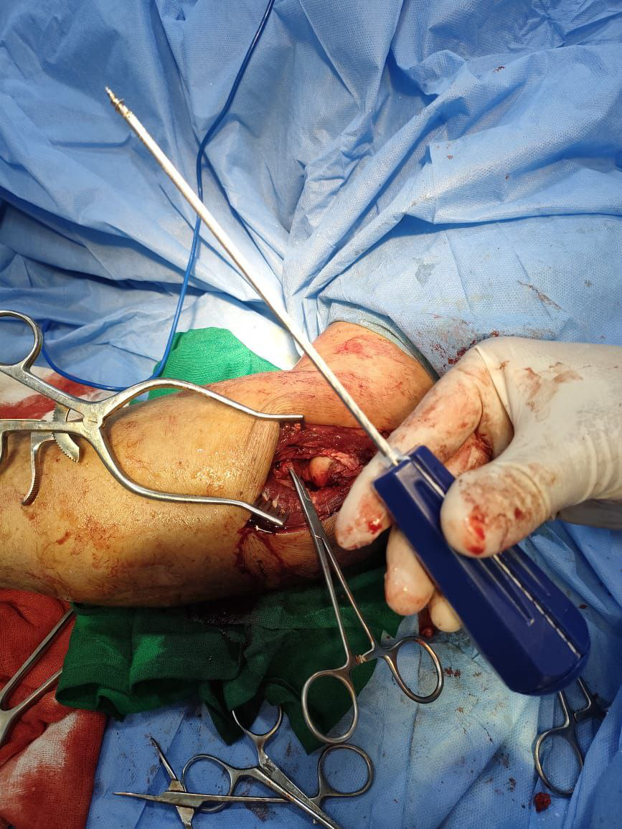
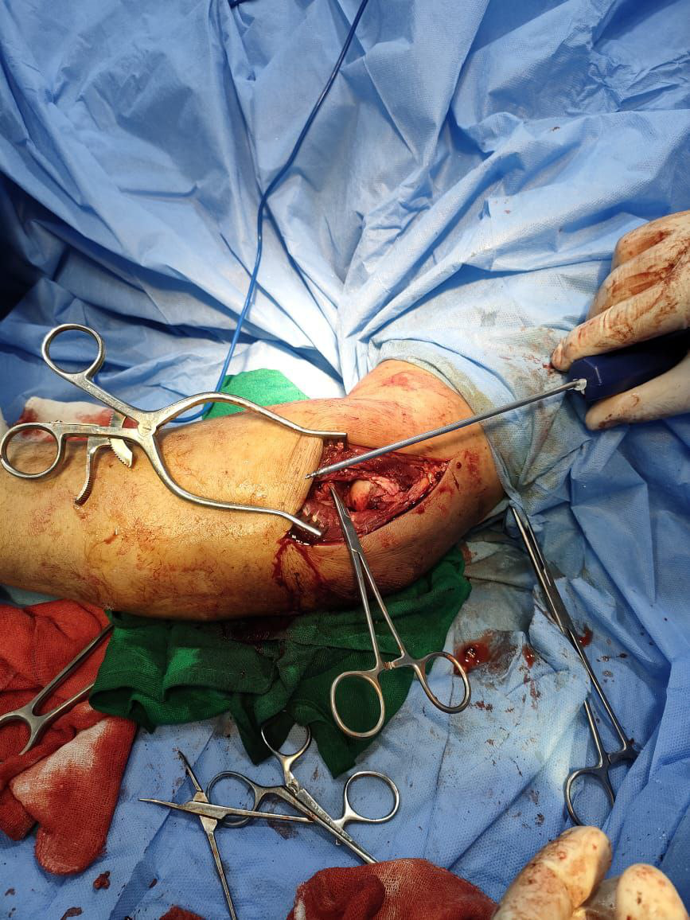
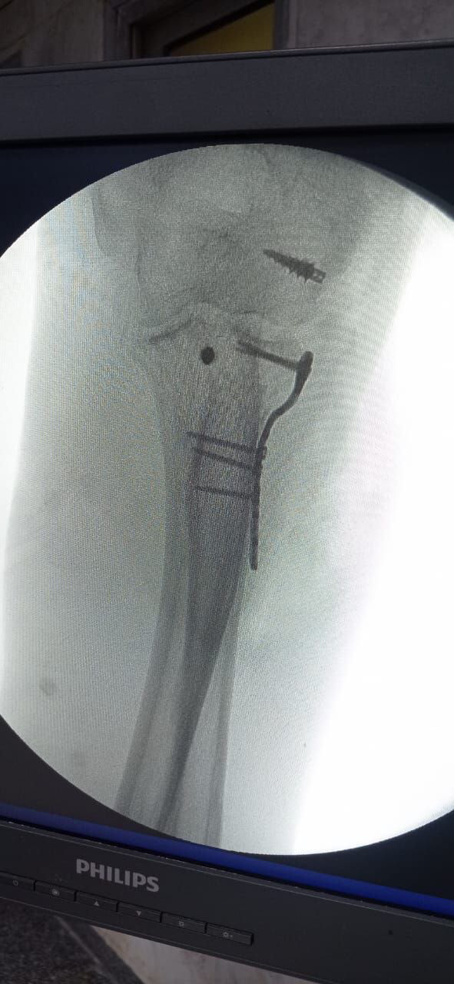
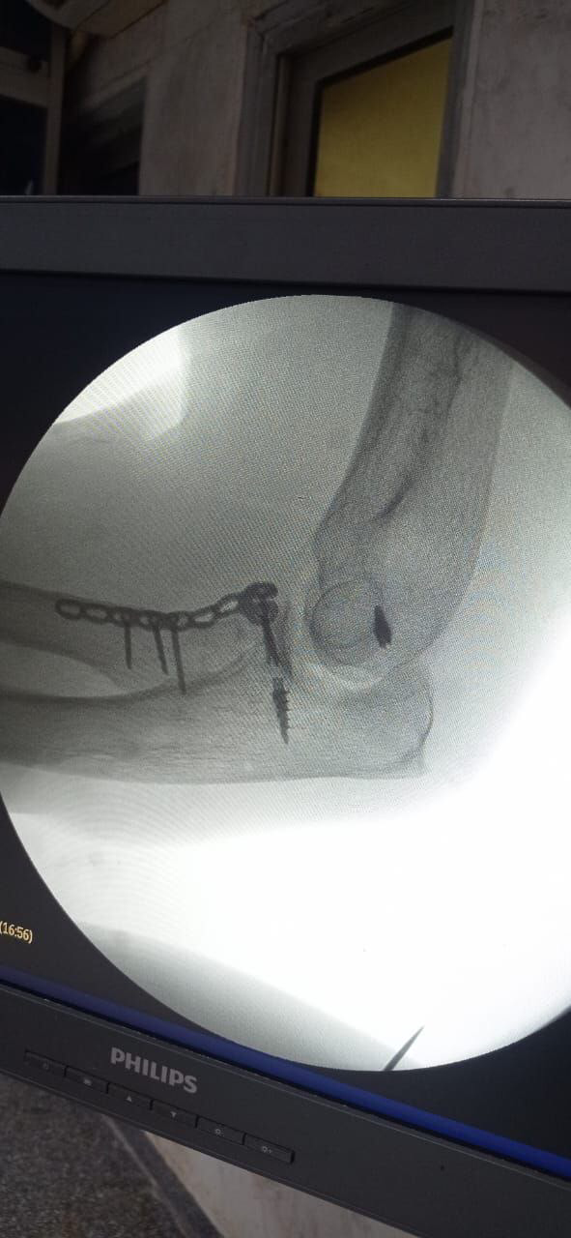
Intra operative x-ray

Slide 16
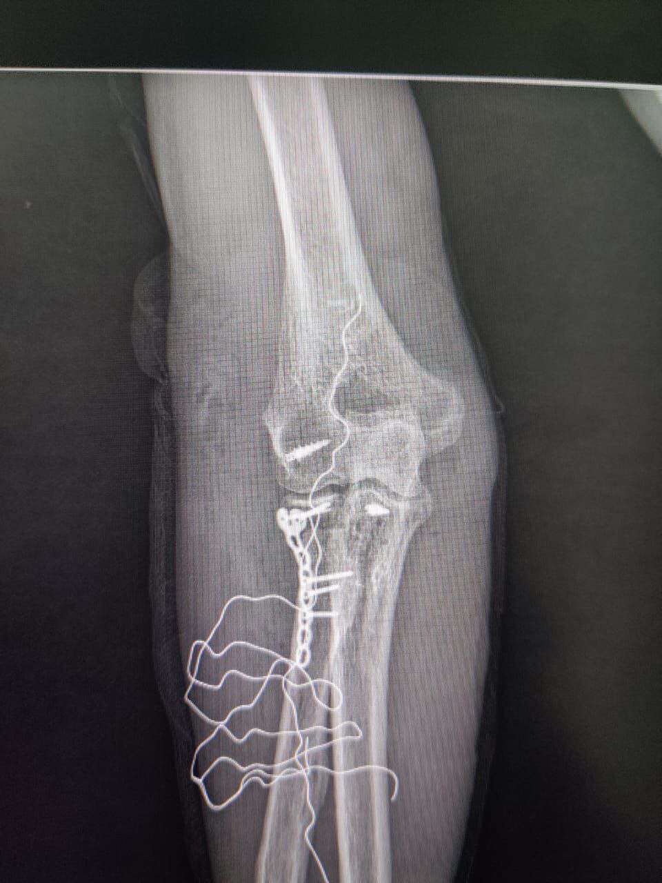
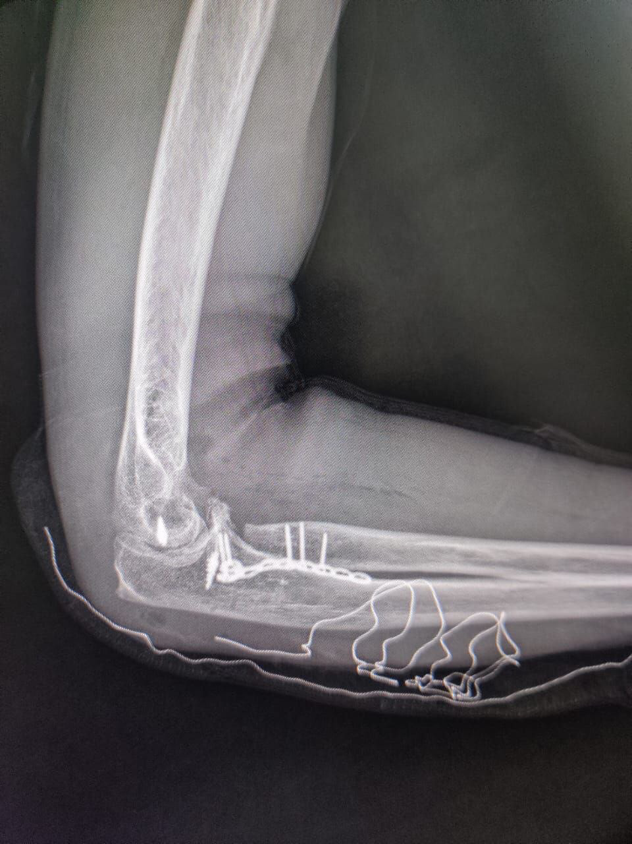
After one day

Slide 17
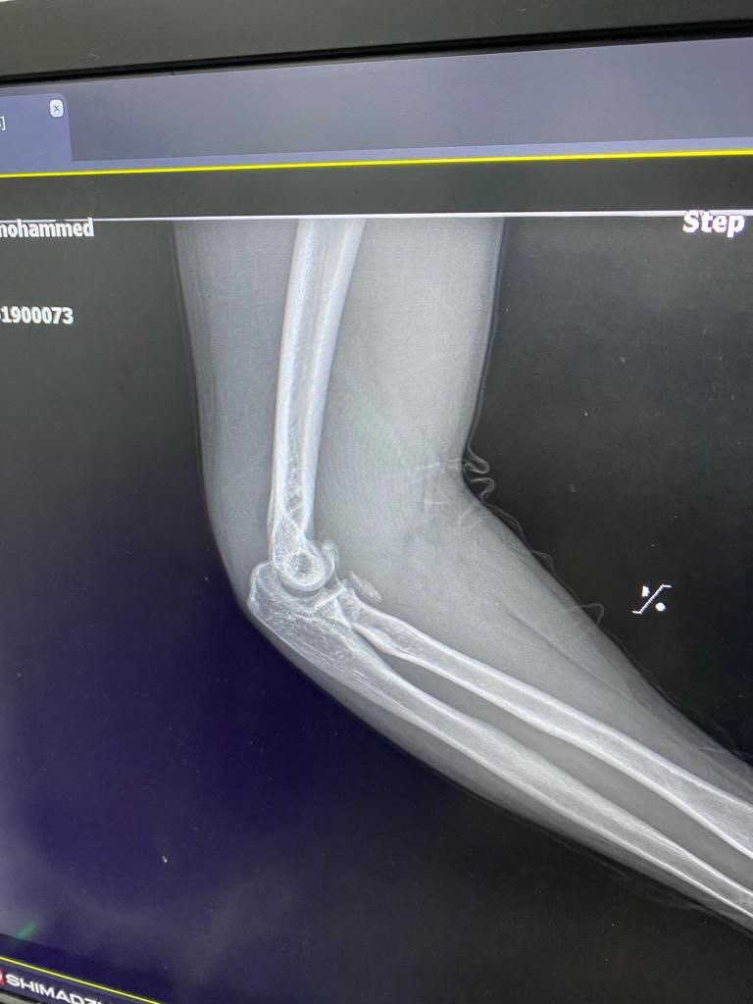
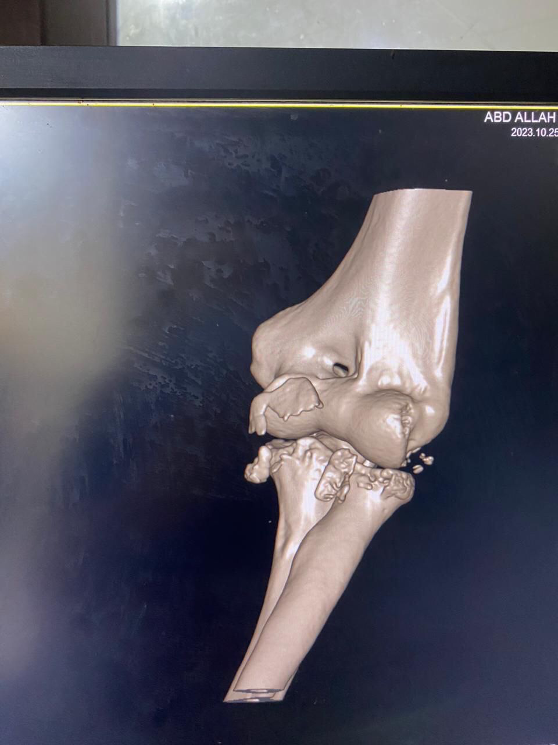
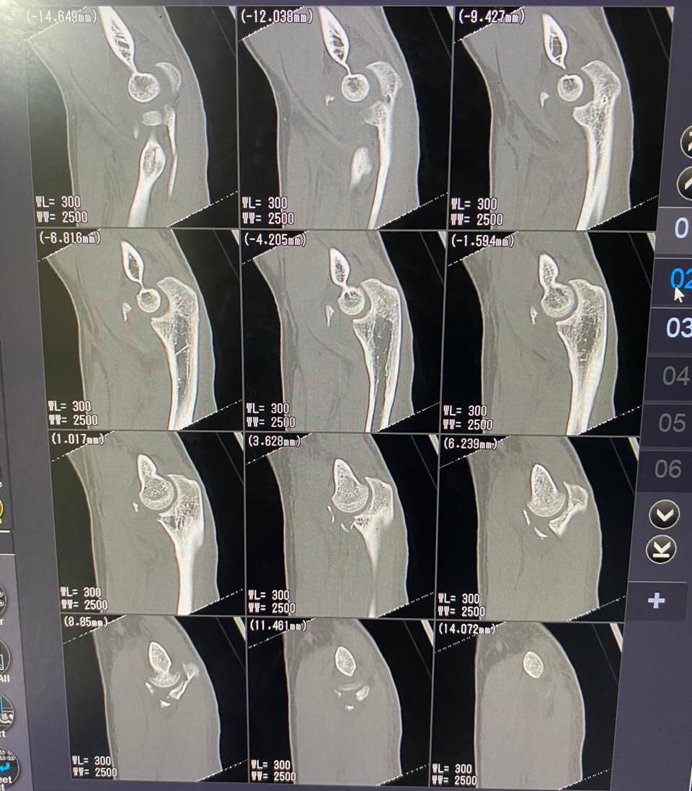
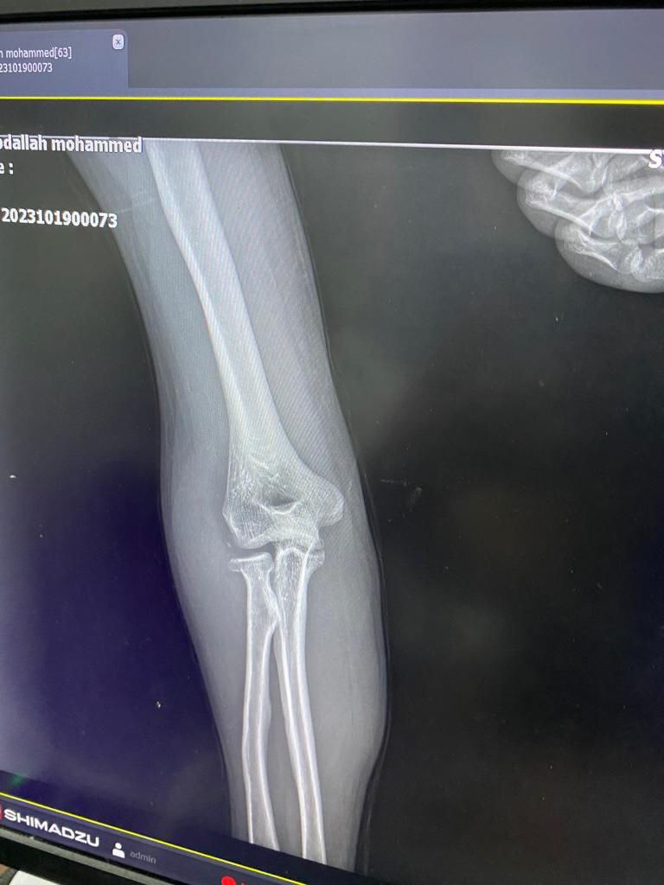
Case 2

Slide 18
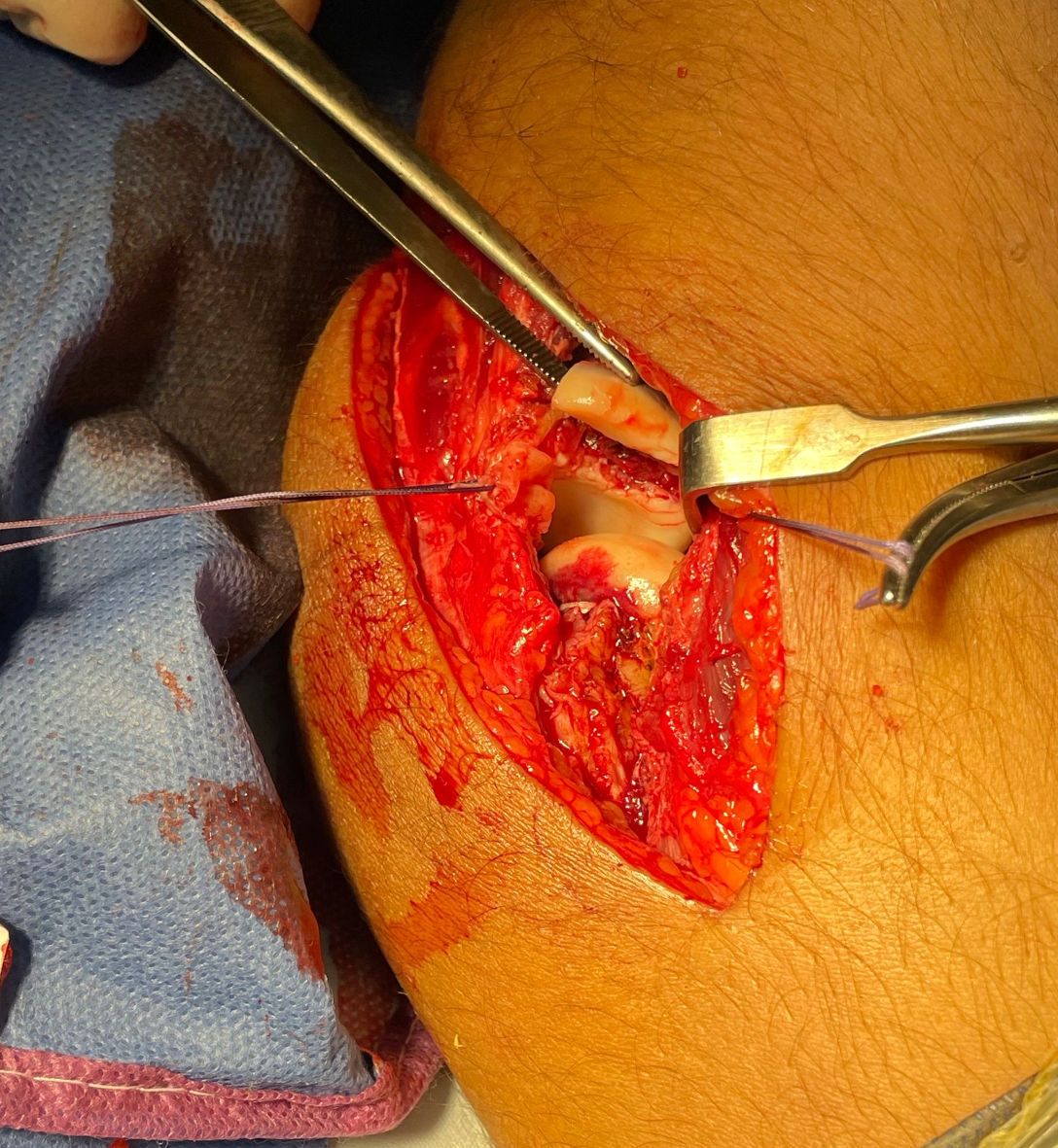
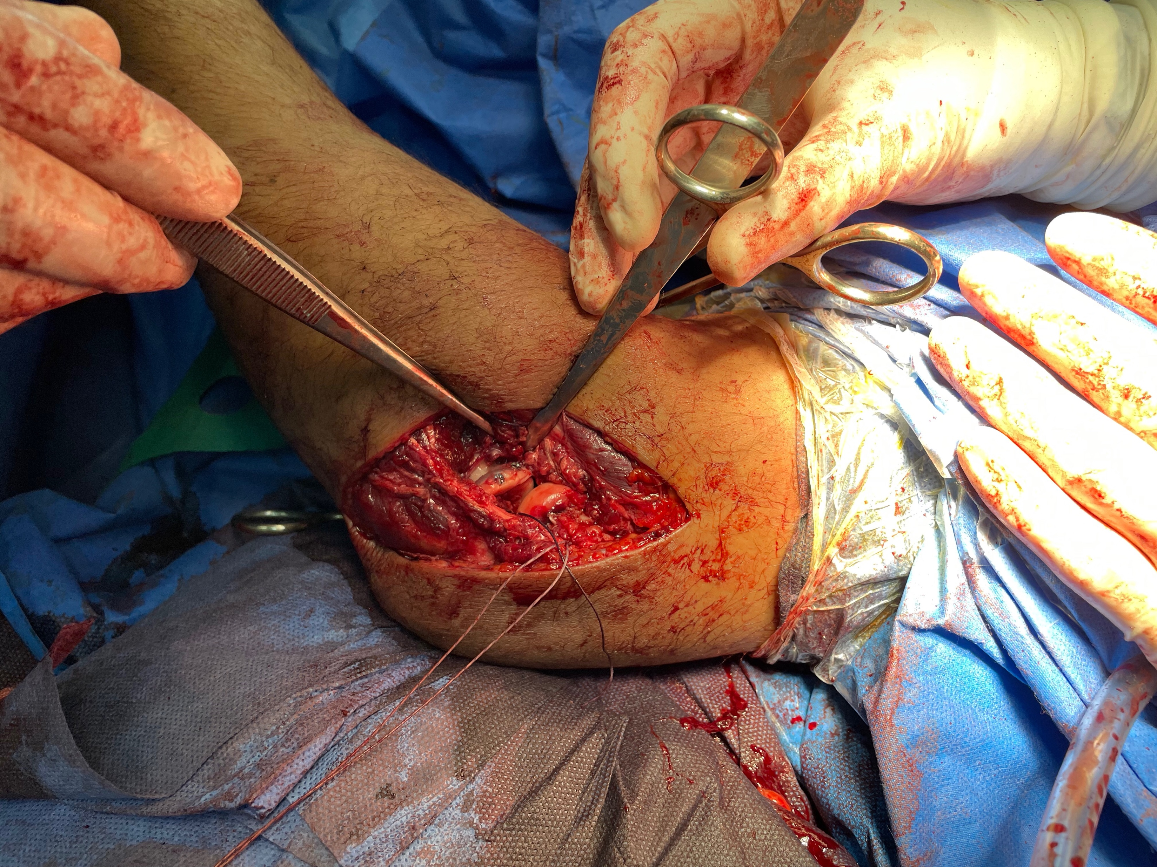

Slide 19
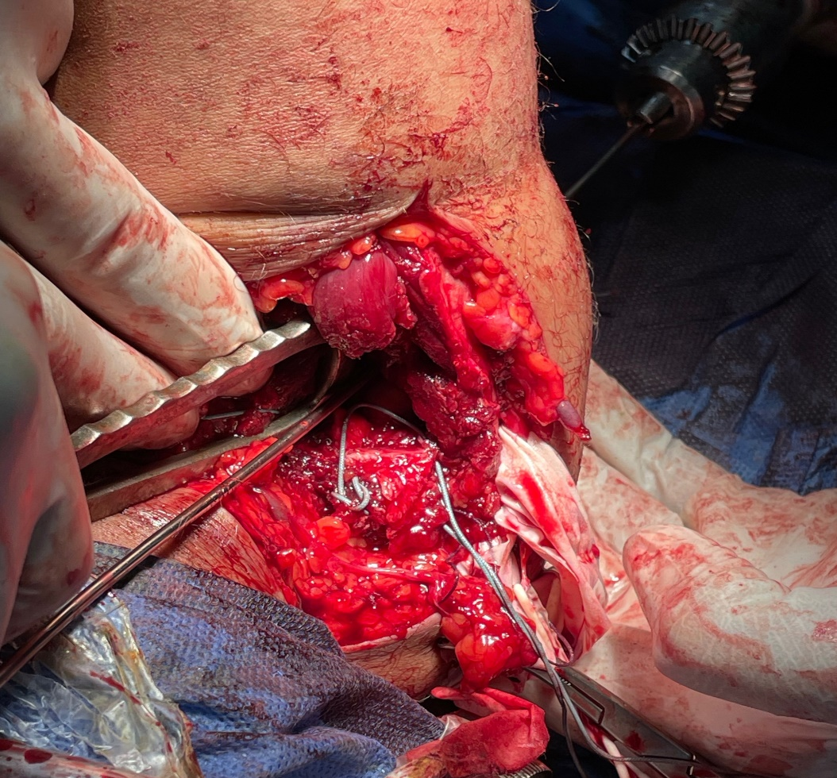
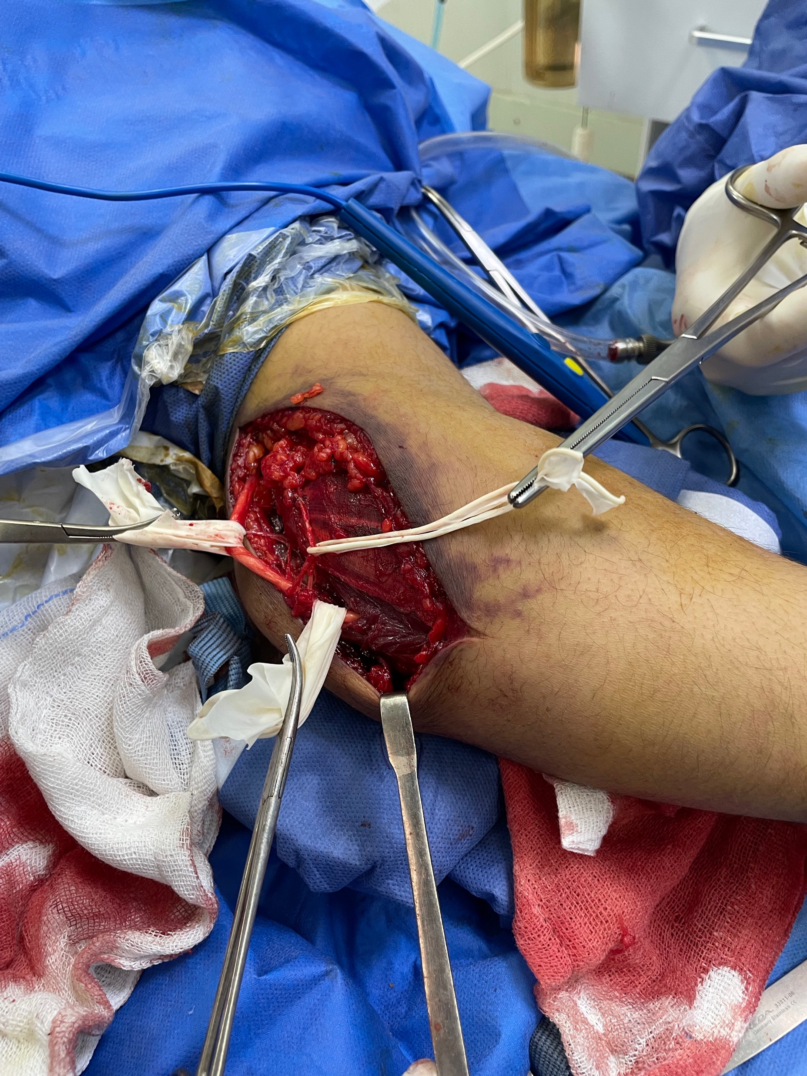
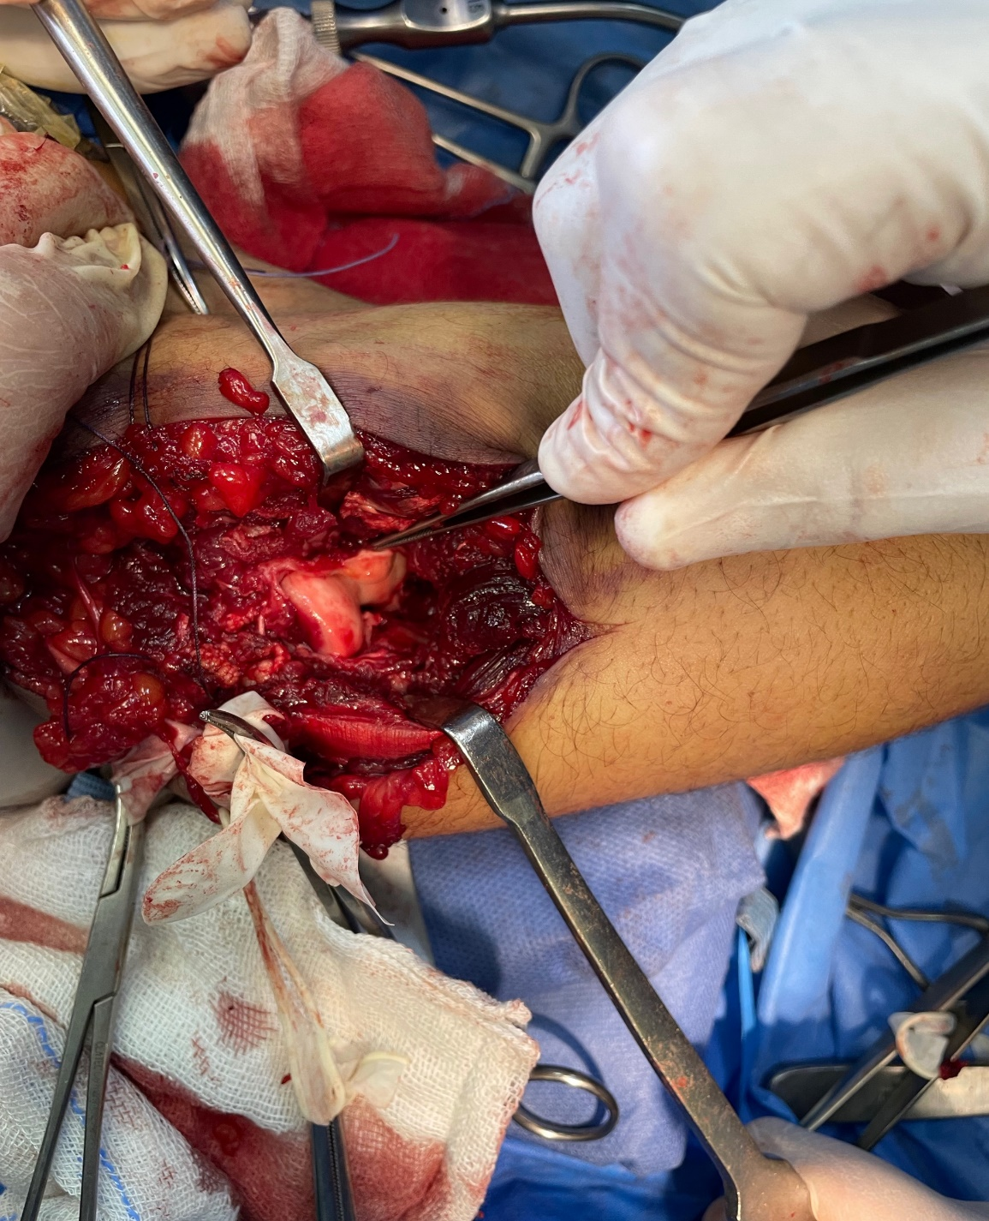
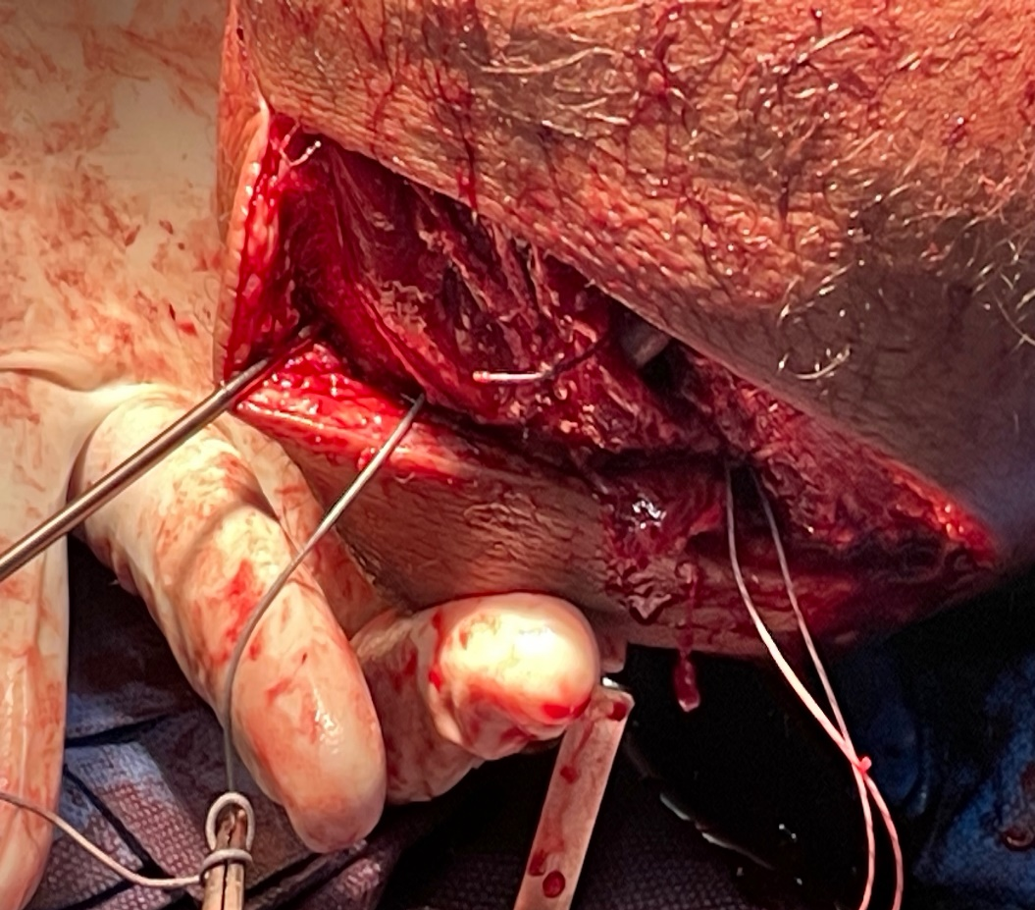

Slide 20
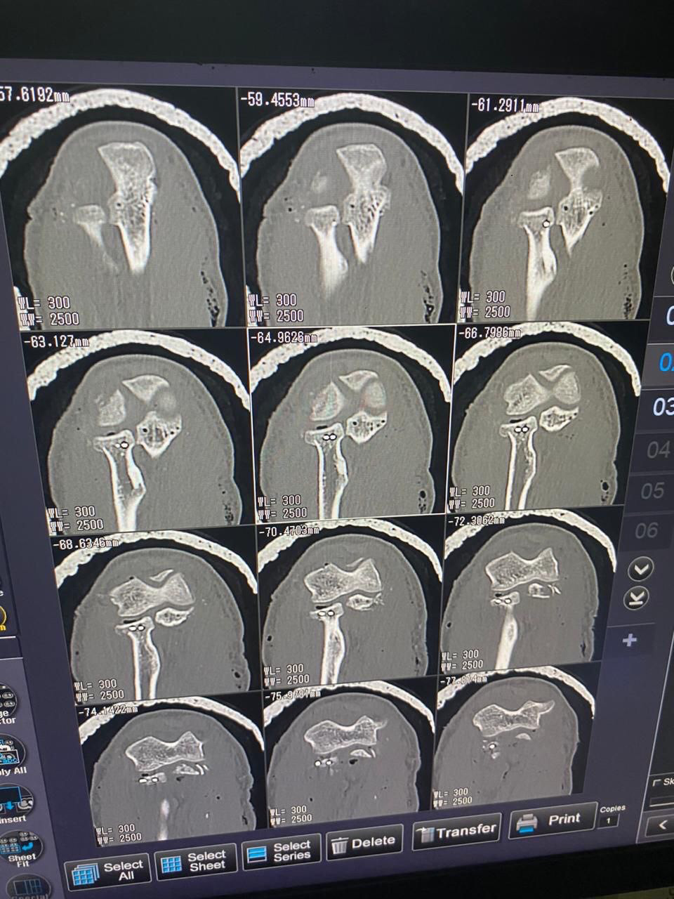
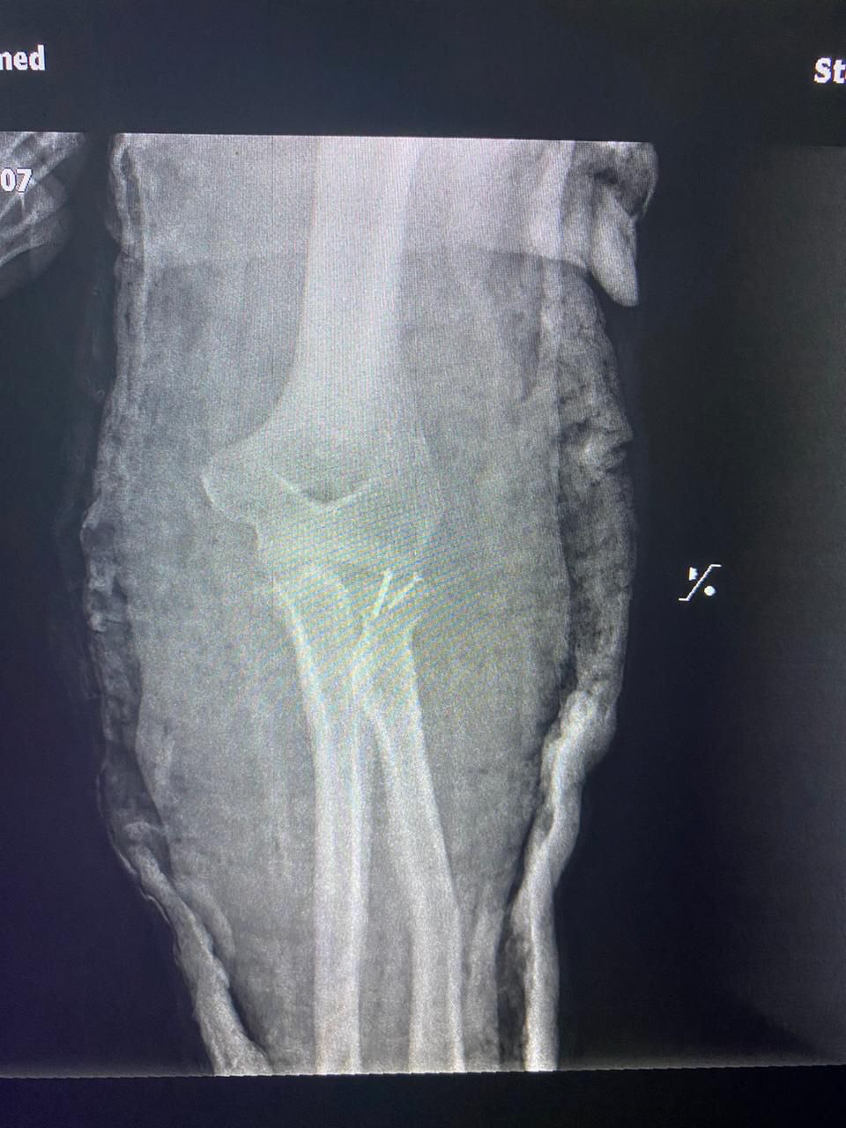
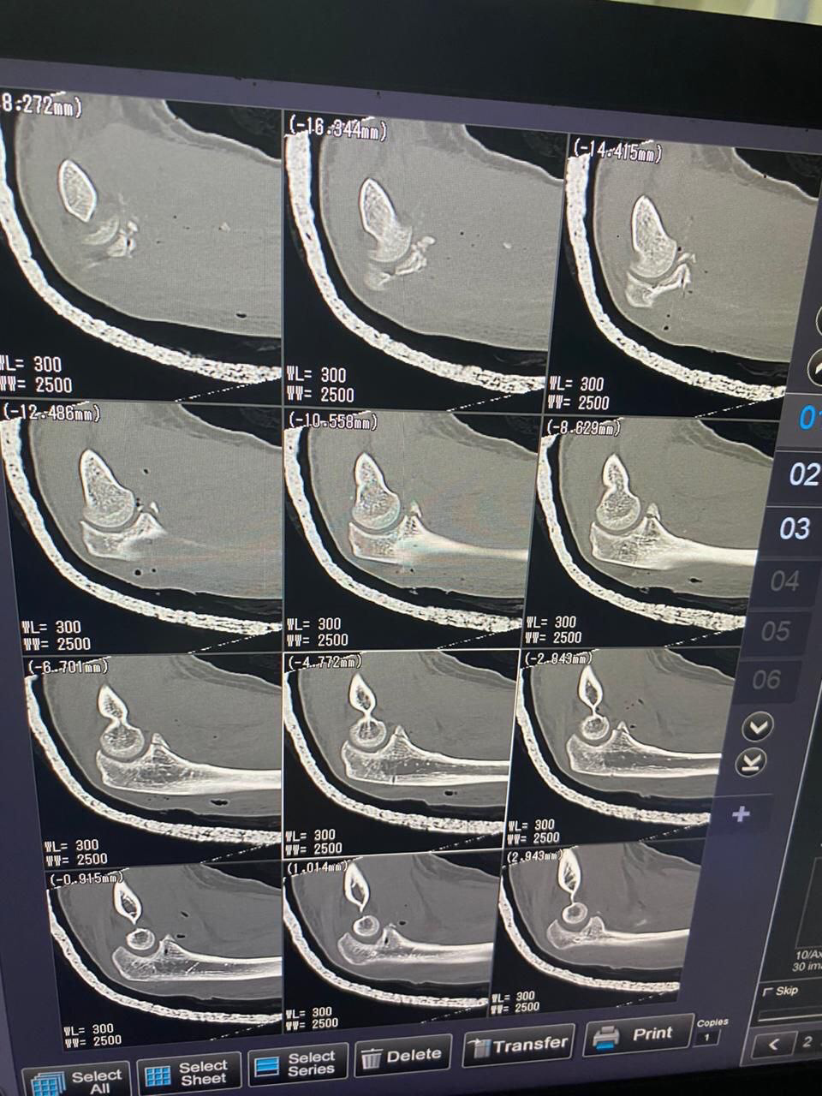
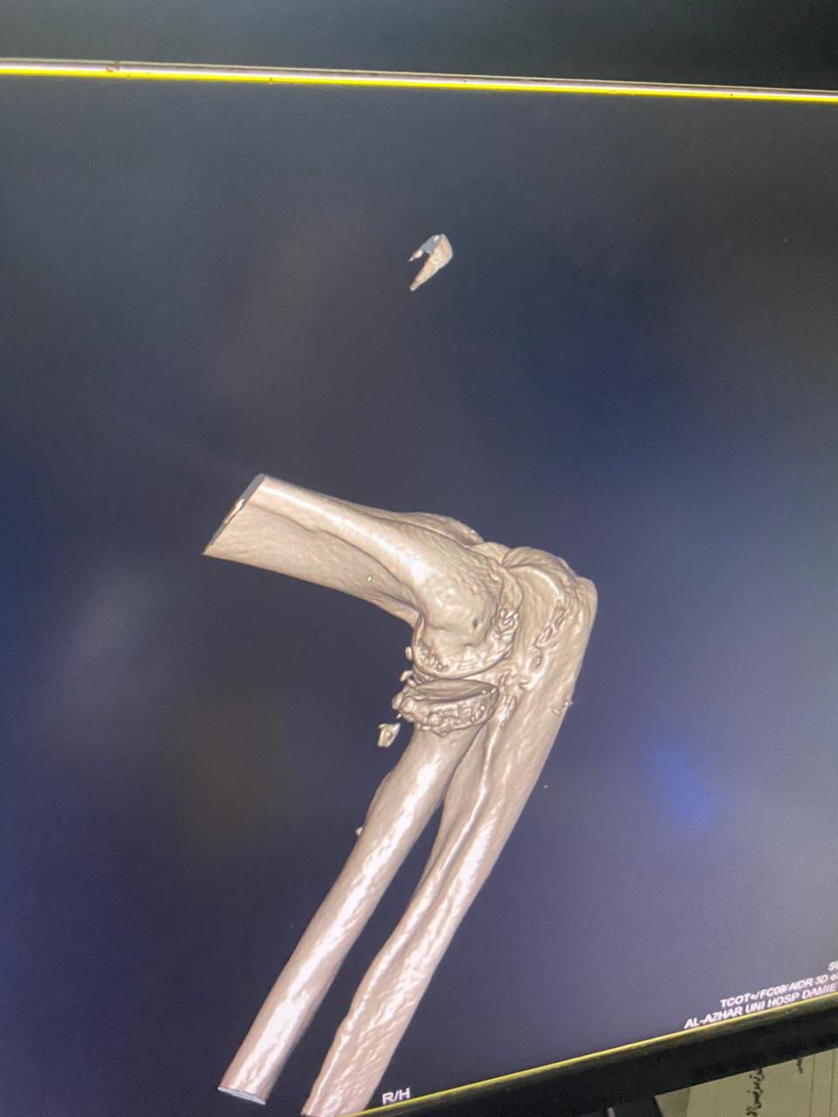
Post operative radiology

Slide 21
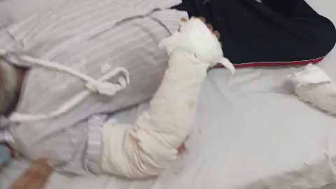
2nd day of surgery

Slide 22
Rehabilitation
Stiffness vs. Instability
So …
Posterior splint for 2weeks
Start active flexion after 2weeks
Start active and passive rotation at 90 flexion
Start extension at 3 weeks active only

Slide 23
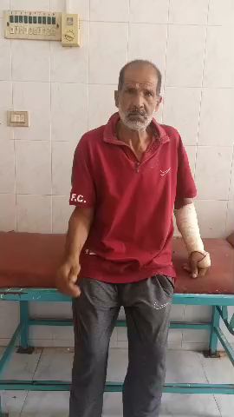
After 6 weeks

Slide 24
summary
Not to be terrible IF
Isolated injury & cooperative patient
Stable repair & motion
Coronoid fixation
Redial head arthroplasty vs. ORIF
LCL repair

Slide 25
Summary
Terrible IF
Poor stability after repair complete
Multi-trauma
ICU stay
Head injury
Non weight bearing on lower extremity
Uncooperative patient

Slide 26
Tkanks

