Slide 1


Evaluation of Arthroscopic Management of Tennis Elbow; Emphasis on Resection of Radio-Capitellar Capsular Complex (RCCC)
Prof Mohamed M Kotb
Assiut University

Slide 2
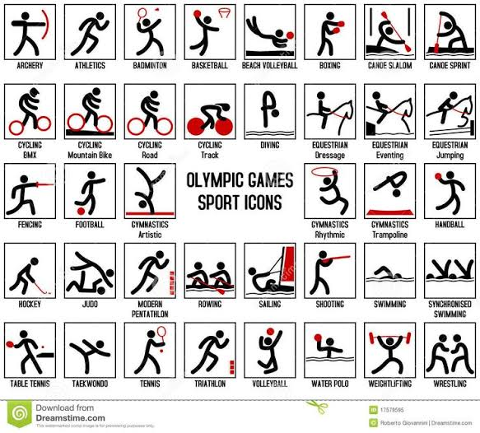

Slide 3
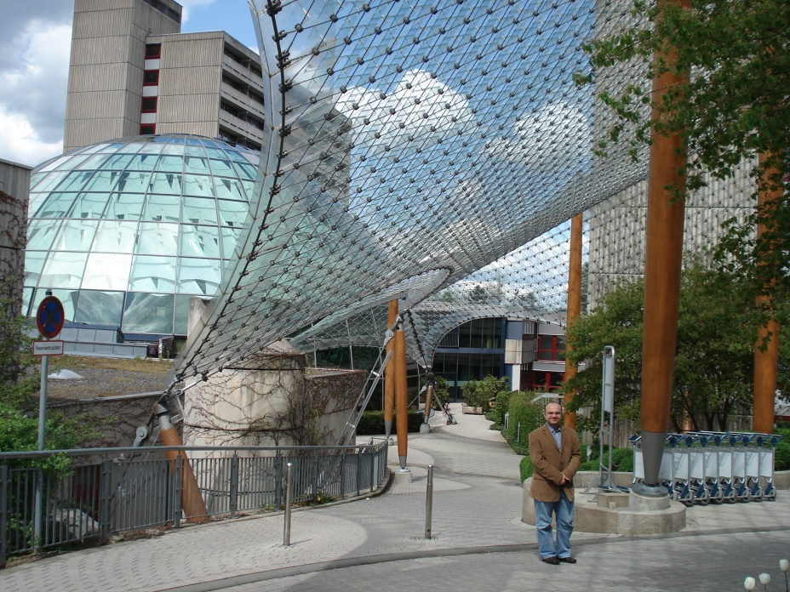

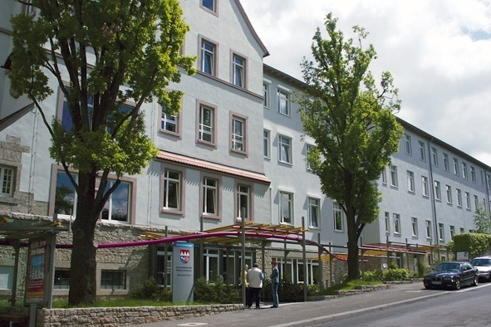
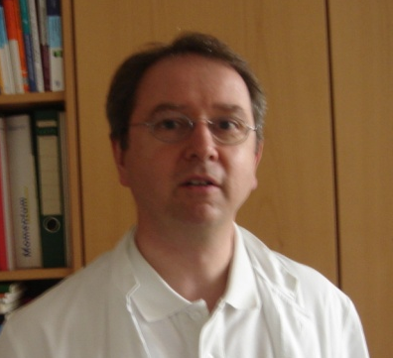
Appretiation
Dr Prommersberger
Rhoene Klinikum, Bad Neustadt, Germany
Dr Barthel
Koenig Ludwig Haus, Wuerzburg, Germany

Slide 4
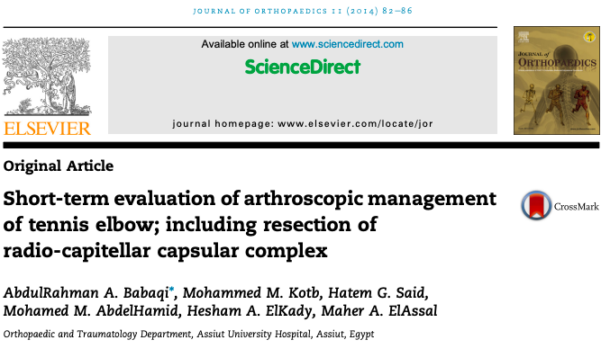

Slide 5
Introduction and Background
In the literature, there are more than 15 different surgical techniques
simple release,
reconstruction of the common extensor tendons,
a separation of the deep fascia that covers the common extensor tendon,
distal tenotomy of the ECRB tendon at the musculo-tendinous border near to the wrist,
extra-articular approach for arthroscopic lateral elbow release,
Recent studies have reported good results of arthroscopic release used in the treatment of lateral epicondylitis.
4. Verhaar J, Walenkamp G, Kester A, van Mameren H, van der Linden T. Lateral extensor release for tennis elbow. A prospective long-term follow-up study. J Bone Joint Surg Am. 1993;75:1034e1043.
5. Gardner RC. Tennis elbow: diagnosis, pathology and treatment. Nine severe cases treated by a new reconstructive operation. Clin Orthop Relat Res. 1970;72:248e253.
6. Stovell PB, Beinfield MS. Treatment of resistant lateral epicondylitis of the elbow by lengthening of the extensor carpi radialis brevis tendon. Surg Gynecol Obstet. 1979;149:526e528.
7. Brooks-Hill AL, Regan WD. Extra-articular arthroscopic lateral elbow release. Arthroscopy. 2008;24:483e485. 8. Savoie 3rd FH, VanSice W, O’Brien MJ. Arthroscopic tennis elbow release. J Shoulder Elbow Surg. 2010;19:31e36.

Slide 6
Introduction and Background
Mullett et al,
cadaveric study,
Degenerative capsular fold impinging on the radial head was seen in 15 elbows.
A classification system,
Type 1, the radial head is completely exposed during ROM.
Type 2, there is partial coverage of the radial head by the capsuloligamentous complex without interposition into the joint in any position.
Type 3 as Type 2 but with capsuloligamentous complex interposed in the radio-capitellar joint during flexion and extension,
Type 4, the radial head is completely obscured by a fully thickened band throughout the range of motion.
The lesion was equally prevalent in men and women.
9. Mullett H, Sprague M, Brown G, Hausman M. Arthroscopic treatment of lateral epicondylitis: clinical and cadaveric studies. Clin Orthop Relat Res. 2005;439:123e128.

Slide 7
Aim of the work
The purpose of this study was to evaluate the short-term outcomes of arthroscopic release of lateral epicondylitis including resection of the radio-capitellar capsular complex, using different validated scores.

Slide 8
33 consecutive arthroscopic tennis elbow releases performed in 31 patients
20 male (22 elbows, 66.7%) and 11 female (11 elbows, 33.3%).
Average patient age 33.70 years (range: 24-42 years).
Twelve patients (38.7%) heavy manual labor,
15 patients (48.3%) described their work as repetitive, and
4 patients (12.9%) were not working at the time of surgery.
Eighteen (55%) of the 33 elbows involved the dominant arm.
Patients and Methods

Slide 9
All of these elbows were treated non-operatively before undergoing arthroscopic release.
Rest,
Activity modification,
Physical therapy,
NSAIDS and corticosteroid injection.
All the patients had at least 2 injections before surgery.
Patients and Methods

Slide 10
Patients and Methods
Mayo Elbow Performance Index (MEPI),
Patient-Rated Tennis Elbow Evaluation (PRTEE),
Disability of the Arm, Shoulder, and Hand (DASH),
Visual analog scale (VAS) for pain and satisfaction criteria.

Slide 11
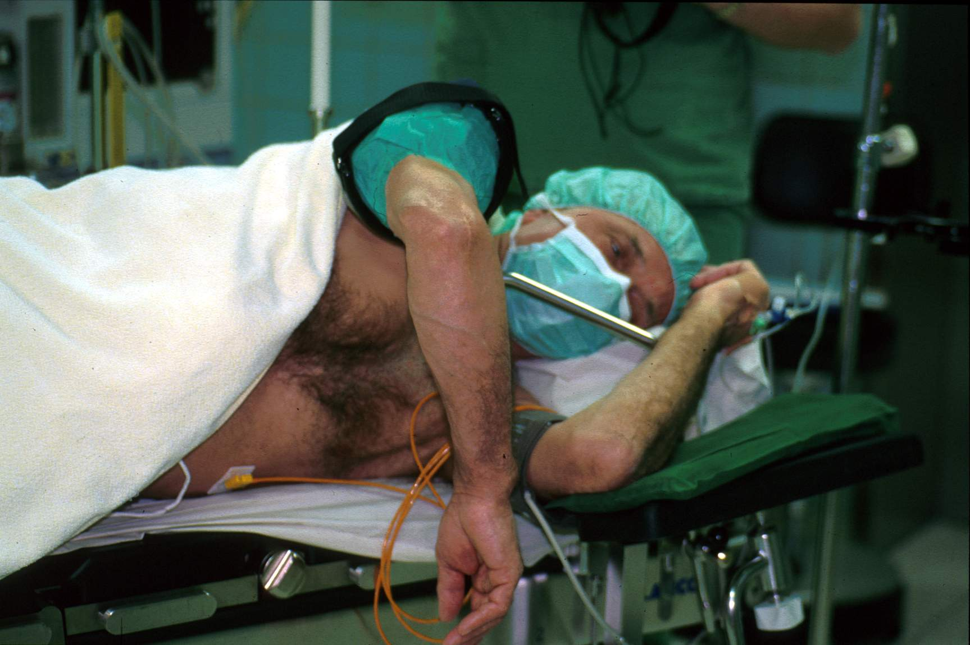
Technique is critical
Lateral or Prone position

Slide 12
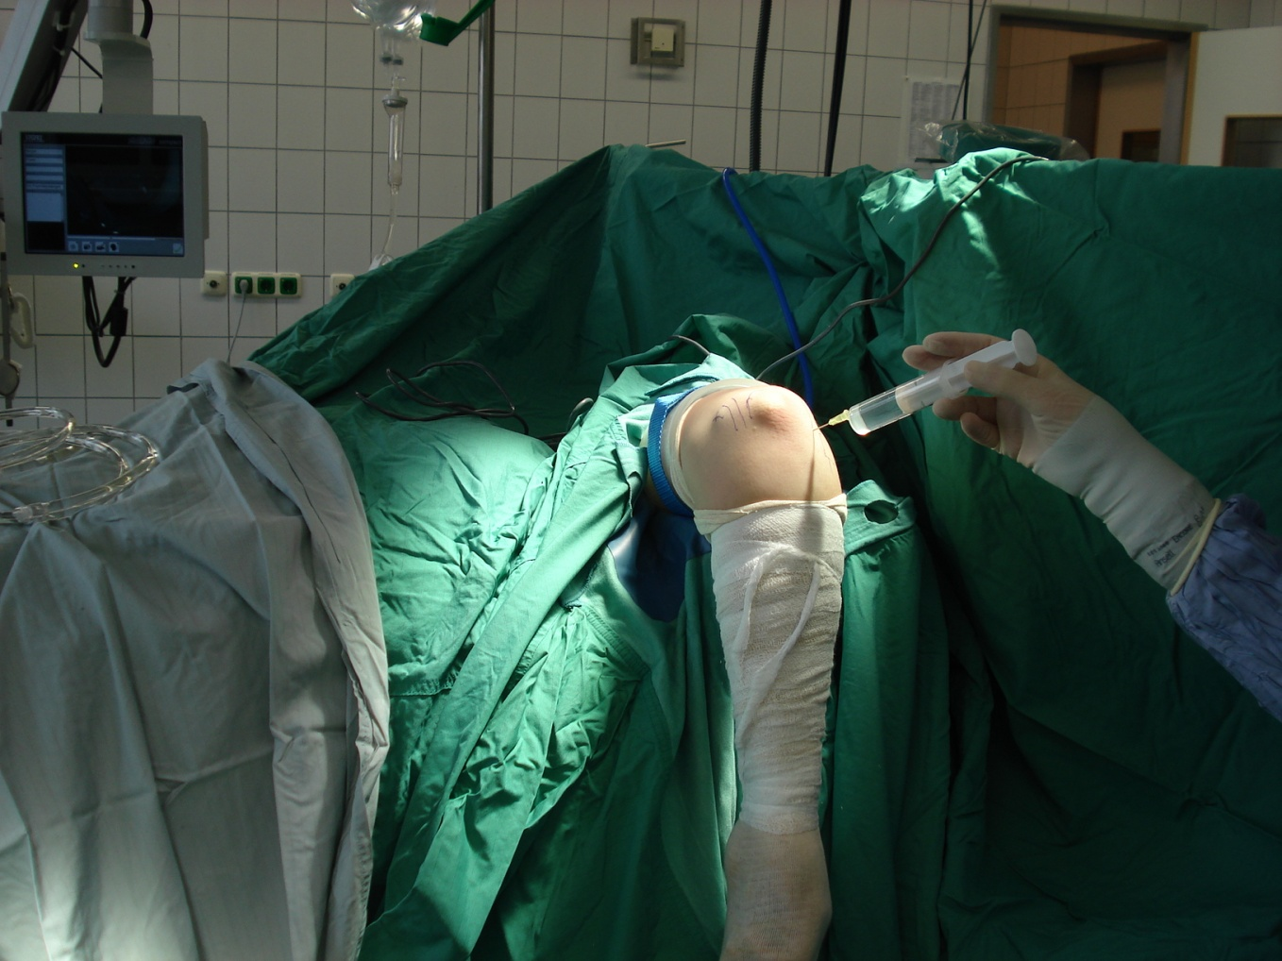
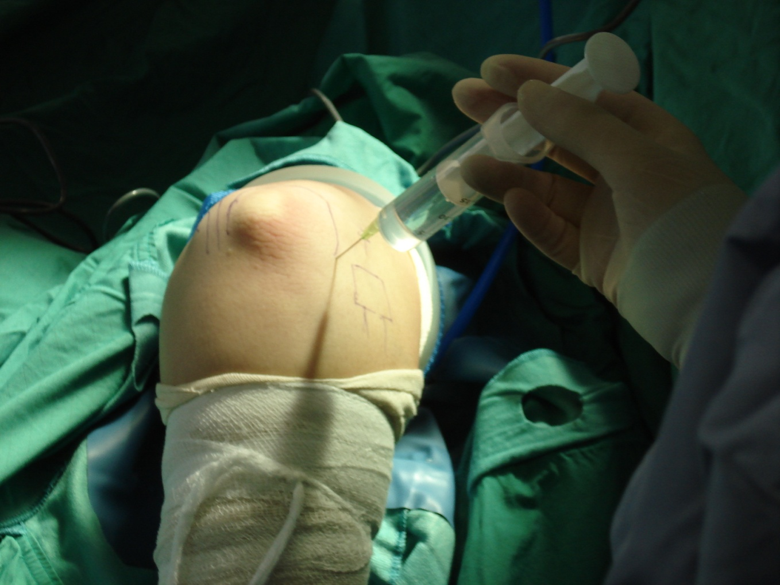
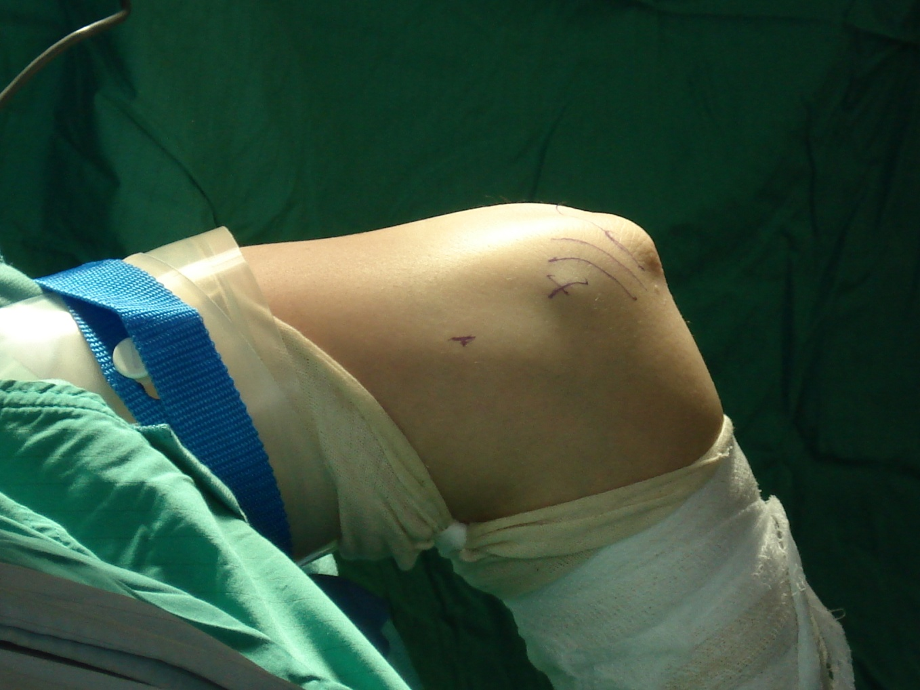
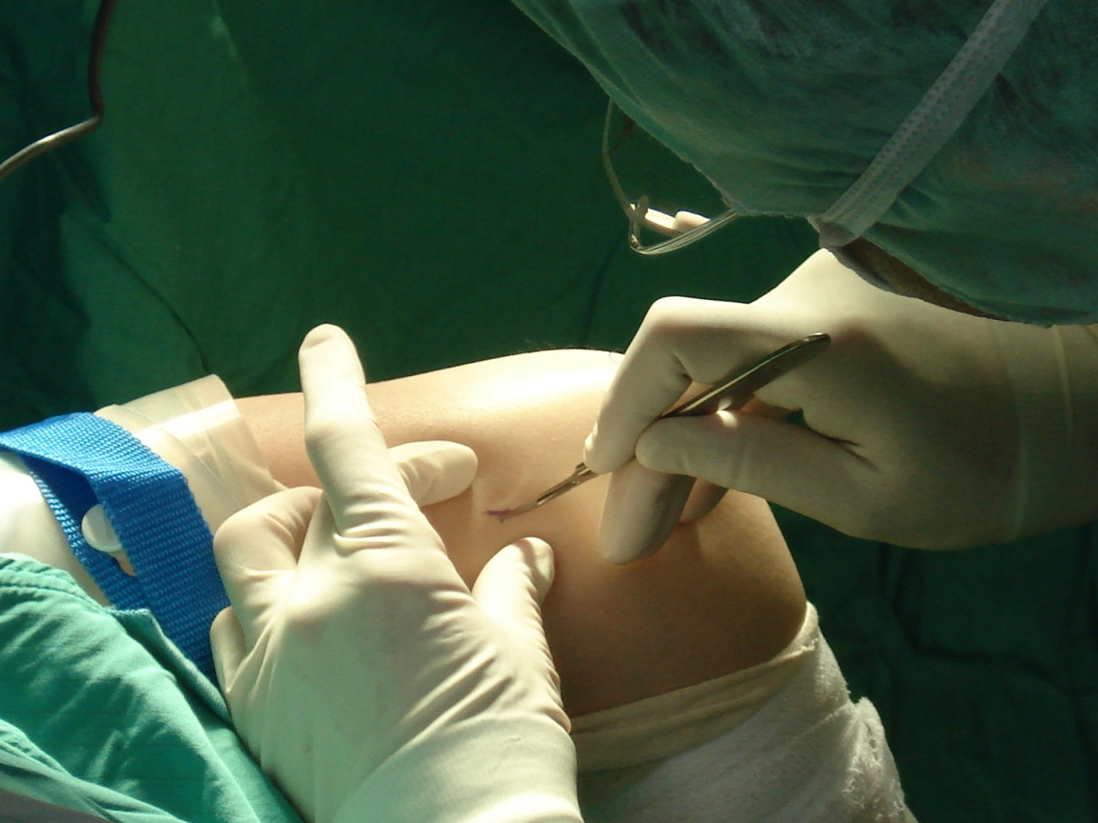
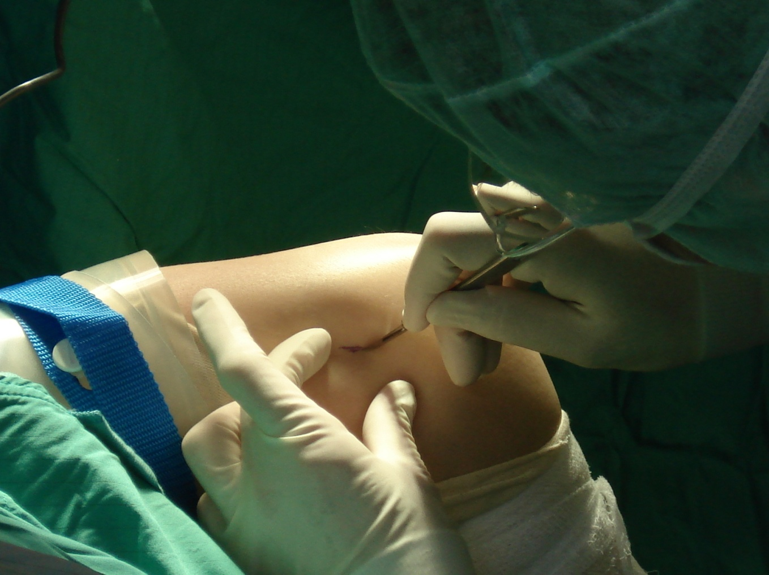
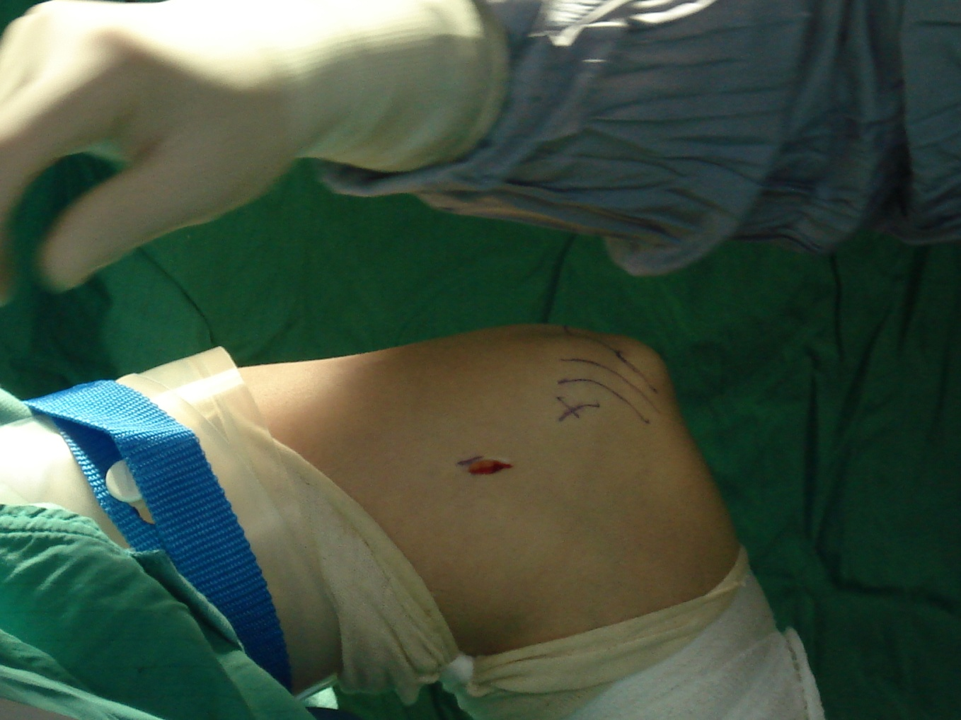
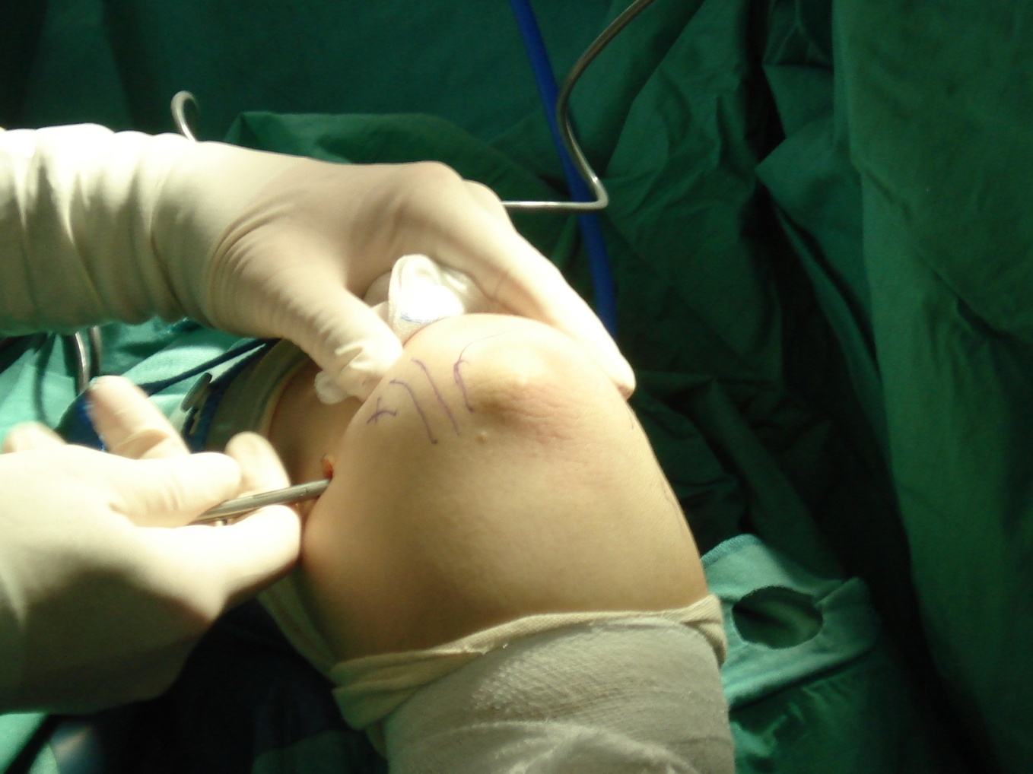
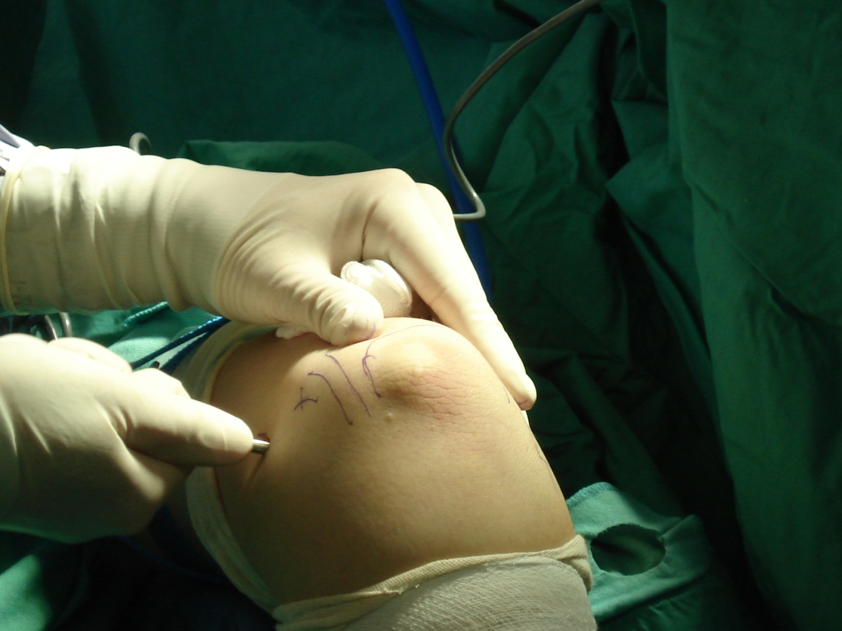

Slide 13
Results (Findings)
Radio-capitellar synovial plica,
18 (54.5%) type 1 variant,
11 (33.3%) type 2 variant,
4 (12.2%) type 3 variant, and
no one type 4 variant
There was NO statistical correlation between these different arthroscopic findings and the clinical results.

Slide 14
Results
Concerning the ECRB origin according to Baker et al
22 (66.7%) type I lesions (intact capsule),
7 (21.2%) type II lesions (linear capsule tear), and
4 (12.1) type III lesions (complete capsular tear) (Fig. 4). There was no statistical correlation between these different arthroscopic findings and the clinical results.

Slide 15
Results (Satisfaction)
Mean follow-up time of 14.4 months (range: 12-24 months)
12 patients completely asymptomatic,
17 were better or much better, and
2 remained the same.
The average time for return to work was 8 days (range, 3-21 days).

Slide 16
Results (VAS)
A highly statistically significant improvement was identified comparing preoperative with postoperative VAS for pain (P < 0.05).
The mean score for pain improved from 8.64 (range, 7-10) to 1.48 (range 0-3).
31 patients, 93.5% of the patients rated their satisfaction using VAS between 7 and 10 out of 10. While the remaining 6.5% (2 patients) rated as 3 out of 10.

Slide 17
Results (PRTEE)
A highly statistically significant improvement was identified comparing preoperative with postoperative PRTEE score (P < 0.05).
The total PRTEE, improved from 55.53 out of 100 (range, 35.5-72.5) to 10.39 out of 100 (range, 1-68).

Slide 18
Results (MEPI)
The mean MEPI score was improved from 61.82 (range, 55-85) preoperatively to 94.10 (range, 70-100) postoperatively, this improvement was statistically significant (P < 0.05).

Slide 19
Results (DASH)
Statistically significant improvement (P < 0.05).
The mean preoperative score was 24.46 (range, 13.80-37.10), while the mean postoperative score was 4.81 (range, 0-30.20).

Slide 20
Results (Complications)
Two complications were reported:
one patient had radial nerve palsy, Supportive medicatiosn and PT improved partially at 4 months and completely at 12 months
The other one had superficial wound infection, was treated successfully with a short course of antibiotics.

Slide 21
Results
No significant associations were observed between
  age,
  gender,
  preoperative length of non-operative treatment,
  time to return to work and
  final outcome
          (P > 0.05).

Slide 22


Slide 23
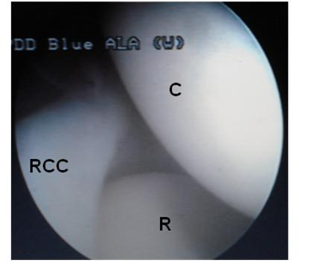
Arthroscopic view showing Capitellum (C), Radial Head (R), and Radio-capitellar Complex (RCC). RCC is impinging on radial head.

Slide 24
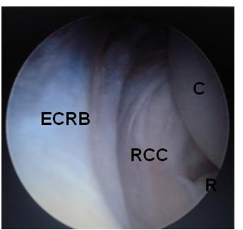
Arthroscopic view showing inflamed degenerated undersurface of Extensor Carpi Radialis Brevis (ECRB), RCC type II.

Slide 25
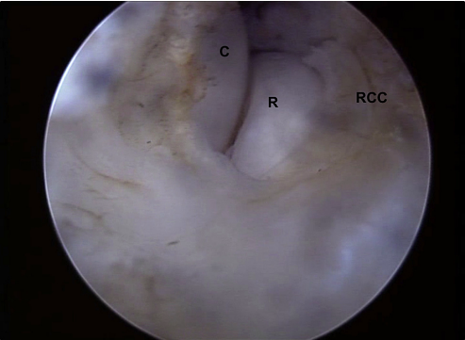
Arthroscopic view showing RCC type III after shaving part of it.

Slide 26
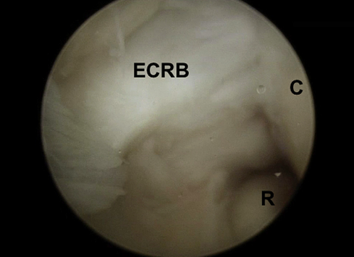
Arthroscopic view showing Type III ECRB

Slide 27
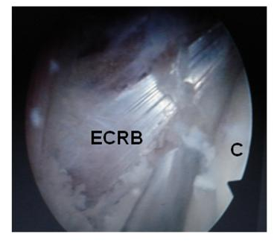
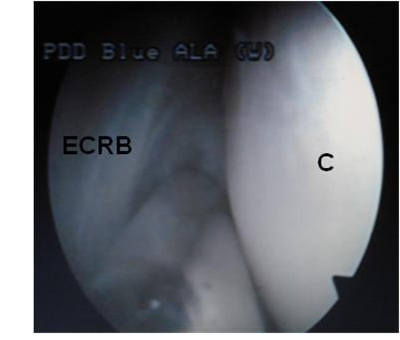
Arthroscopic view after complete debridmenet of RCCC and ECRB sheath
Arthroscopic view while shaving The RCCC

Slide 28
Conclusion
Arthroscopic release in patients with lateral epicondylitis is
  a reproducible method with a
  marked postoperative increase in function within a
  short rehabilitation period, with
  special consideration for resection of radiocapitellar capsular complex.

Slide 29




