Slide 1

SEVEN POSTOPERATIVE REHABILITATION PROTOCOLS BASED ON PATHOLOGY AFTER ARTHROSCOPIC ROTATOR CUFF SURGERY
40 years of rehabilitation experience
Ahmed Hosam Thoraya MD/ Basim Fleega MD

Slide 2
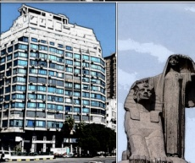
SHOULDER SURGERY AND REHABILITATION EXPERIENCE
41 years experience in shoulder surgery and rehabilitation
1982 Head of Shoulder and Elbow Dept. Heinrich H. Orthopedic Hospital Neuwied Germany
1989 Director and medical Chief of the GOC Shoulder Hospital Bonn Germany
2021 Director Shoulder and Elbow Service Alsalaam International Hospital Maadi Cairo
Postoperative rehabilitation exercise program after shoulder operations
B. A. Fleega
Manuelle Medizin volume 37, pages96-100(1999)
GOC CENTRE

Slide 3
7 TYPES
1- PARTIAL INSERTION SSP TEAR
PATIAL MEDIAL SSP TEAR and SMALL TEAR
2- MEDIUM TEAR SSP
3- LARGE TEAR SSP
4- MASSIVE and recurrent TEAR
5- SUBSCAPULARIS TEAR
6- INFRASPINATUS TEAR
7- BICEPS TEAR 7

Slide 4
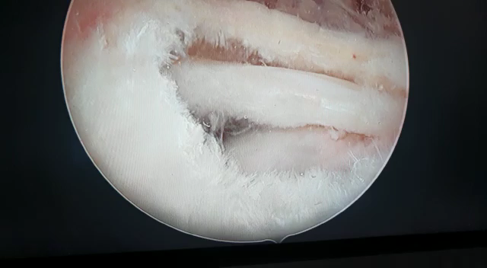
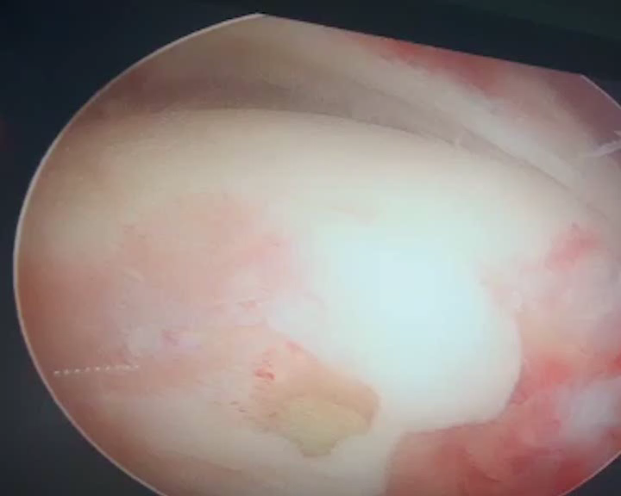
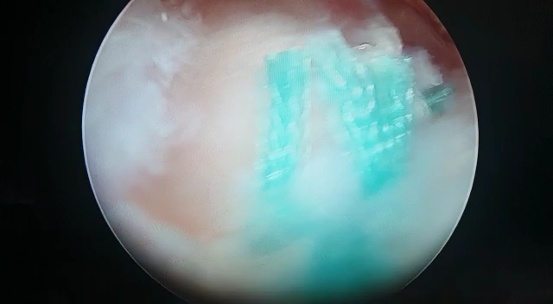
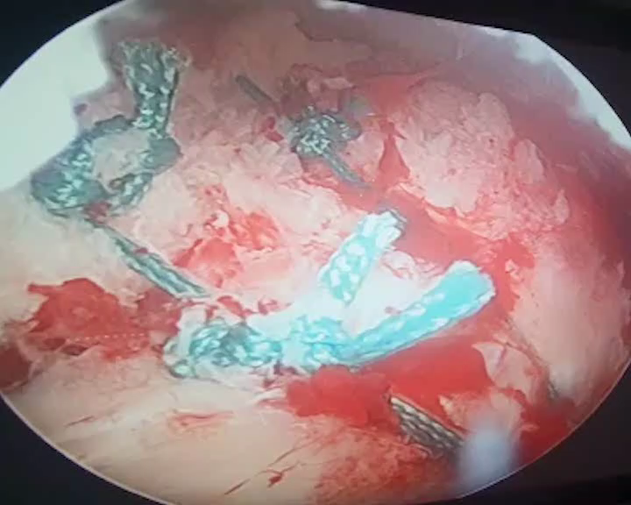
MEDIUM MASSIVE

Slide 5
SPECIAL CONSIDERATIONS IN ROTATOR CUFF REPAIR REHABILITATION
TRAUMA (Direct trauma , Micro-trauma) (5%)
(NO Adhesions, No Muscle Atrophy, No Scapular muscular contraction imbalance )
IMPINGEMENT (90%)
( Tendon Muscle Atrophy , Adhesions, Scapular muscle changes
INSTABILITY ( Instability or dislocation tear)
(Tear repair maybe associated with instability surgery)
FROZEN SHOULDER (mobilization tear repair)
(Stiff shortening of all tendons)
B. A. Fleega
Manuelle Medizin volume 37, pages96-100(1999)

Slide 6
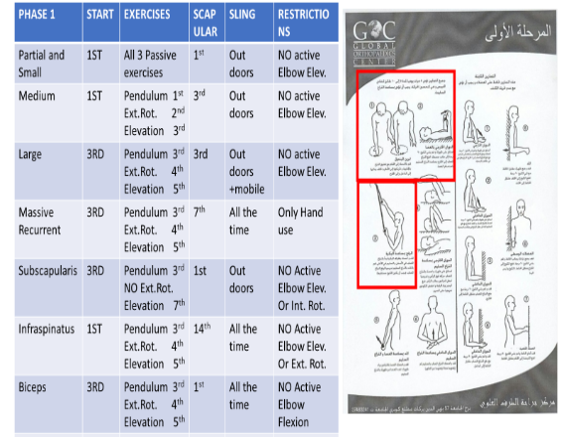
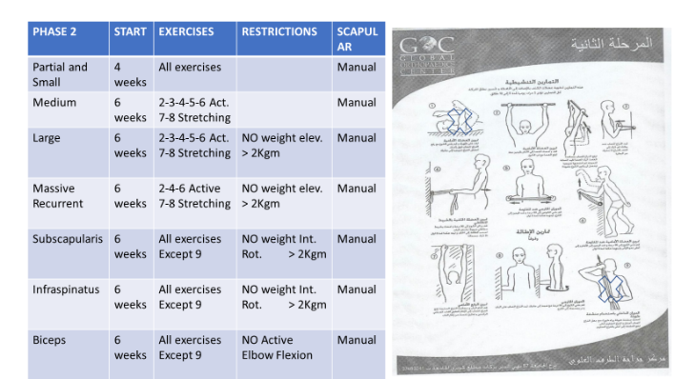
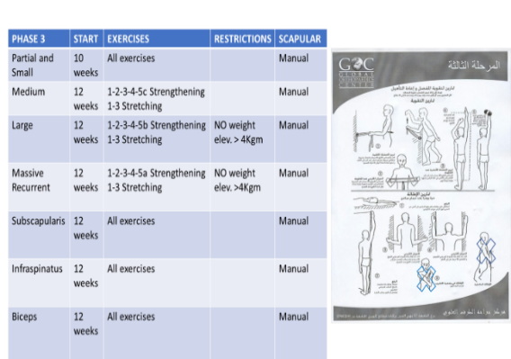
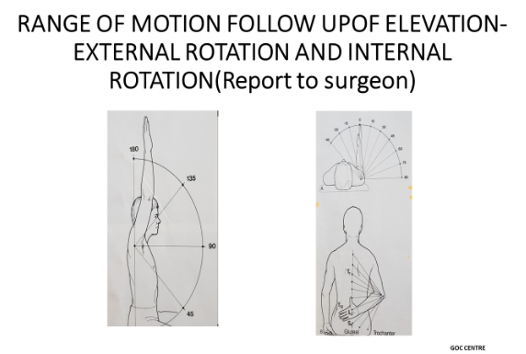
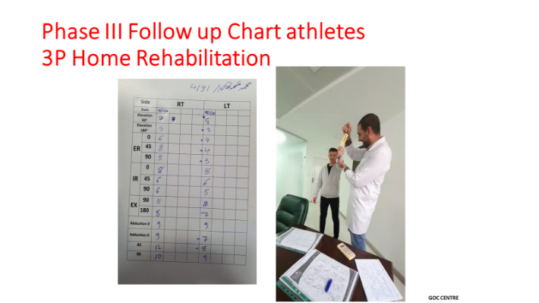
Three Phases Program with 7 variations
Phase 1 phase 2 phase 3

Slide 7
RESULTS
The results of this program are widely more effective than other programs as reported by ten physiotherapists involved in the study of 100 cases of outlet impingement rotator cuff tears.
No financial problems as the rehabilitation cost were inclusive in the surgery cost which increases the commitment level of the patients.
In the last 10 years the senior last Author has been using this rehabilitation protocols with distinguished results

Slide 8
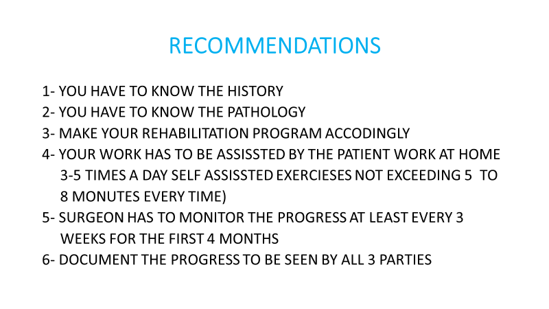

Slide 9



THANK YOU

Slide 10
MASSIVE WITHOUT BICEPS
BEFORE REPAIR
AFTER REPAIR

Slide 11
Although there are many different types and degrees of rotator cuff tear no sophisticated protocol is presented in the literature as far as our knowledge.
In this study we present seven protocols developed by the second Author and based on the different types of the rotator cuff pathologies. The program is done with coordination of the patient, the physiotherapist, and the surgeon.

Slide 12
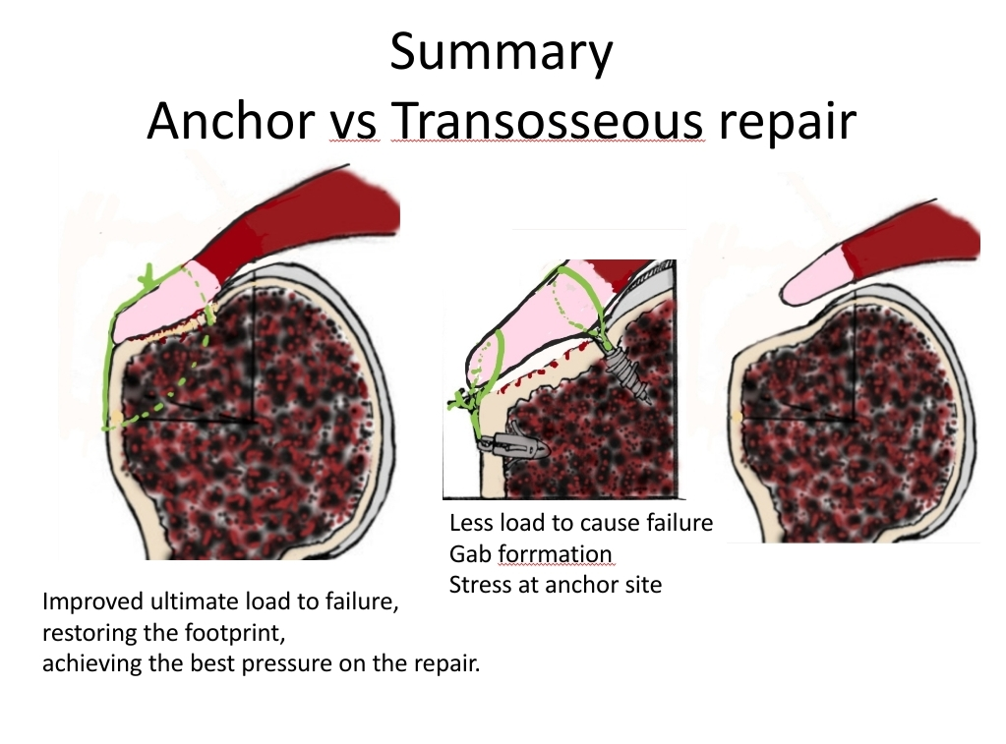
Cole et al 2007,
Park et al 2006,
Salata et al 2013,
Bunker et al 2011,
Gerber et al,
Bisson et al,
Waltrip et al,
Sano et al,
Kim et al 2016,
SH Kim et al 2017
Gap formation

Slide 13
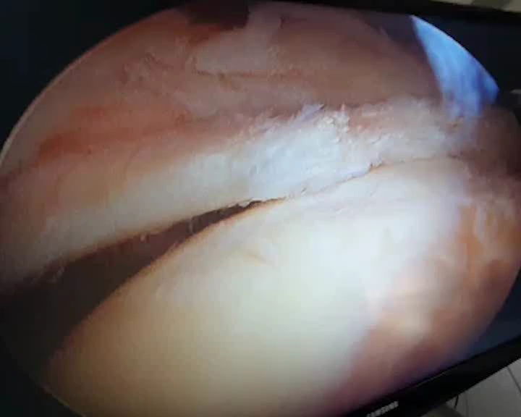
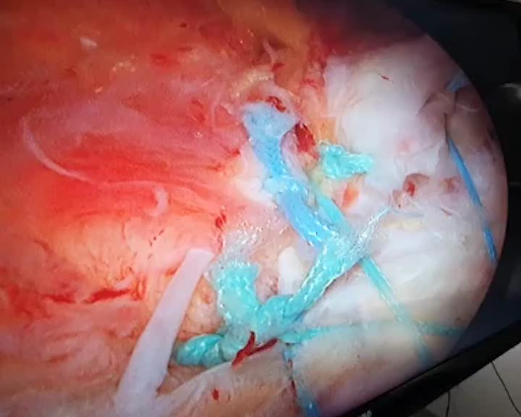
LARGE TEAR WITH PRSENCE OF THE BICEPS
BEFORE REPAIR
AFTER REPAIR

Slide 14
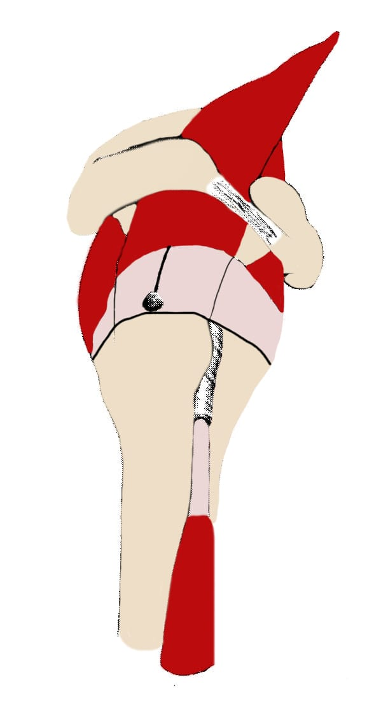
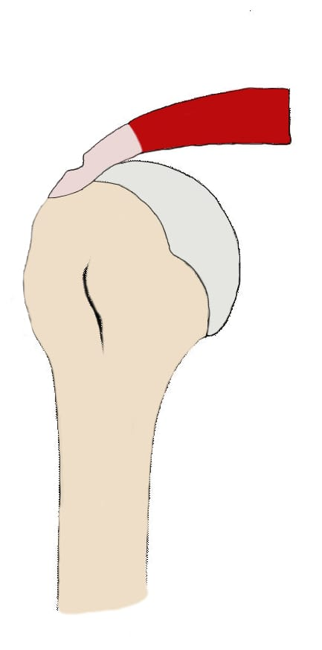
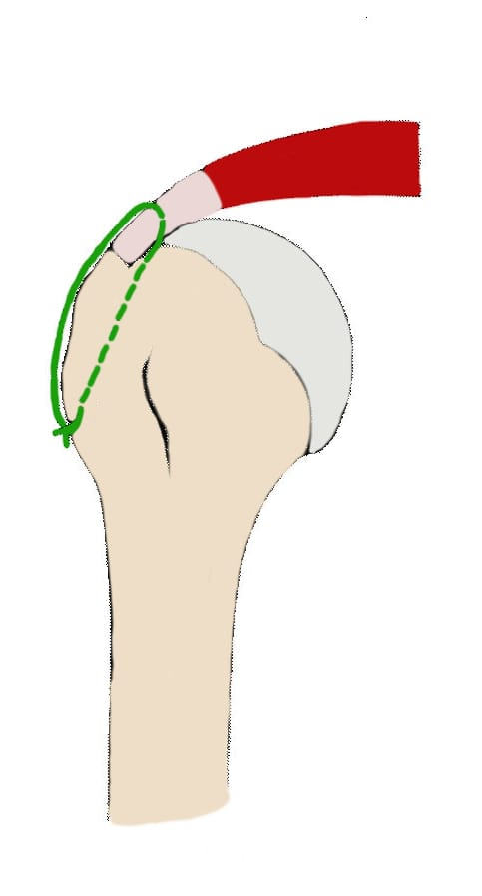
Partial Tear simple transosseous repair

Slide 15
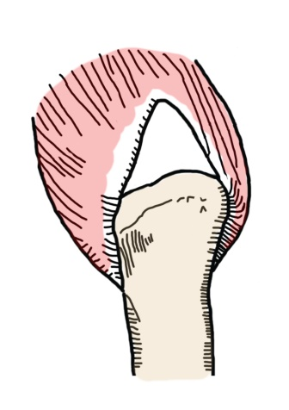
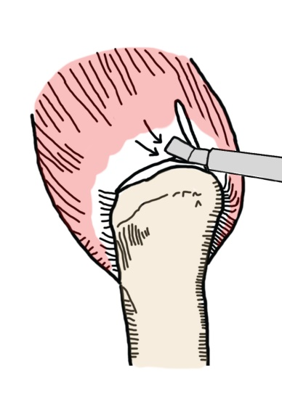
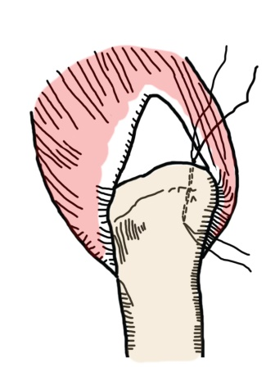
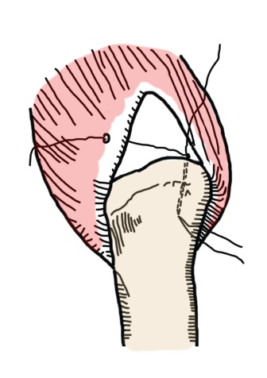
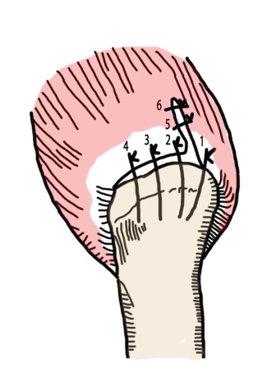
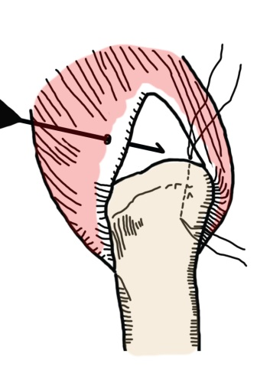
Medium size tear
1 2 3
4 5 6

Slide 16
The main muscles that control scapular movement 35% of shoulder elevation
Upper Trapezius Upward rotation, retraction, elevation
Middle Trapezius Upward rotation, retraction
Lower Trapezius Upward rotation, retraction, depression
Serratus Anterior Upward rotation, protraction
Rhomboids Downward rotation, retraction, elevation
Levator Scapulae Downward rotation, elevation
Pectoralis Minor Anterior tipping

Slide 17
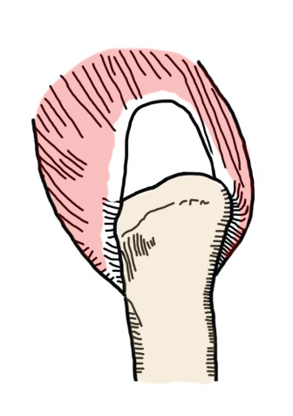
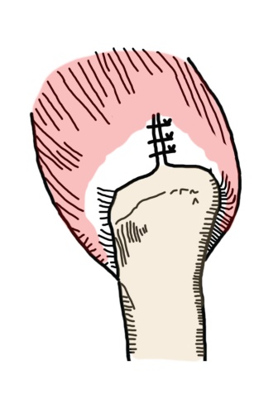
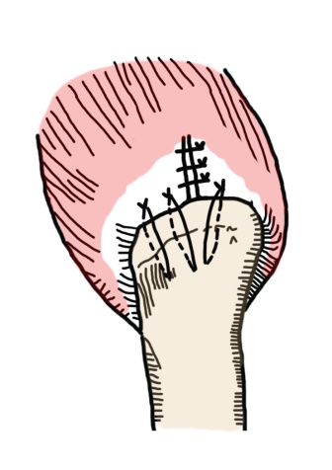
LARGE U-SHAPE REPAIR
1- First suture end to end repair of the medial apex of the tear
using portal-less Giant Needle or Chop needle system
2- Then Transosseous Giant Needle Suture Repair of the Tendon

Slide 18
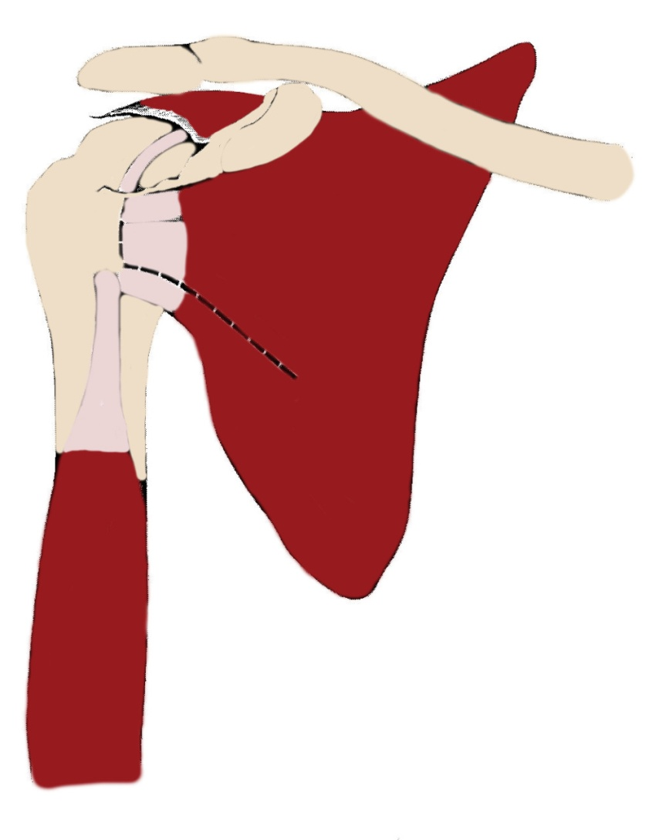
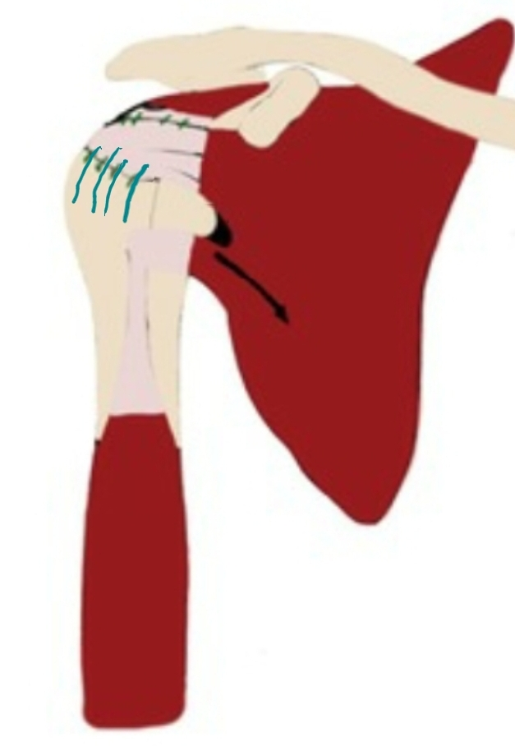
Transfer upper half of the Subscapularis for Supraspinatus
( or Infraspinatus for supraspinatus)

Slide 19
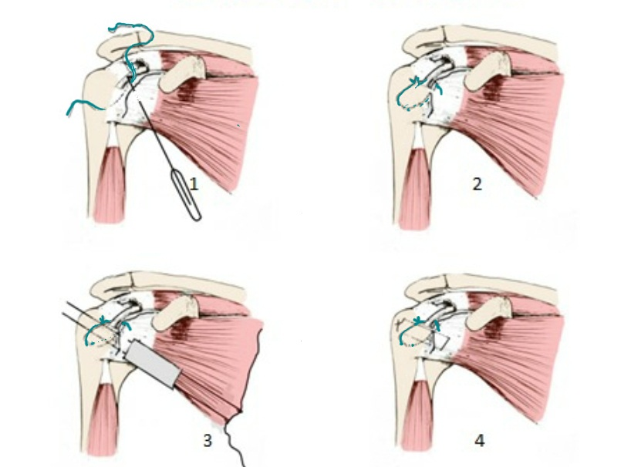
SUBSCAPULARIS REPAIR
The repair of the subscapularis is by using the same technique
as for the infraspinatus with placing the upper limb of the suture
below the Biceps tendon

Slide 20
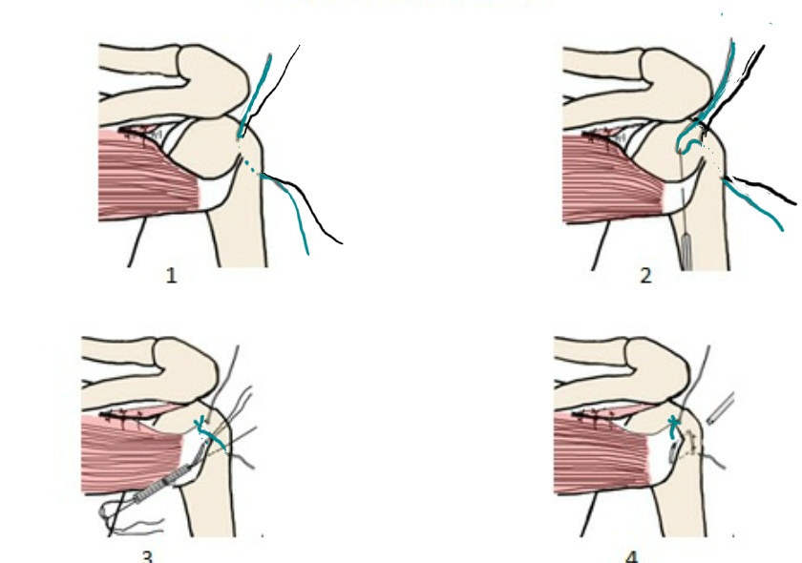
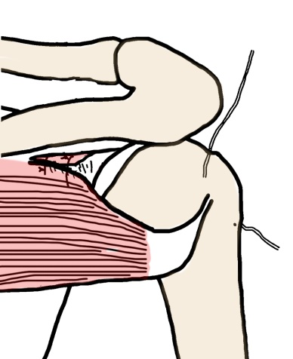
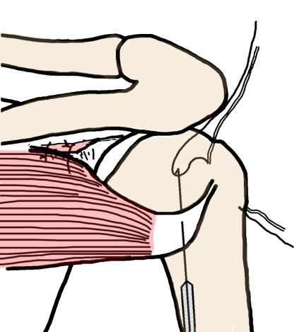
INFRASPINATUS REPAIR
1 2
Tie the suture and fix the lower
part of the Infraspinatus with a
suture passing pin if needed
3 4

Slide 21
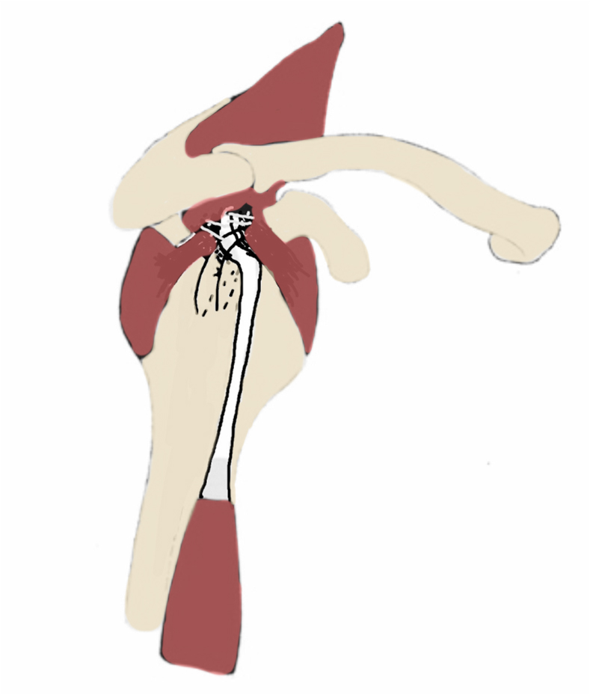
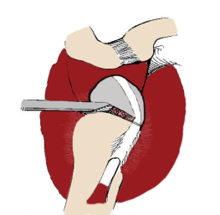
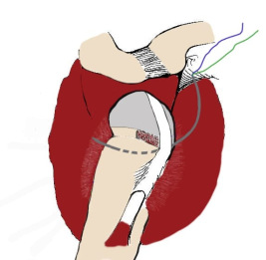
TEAR OR CONSTRUCTION FIXATION long head of the Biceps
Biceps tenodesis in a groove on the greater tuberosity
B
1 2 3

Slide 22
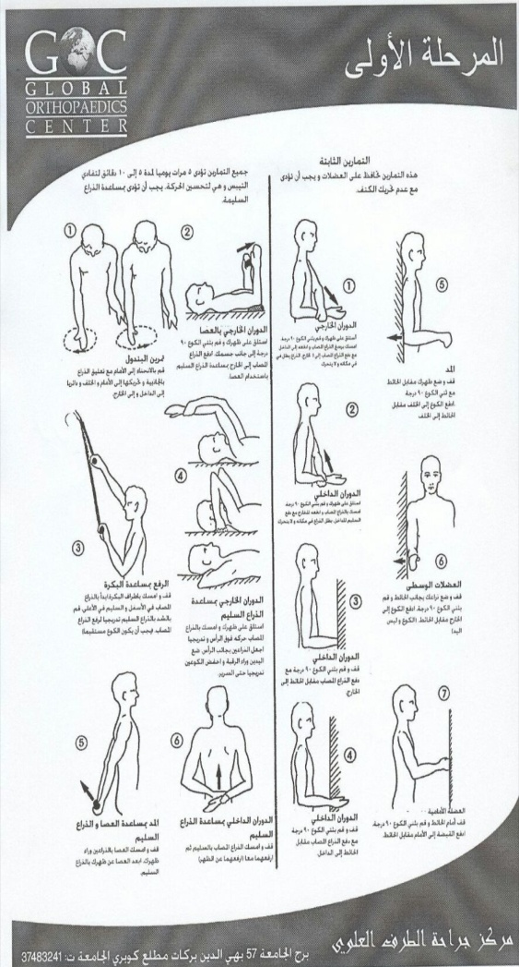
PHASE 1 | START | EXERCISES | SCAPULAR | SLING | RESTRICTIONS
Partial and Small | 1ST | All 3 Passive exercises | 1st | Out doors | NO active Elbow Elev.

Slide 23
PHASE 1 | START | EXERCISES | SCAPULAR | SLING | RESTRICTIONS
Partial and Small | 1ST | All 3 Passive exercises | 1st | Out doors | NO active Elbow Elev.
Medium | 1ST | Pendulum 1st Ext.Rot. 2nd Elevation 3rd | 3rd | Out doors | NO active Elbow Elev.

Slide 24
PHASE 1 | START | EXERCISES | SCAPULAR | SLING | RESTRICTIONS
Partial and Small | 1ST | All 3 Passive exercises | 1st | Out doors | NO active Elbow Elev.
Medium | 1ST | Pendulum 1st Ext.Rot. 2nd Elevation 3rd | 3rd | Out doors | NO active Elbow Elev.
Large | 3RD | Pendulum 3rd Ext.Rot. 4th Elevation 5th | 3rd | Out doors +mobile | NO active Elbow Elev.

Slide 25
PHASE 1 | START | EXERCISES | SCAPULAR | SLING | RESTRICTIONS
Partial and Small | 1ST | All 3 Passive exercises | 1st | Out doors | NO active Elbow Elev.
Medium | 1ST | Pendulum 1st Ext.Rot. 2nd Elevation 3rd | 3rd | Out doors | NO active Elbow Elev.
Large | 3RD | Pendulum 3rd Ext.Rot. 4th Elevation 5th | 3rd | Out doors +mobile | NO active Elbow Elev.
Massive Recurrent | 3RD | Pendulum 3rd Ext.Rot. 4th Elevation 5th | 7th | All the time | Only Hand use

Slide 26
PHASE 1 | START | EXERCISES | SCAPULAR | SLING | RESTRICTIONS
Partial and Small | 1ST | All 3 Passive exercises | 1st | Out doors | NO active Elbow Elev.
Medium | 1ST | Pendulum 1st Ext.Rot. 2nd Elevation 3rd | 3rd | Out doors | NO active Elbow Elev.
Large | 3RD | Pendulum 3rd Ext.Rot. 4th Elevation 5th | 3rd | Out doors +mobile | NO active Elbow Elev.
Massive Recurrent | 3RD | Pendulum 3rd Ext.Rot. 4th Elevation 5th | 7th | All the time | Only Hand use
Subscapularis | 3RD | Pendulum 3rd NO Ext.Rot. Elevation 7th | 1st | Out doors | NO Active Elbow Elev. Or Int. Rot.

Slide 27
PHASE 1 | START | EXERCISES | SCAPULAR | SLING | RESTRICTIONS
Partial and Small | 1ST | All 3 Passive exercises | 1st | Out doors | NO active Elbow Elev.
Medium | 1ST | Pendulum 1st Ext.Rot. 2nd Elevation 3rd | 3rd | Out doors | NO active Elbow Elev.
Large | 3RD | Pendulum 3rd Ext.Rot. 4th Elevation 5th | 3rd | Out doors +mobile | NO active Elbow Elev.
Massive Recurrent | 3RD | Pendulum 3rd Ext.Rot. 4th Elevation 5th | 7th | All the time | Only Hand use
Subscapularis | 3RD | Pendulum 3rd NO Ext.Rot. Elevation 7th | 1st | Out doors | NO Active Elbow Elev. Or Int. Rot.
Infraspinatus | 1ST | Pendulum 3rd Ext.Rot. 4th Elevation 5th | 14th | All the time | NO Active Elbow Elev. Or Ext. Rot.

Slide 28
PHASE 1 | START | EXERCISES | SCAPULAR | SLING | RESTRICTIONS
Partial and Small | 1ST | All 3 Passive exercises | 1st | Out doors | NO active Elbow Elev.
Medium | 1ST | Pendulum 1st Ext.Rot. 2nd Elevation 3rd | 3rd | Out doors | NO active Elbow Elev.
Large | 3RD | Pendulum 3rd Ext.Rot. 4th Elevation 5th | 3rd | Out doors +mobile | NO active Elbow Elev.
Massive Recurrent | 3RD | Pendulum 3rd Ext.Rot. 4th Elevation 5th | 7th | All the time | Only Hand use
Subscapularis | 3RD | Pendulum 3rd NO Ext.Rot. Elevation 7th | 1st | Out doors | NO Active Elbow Elev. Or Int. Rot.
Infraspinatus | 1ST | Pendulum 3rd Ext.Rot. 4th Elevation 5th | 14th | All the time | NO Active Elbow Elev. Or Ext. Rot.
Biceps | 3RD | Pendulum 3rd Ext.Rot. 4th Elevation 5th | 1st | All the time | NO Active Elbow Flexion

Slide 29
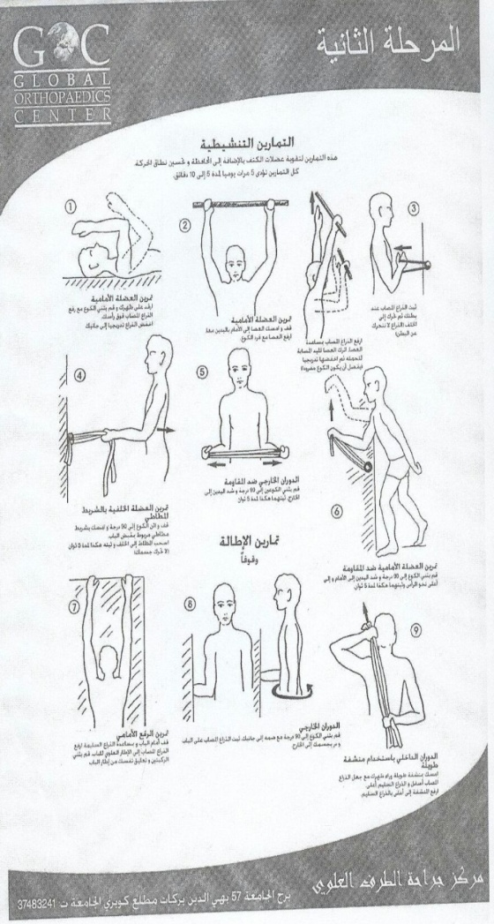
PHASE 2 | START | EXERCISES | RESTRICTIONS | SCAPULAR
Partial and Small | 4 weeks | All exercises |  | Manual

Slide 30
PHASE 2 | START | EXERCISES | RESTRICTIONS | SCAPULAR
Partial and Small | 4 weeks | All exercises |  | Manual
Medium | 6 weeks | 2-3-4-5-6 Act. 7-8 Stretching |  | Manual

Slide 31
PHASE 2 | START | EXERCISES | RESTRICTIONS | SCAPULAR
Partial and Small | 4 weeks | All exercises |  | Manual
Medium | 6 weeks | 2-3-4-5-6 Act. 7-8 Stretching |  | Manual
Large | 6 weeks | 2-3-4-5-6 Act. 7-8 Stretching | NO weight elev. > 2Kgm | Manual

Slide 32
PHASE 2 | START | EXERCISES | RESTRICTIONS | SCAPULAR
Partial and Small | 4 weeks | All exercises |  | Manual
Medium | 6 weeks | 2-3-4-5-6 Act. 7-8 Stretching |  | Manual
Large | 6 weeks | 2-3-4-5-6 Act. 7-8 Stretching | NO weight elev. > 2Kgm | Manual
Massive Recurrent | 6 weeks | 2-4-6 Active 7-8 Stretching | NO weight elev. > 2Kgm | Manual

Slide 33
PHASE 2 | START | EXERCISES | RESTRICTIONS | SCAPULAR
Partial and Small | 4 weeks | All exercises |  | Manual
Medium | 6 weeks | 2-3-4-5-6 Act. 7-8 Stretching |  | Manual
Large | 6 weeks | 2-3-4-5-6 Act. 7-8 Stretching | NO weight elev. > 2Kgm | Manual
Massive Recurrent | 6 weeks | 2-4-6 Active 7-8 Stretching | NO weight elev. > 2Kgm | Manual
Subscapularis | 6 weeks | All exercises Except 9 | NO weight Int. Rot. > 2Kgm | Manual

Slide 34
PHASE 2 | START | EXERCISES | RESTRICTIONS | SCAPULAR
Partial and Small | 4 weeks | All exercises |  | Manual
Medium | 6 weeks | 2-3-4-5-6 Act. 7-8 Stretching |  | Manual
Large | 6 weeks | 2-3-4-5-6 Act. 7-8 Stretching | NO weight elev. > 2Kgm | Manual
Massive Recurrent | 6 weeks | 2-4-6 Active 7-8 Stretching | NO weight elev. > 2Kgm | Manual
Subscapularis | 6 weeks | All exercises Except 9 | NO weight Int. Rot. > 2Kgm | Manual
Infraspinatus | 6 weeks | All exercises Except 9 | NO weight Int. Rot. > 2Kgm | Manual

Slide 35
PHASE 2 | START | EXERCISES | RESTRICTIONS | SCAPULAR
Partial and Small | 4 weeks | All exercises |  | Manual
Medium | 6 weeks | 2-3-4-5-6 Act. 7-8 Stretching |  | Manual
Large | 6 weeks | 2-3-4-5-6 Act. 7-8 Stretching | NO weight elev. > 2Kgm | Manual
Massive Recurrent | 6 weeks | 2-4-6 Active 7-8 Stretching | NO weight elev. > 2Kgm | Manual
Subscapularis | 6 weeks | All exercises Except 9 | NO weight Int. Rot. > 2Kgm | Manual
Infraspinatus | 6 weeks | All exercises Except 9 | NO weight Int. Rot. > 2Kgm | Manual
Biceps | 6 weeks | All exercises Except 9 | NO Active Elbow Flexion | Manual

Slide 36
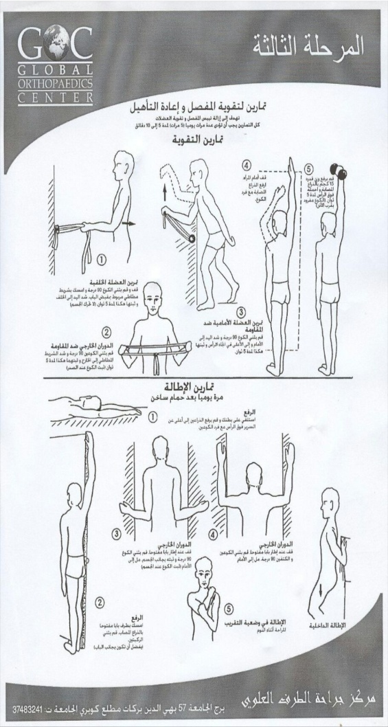
PHASE 3 | START | EXERCISES | RESTRICTIONS | SCAPULAR
Partial and Small | 10 weeks | All exercises |  | Manual

Slide 37
PHASE 3 | START | EXERCISES | RESTRICTIONS | SCAPULAR
Partial and Small | 10 weeks | All exercises |  | Manual
Medium | 12 weeks | 1-2-3-4-5c Strengthening 1-3 Stretching |  | Manual

Slide 38
PHASE 3 | START | EXERCISES | RESTRICTIONS | SCAPULAR
Partial and Small | 10 weeks | All exercises |  | Manual
Medium | 12 weeks | 1-2-3-4-5c Strengthening 1-3 Stretching |  | Manual
Large | 12 weeks | 1-2-3-4-5b Strengthening 1-3 Stretching | NO weight elev. > 4Kgm | Manual

Slide 39
PHASE 3 | START | EXERCISES | RESTRICTIONS | SCAPULAR
Partial and Small | 10 weeks | All exercises |  | Manual
Medium | 12 weeks | 1-2-3-4-5c Strengthening 1-3 Stretching |  | Manual
Large | 12 weeks | 1-2-3-4-5b Strengthening 1-3 Stretching | NO weight elev. > 4Kgm | Manual
Massive Recurrent | 12 weeks | 1-2-3-4-5a Strengthening 1-3 Stretching | NO weight elev. >4Kgm | Manual

Slide 40
PHASE 3 | START | EXERCISES | RESTRICTIONS | SCAPULAR
Partial and Small | 10 weeks | All exercises |  | Manual
Medium | 12 weeks | 1-2-3-4-5c Strengthening 1-3 Stretching |  | Manual
Large | 12 weeks | 1-2-3-4-5b Strengthening 1-3 Stretching | NO weight elev. > 4Kgm | Manual
Massive Recurrent | 12 weeks | 1-2-3-4-5a Strengthening 1-3 Stretching | NO weight elev. >4Kgm | Manual
Subscapularis | 12 weeks | All exercises |  | Manual

Slide 41
PHASE 3 | START | EXERCISES | RESTRICTIONS | SCAPULAR
Partial and Small | 10 weeks | All exercises |  | Manual
Medium | 12 weeks | 1-2-3-4-5c Strengthening 1-3 Stretching |  | Manual
Large | 12 weeks | 1-2-3-4-5b Strengthening 1-3 Stretching | NO weight elev. > 4Kgm | Manual
Massive Recurrent | 12 weeks | 1-2-3-4-5a Strengthening 1-3 Stretching | NO weight elev. >4Kgm | Manual
Subscapularis | 12 weeks | All exercises |  | Manual
Infraspinatus | 12 weeks | All exercises |  | Manual

Slide 42
PHASE 3 | START | EXERCISES | RESTRICTIONS | SCAPULAR
Partial and Small | 10 weeks | All exercises |  | Manual
Medium | 12 weeks | 1-2-3-4-5c Strengthening 1-3 Stretching |  | Manual
Large | 12 weeks | 1-2-3-4-5b Strengthening 1-3 Stretching | NO weight elev. > 4Kgm | Manual
Massive Recurrent | 12 weeks | 1-2-3-4-5a Strengthening 1-3 Stretching | NO weight elev. >4Kgm | Manual
Subscapularis | 12 weeks | All exercises |  | Manual
Infraspinatus | 12 weeks | All exercises |  | Manual
Biceps | 12 weeks | All exercises |  | Manual

Slide 43
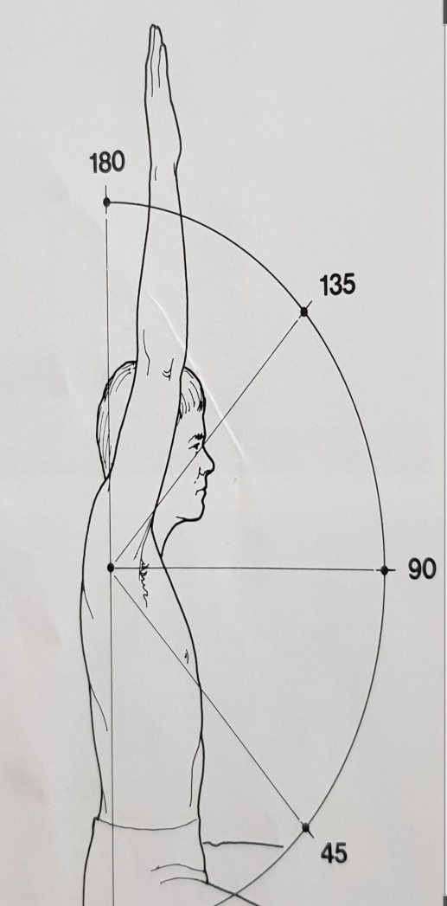
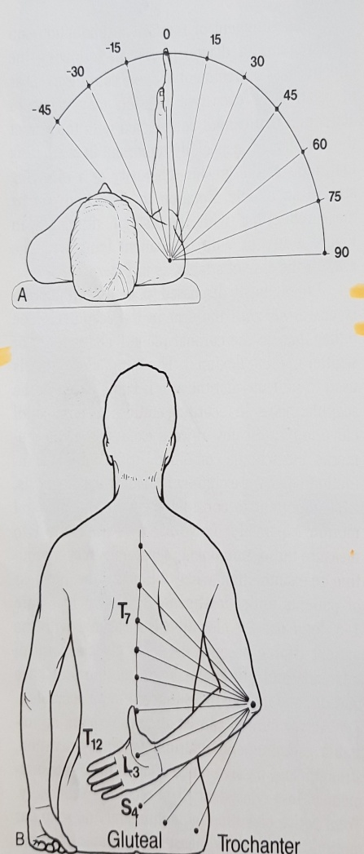
RANGE OF MOTION FOLLOW UPOF ELEVATION- EXTERNAL ROTATION AND INTERNAL ROTATION(Report to surgeon)
GOC CENTRE

Slide 44
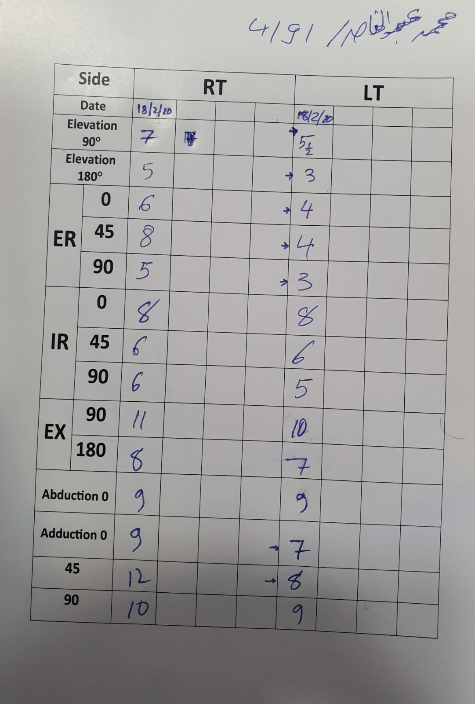
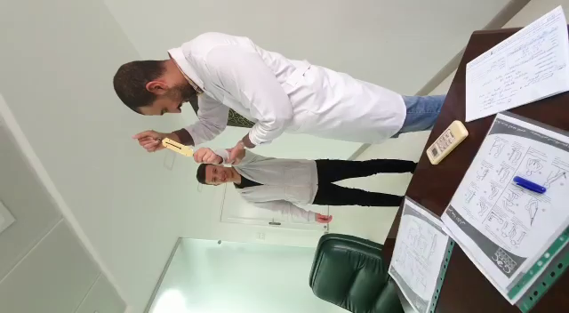
Phase III Follow up Chart athletes
3P Home Rehabilitation
GOC CENTRE

Slide 45
RECOMMENDATIONS
1- YOU HAVE TO KNOW THE HISTORY
2- YOU HAVE TO KNOW THE PATHOLOGY
3- MAKE YOUR REHABILITATION PROGRAM ACCODINGLY
4- YOUR WORK HAS TO BE ASSISSTED BY THE PATIENT WORK AT HOME
3-5 TIMES A DAY SELF ASSISSTED EXERCIESES NOT EXCEEDING 5 TO
8 MONUTES EVERY TIME)
5- SURGEON HAS TO MONITOR THE PROGRESS AT LEAST EVERY 3
WEEKS FOR THE FIRST 4 MONTHS
6- DOCUMENT THE PROGRESS TO BE SEEN BY ALL 3 PARTIES

Slide 46
THANK YOU

