Slide 1
Role Of PT Post Assisted Lower Trap Tendon Transfer
          DR.Abdalla Osman ( PT , DPT )
          Senior AL-Rahma Hospital

Slide 2
INTRODUCTION
Rotator cuff tears are one of the most common causes of shoulder pain and disability in the adult patient.

Slide 3
ROTATOTR CUFF CABLE
“ Organized, parallel-running bundle of connective tissue fibers, forming a curved capsular-ligamentous structure In superolateral part of GHJ capsule ’’ ( Rahu 2017 ).
Starts anteriorly at anterior part of superior facet of GT.
Posteriorly between insertion areas of infraspinatus, teres minor.

Slide 4
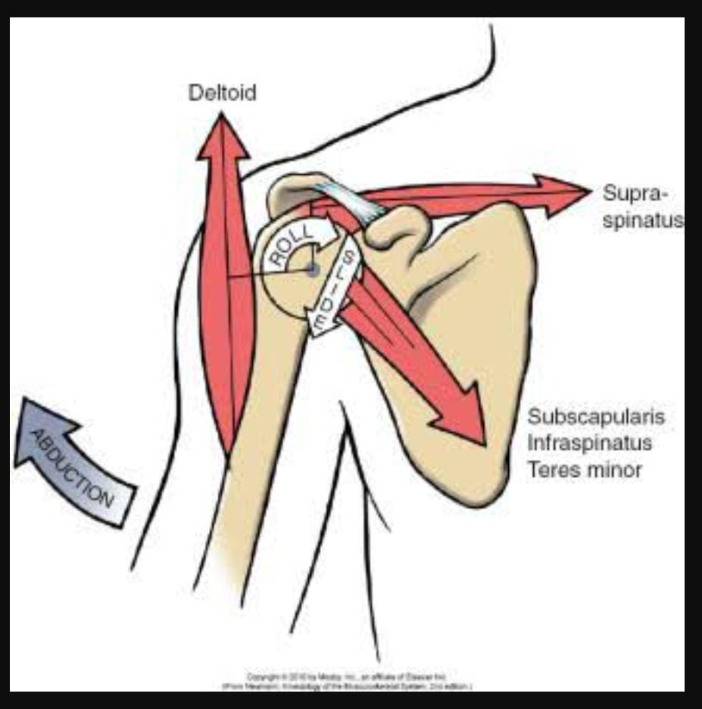
ACTION OF RC
Form a mechanical couple with Deltoid during Abducton & Elevation of arm.
Counteracts upward pull of Deltoid on HH.
Keep HH secured in Glenoid. ( Centered ).
Rotate HH which is important during elevation.

Slide 5
Tricks of irreparable RC
Functionally irreparable rotator cuff tears ( FIRCTs ) remain one of the most challenging pathologies treated in the shoulder.
The natural history of these tears if left untreated involves a predictable progression to arthritic changes.
They are characterized by their tendon retracrion, poor tendon quality, and fatty muscle infiltration, all leading to the shoulder dysfunction and morbidity.

Slide 6
Surgical options
No Arthropathy
1. Partial repair.
2. Biceps tenodesis/tenotomy.
3. Superior capsule reconstruction.
4. Subacromial ballons.
5. Open-/arthroscopic-assisted tendon transfers.
Arthropathy
Reverse shoulder arthtoplasty.

Slide 7
Principles of tendon transfer
The transferred and the recipient muscles should have the same excursion and tension.
The transferred muscle must be expandable.
The transferred and the recipient tendons should have the line of pull of action.

Slide 8
Why lower trapezius transfer?
Fairy simple transfer.
Arthroscopically assisted.
Better restoration of shoulder biomechanics. ( the line of pull of lower trapezius is more closely mimic to the infraspinatus ).
Easy to operative training as the lower trapezius contracts during shoulder external rotations.

Slide 9
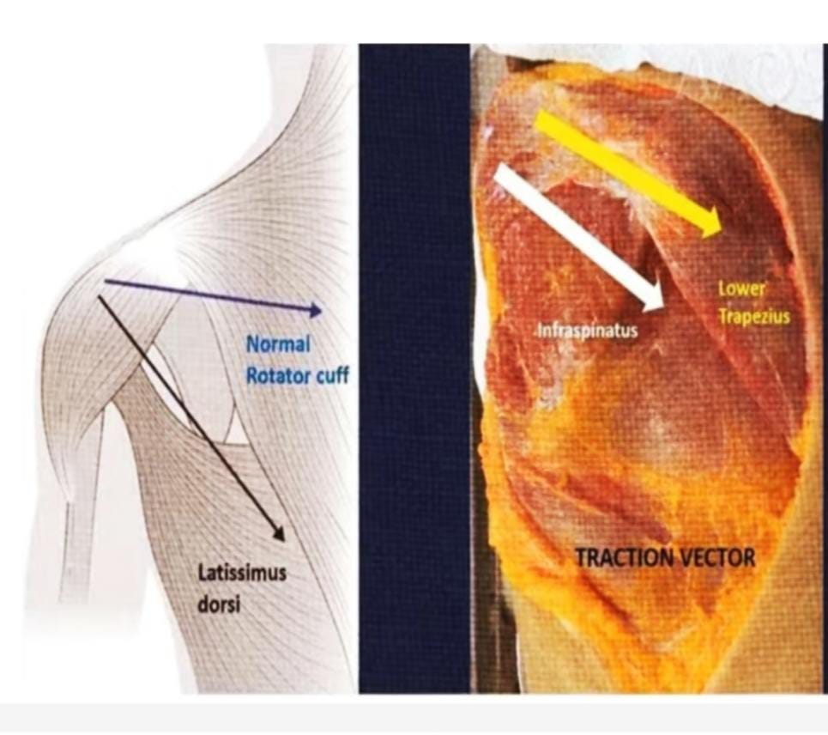
Lower trapezius transfer
The surgeon can achieve better EXTERNAL ROTATION biomechanically more suitable than Latissimus Dorsi.

Slide 10
Why Peroneus longus tendon graft?
Provides a proportional length and diameter.
Good tensile strength.
No significant changes or major complications at the donor ankle site.

Slide 11
Guidelines Principles Of Postoperative Rehablitation
Understand whether the procedure involves simple acromioplasty, or repair of other structure that require additional rehabilitation restrictions.
Although early motion is permitted, forces passive motion or early strenghting inhibit the healing process and can actually cause stiffnes and protected recovery.
One need to respect rate of ROM progression within these guidelines.

Slide 12
Immediate postoperative phase
Re-establish full PROM.
Diminsh pain and inflammation.
Minimize atrophy.
Don’t over stress healing tissues.
Protect healing tissues ( Abduction pillow for 4 weeks )

Slide 13
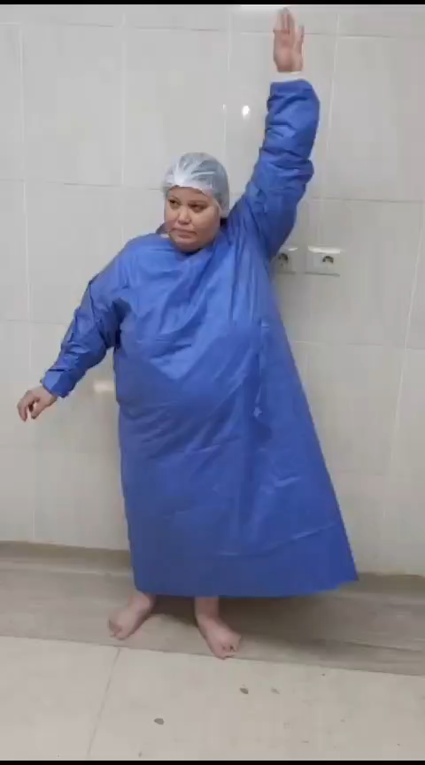
Case 1 ( pre-operative )

Slide 14
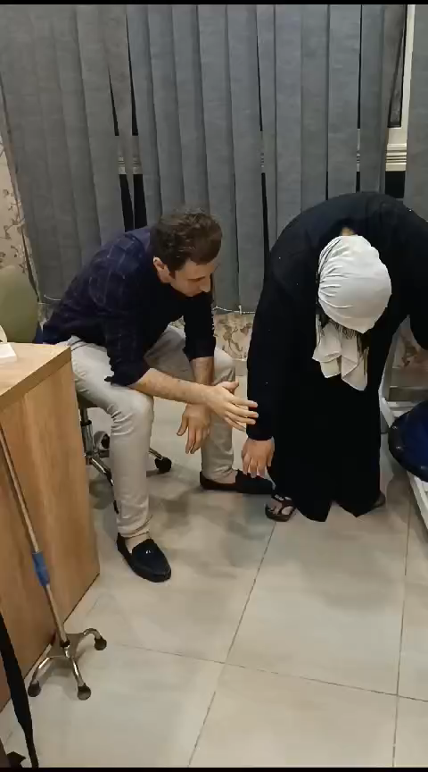
Phase 1
Pendulums exercise
Hand squeezes
Elbow AROM

Slide 15
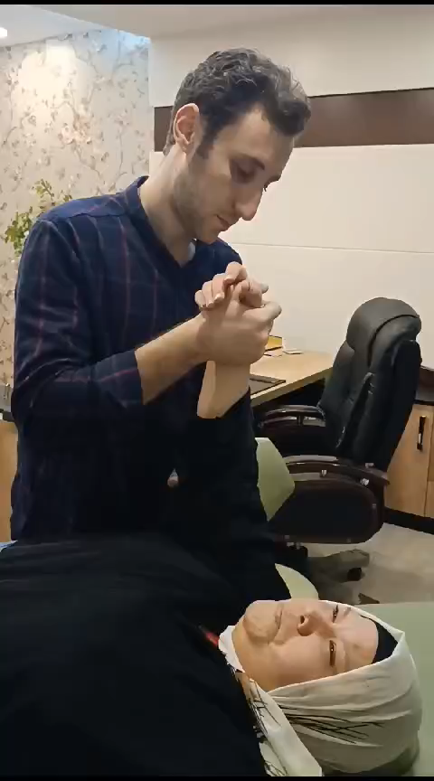
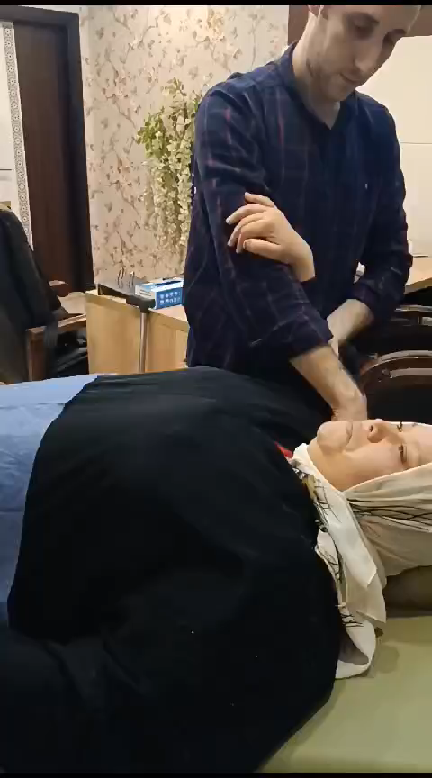
Phase 1
Supine PROM forward elevation and external rotation.
Active scapular exercise ( shoulder shrugs and scapular retraction )

Slide 16
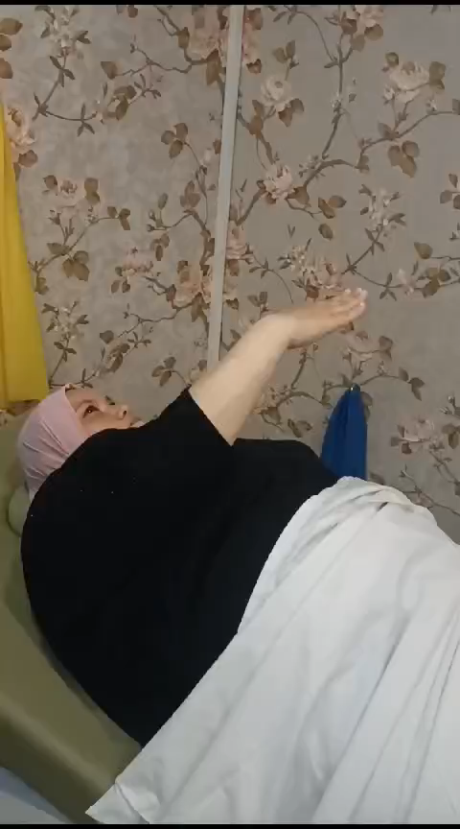
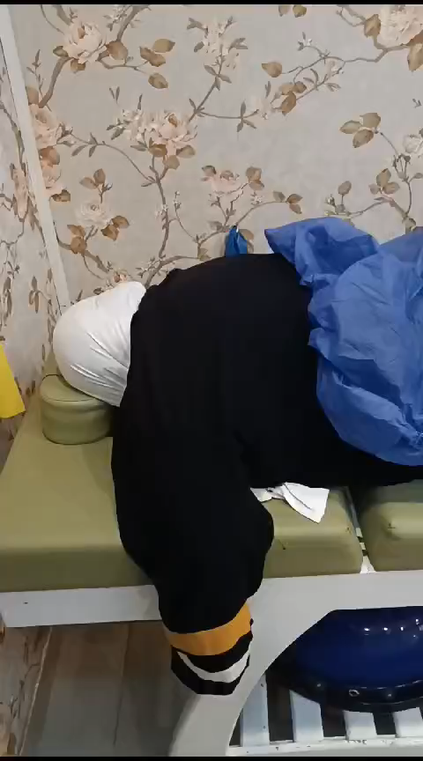
Phase 2
Improve to full ROM
Improve neuromuscular control and strength
Emphasize normal scapulohumeral rhythm

Slide 17
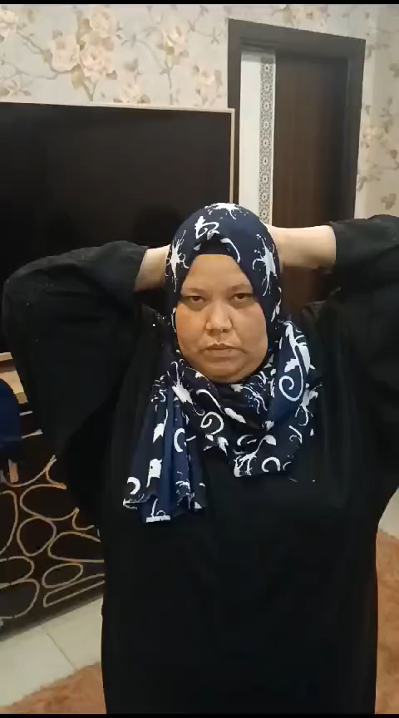
Phase 3
Pain free ROM
Improve endurance
Initiate return to functional activities

Slide 18
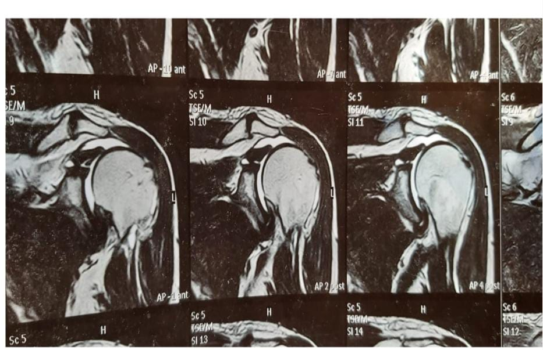
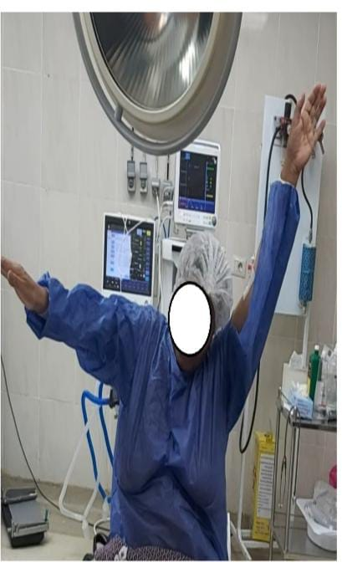
Case 2 ( Pre-rehab )

Slide 19
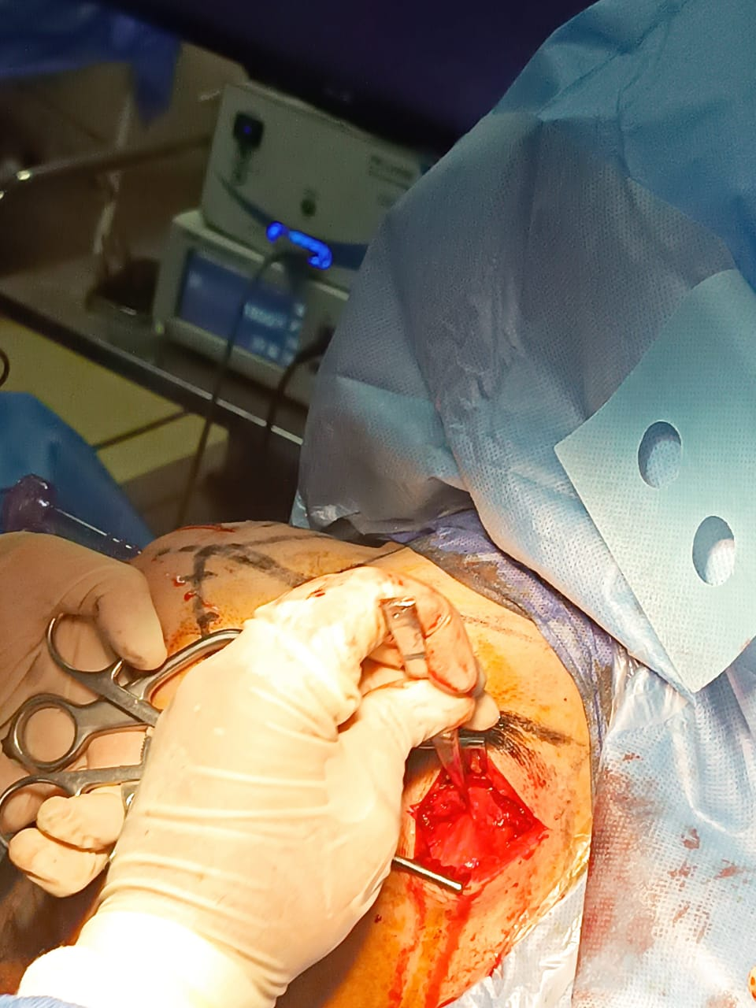

Slide 20
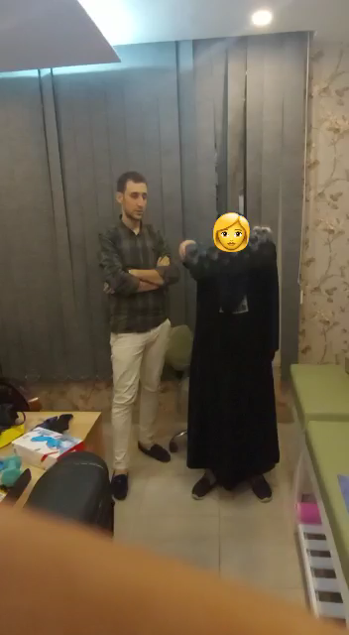
Post-rehab Case 2 ( AAROM )

Slide 21
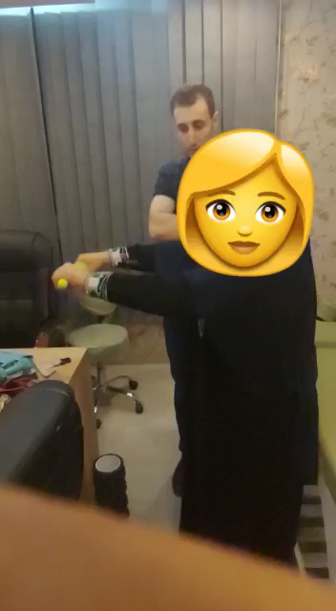
Post-rehab Case 2 ( AAROM )

Slide 22
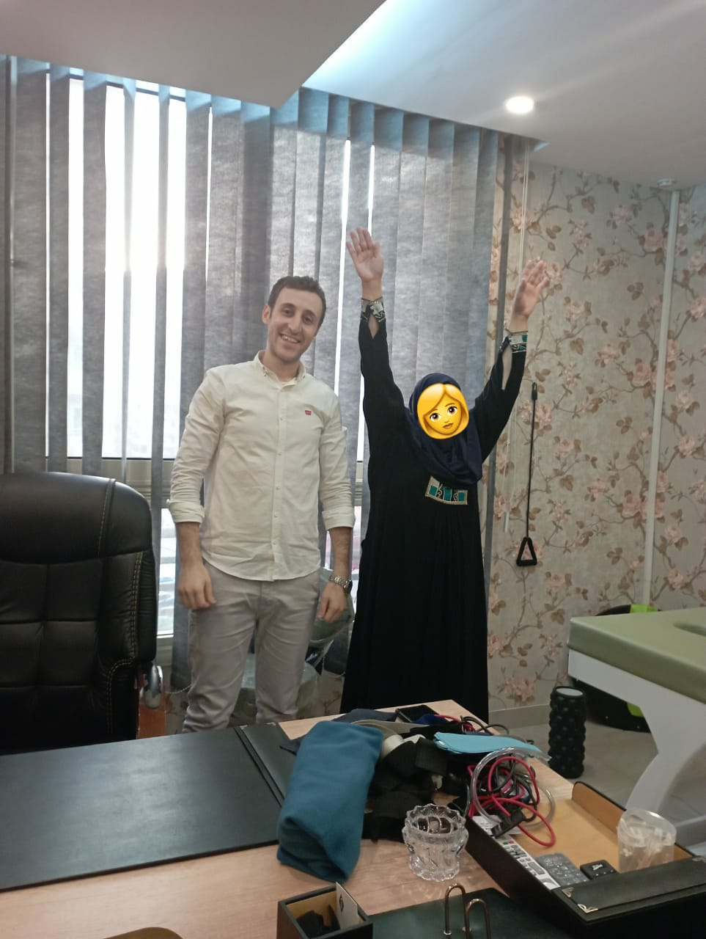
Active Free

Slide 23
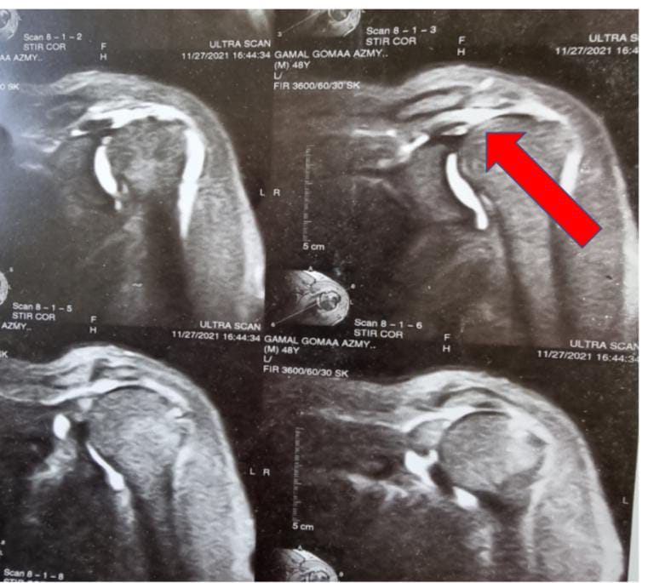
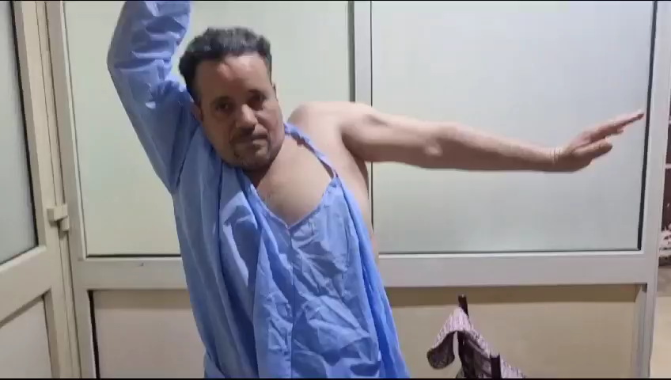
Case 3 ( Pre-rehab )

Slide 24
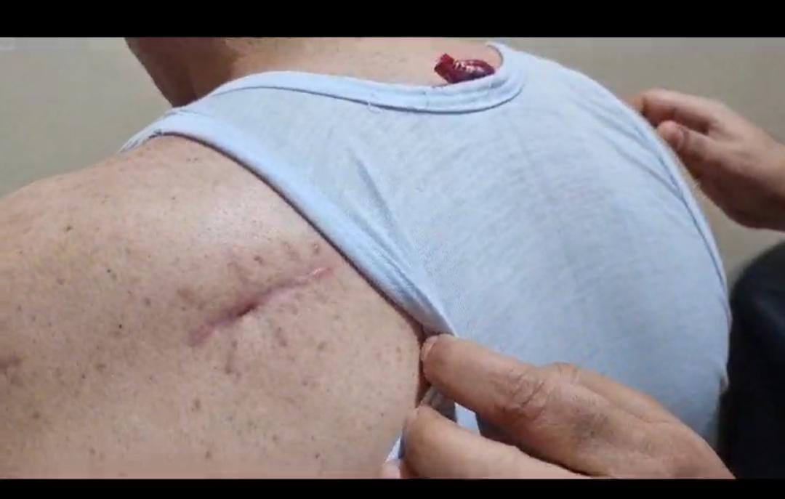

Slide 25
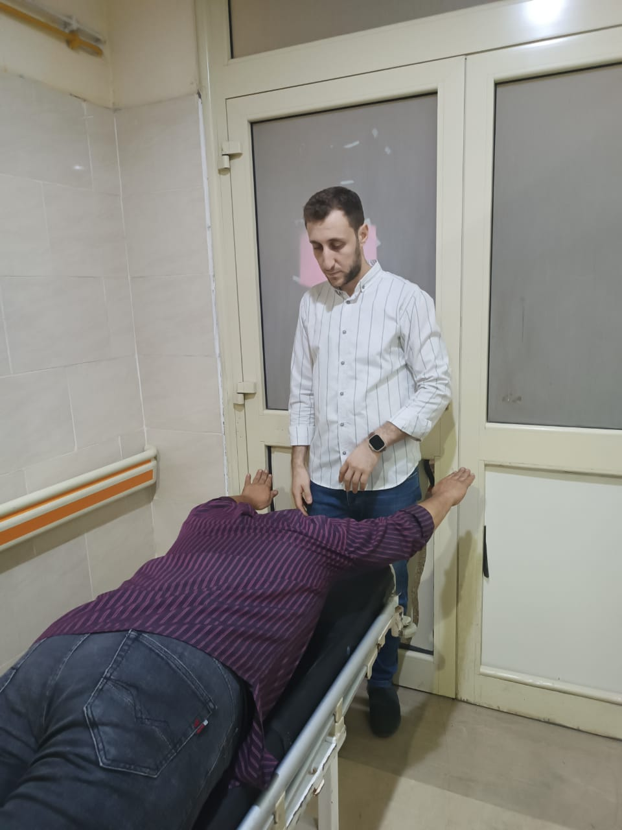
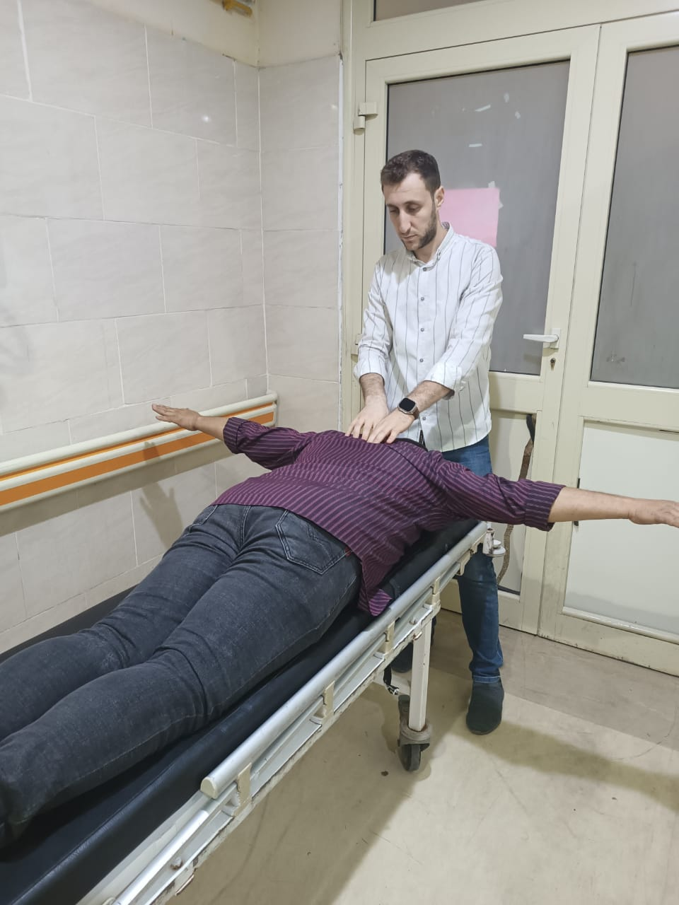
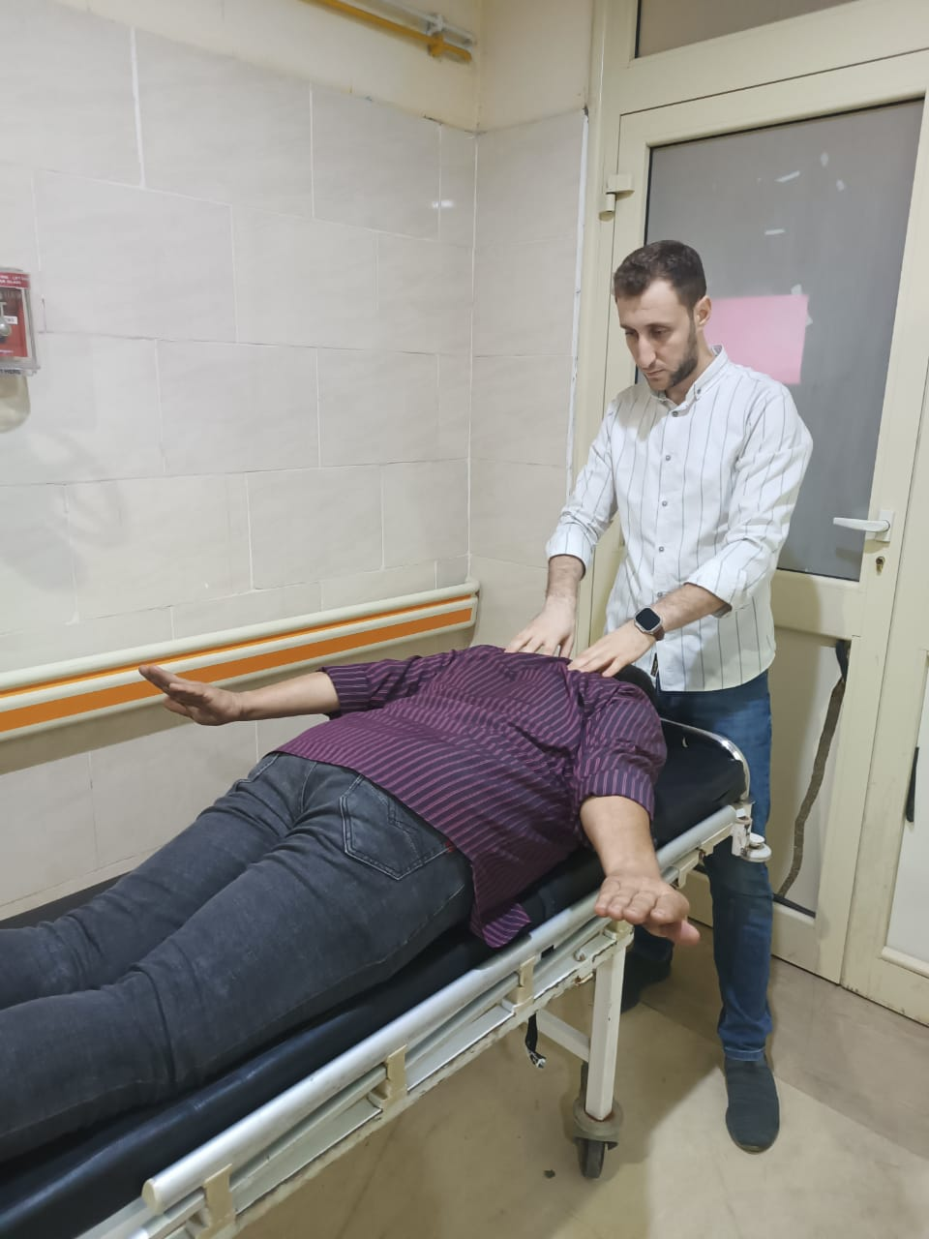
Post-rehab case 3 ( Upper,Middle,Lower trapezius activation )

Slide 26
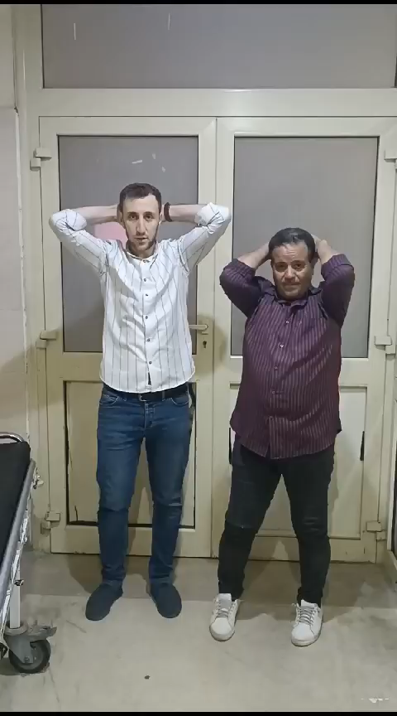
ACTIVE FREE

Slide 27
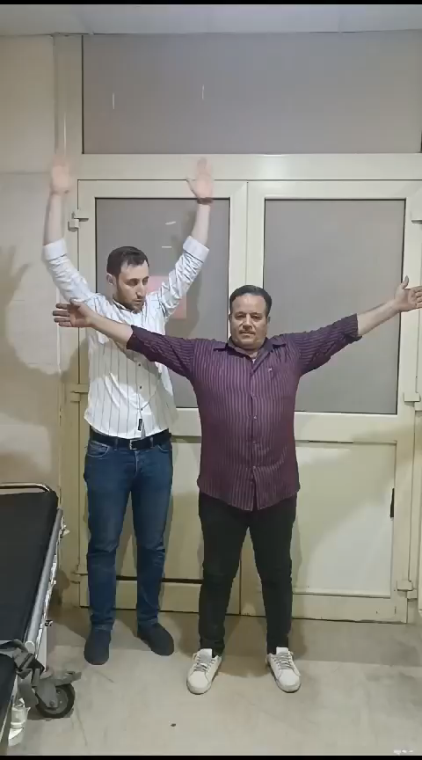
ACTIVE FREE

Slide 28
PROF. DR. Mohammed El Halawany
THANKS FOR YOUR GREAT EFFORTS ,
I’M GREATFUL FOR YOUR ASSISTANCE.
AND THANKS ALL FOR YOUR LISTENING.

