Slide 1
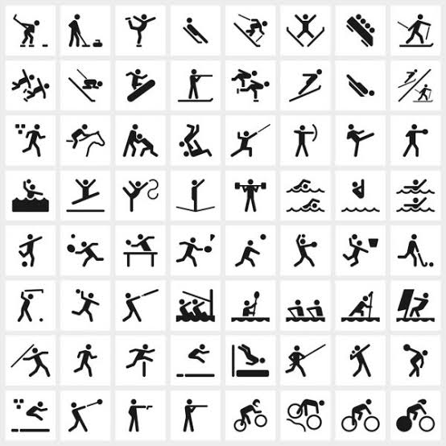

Long thoracic Nerve Release
Prof Mohamed M Kotb
Assiut University

Slide 2
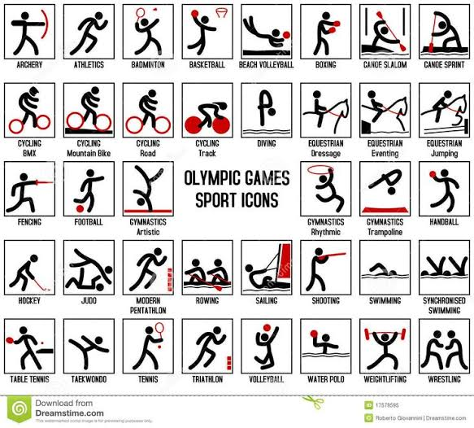

Slide 4
Introduction
Traetment Algorythm
Case resentation

Slide 5
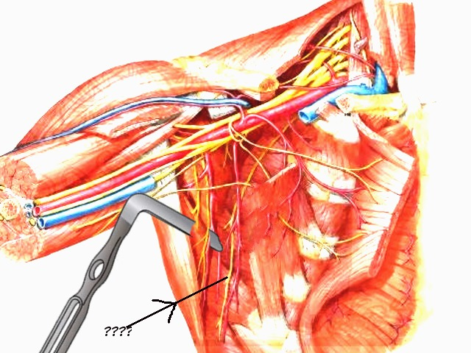
Anatomy
External respiratory nerve of Bell
C5,6,7
Travels to the level of the eighth or ninth rib
Serratus anterior
Winging of the scapula

Slide 6
Aetiology (Non surgical)
Compression from a cast, use of crutches, anesthesia, or Saturday night palsy
Heavy load bearing;
Compression from the middle scalene muscle,
Fascial sheath, or second rib; entrapment within the middle or posterior scalene muscles; and
Nerve traction caused by
  athletics,
  overuse as in unaccustomed household or gardening activities such as digging,
  compression by shoulder straps of heavy backpacks, and
  rarely from chiropractic manipulation

Slide 7
Aetiology (Surgical)
Radical mastectomy,
Transthoracic sympathectomy,
Transaxillary thoracotomy,
Misplaced intercostal drains,
Video thoracoscopy port insertion,
Axillary lymph node dissections,
Chest tube placements, and
Resection of the first rib, increase the risk for proximal injury of the long thoracic nerve

Slide 8
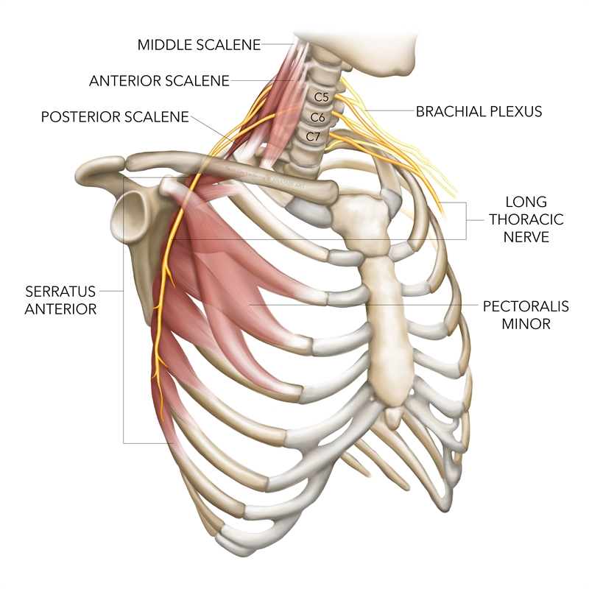
Treatment
Repetitive activity or carrying of heavy loads are incomplete and generally resolve spontaneously in 6 to 24 months
Surgical neurolysis
Nerve transfer utilizing the thoracodorsal or medial pectoral nerves

Slide 9
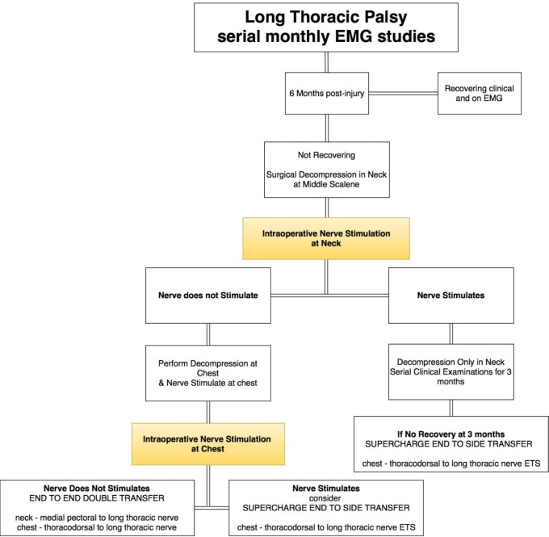

Slide 10
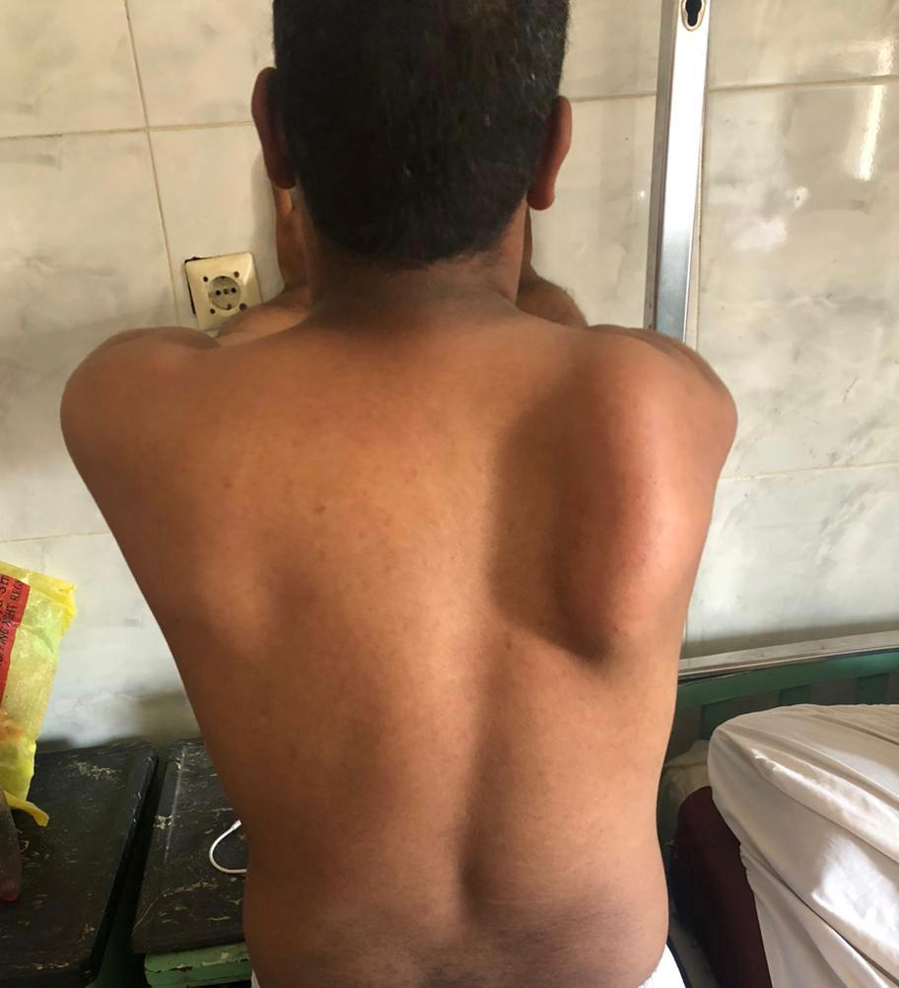
Case
Male, 24vyrs old
Labourer
6 months post sterenious work of loading haevy materials
O/E Winged scapula
Tender suprascapular portion of brachial plexus
+ve Tinnels suprascapular
No other motor or sensory affection
No response to conservative

Slide 11
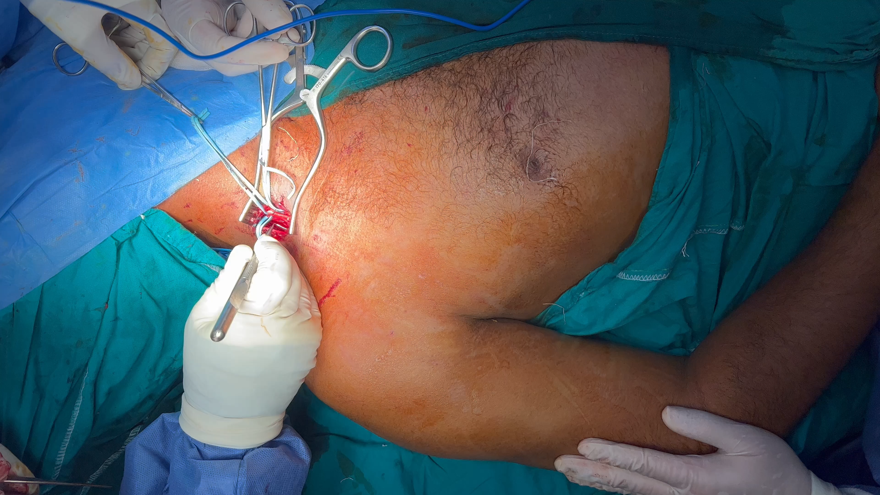
Supraclavicular exploration

Slide 12
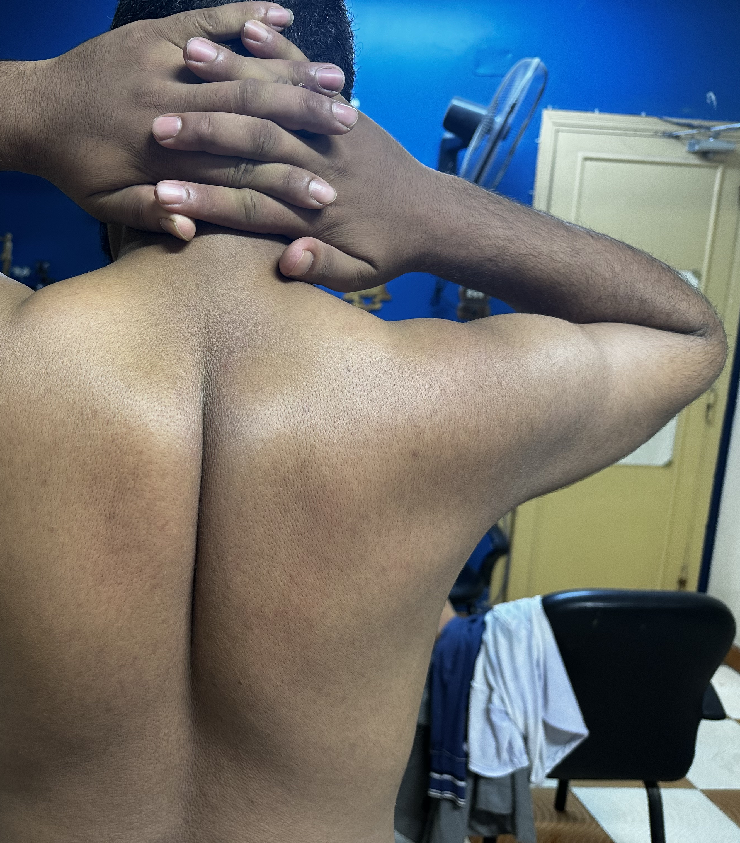
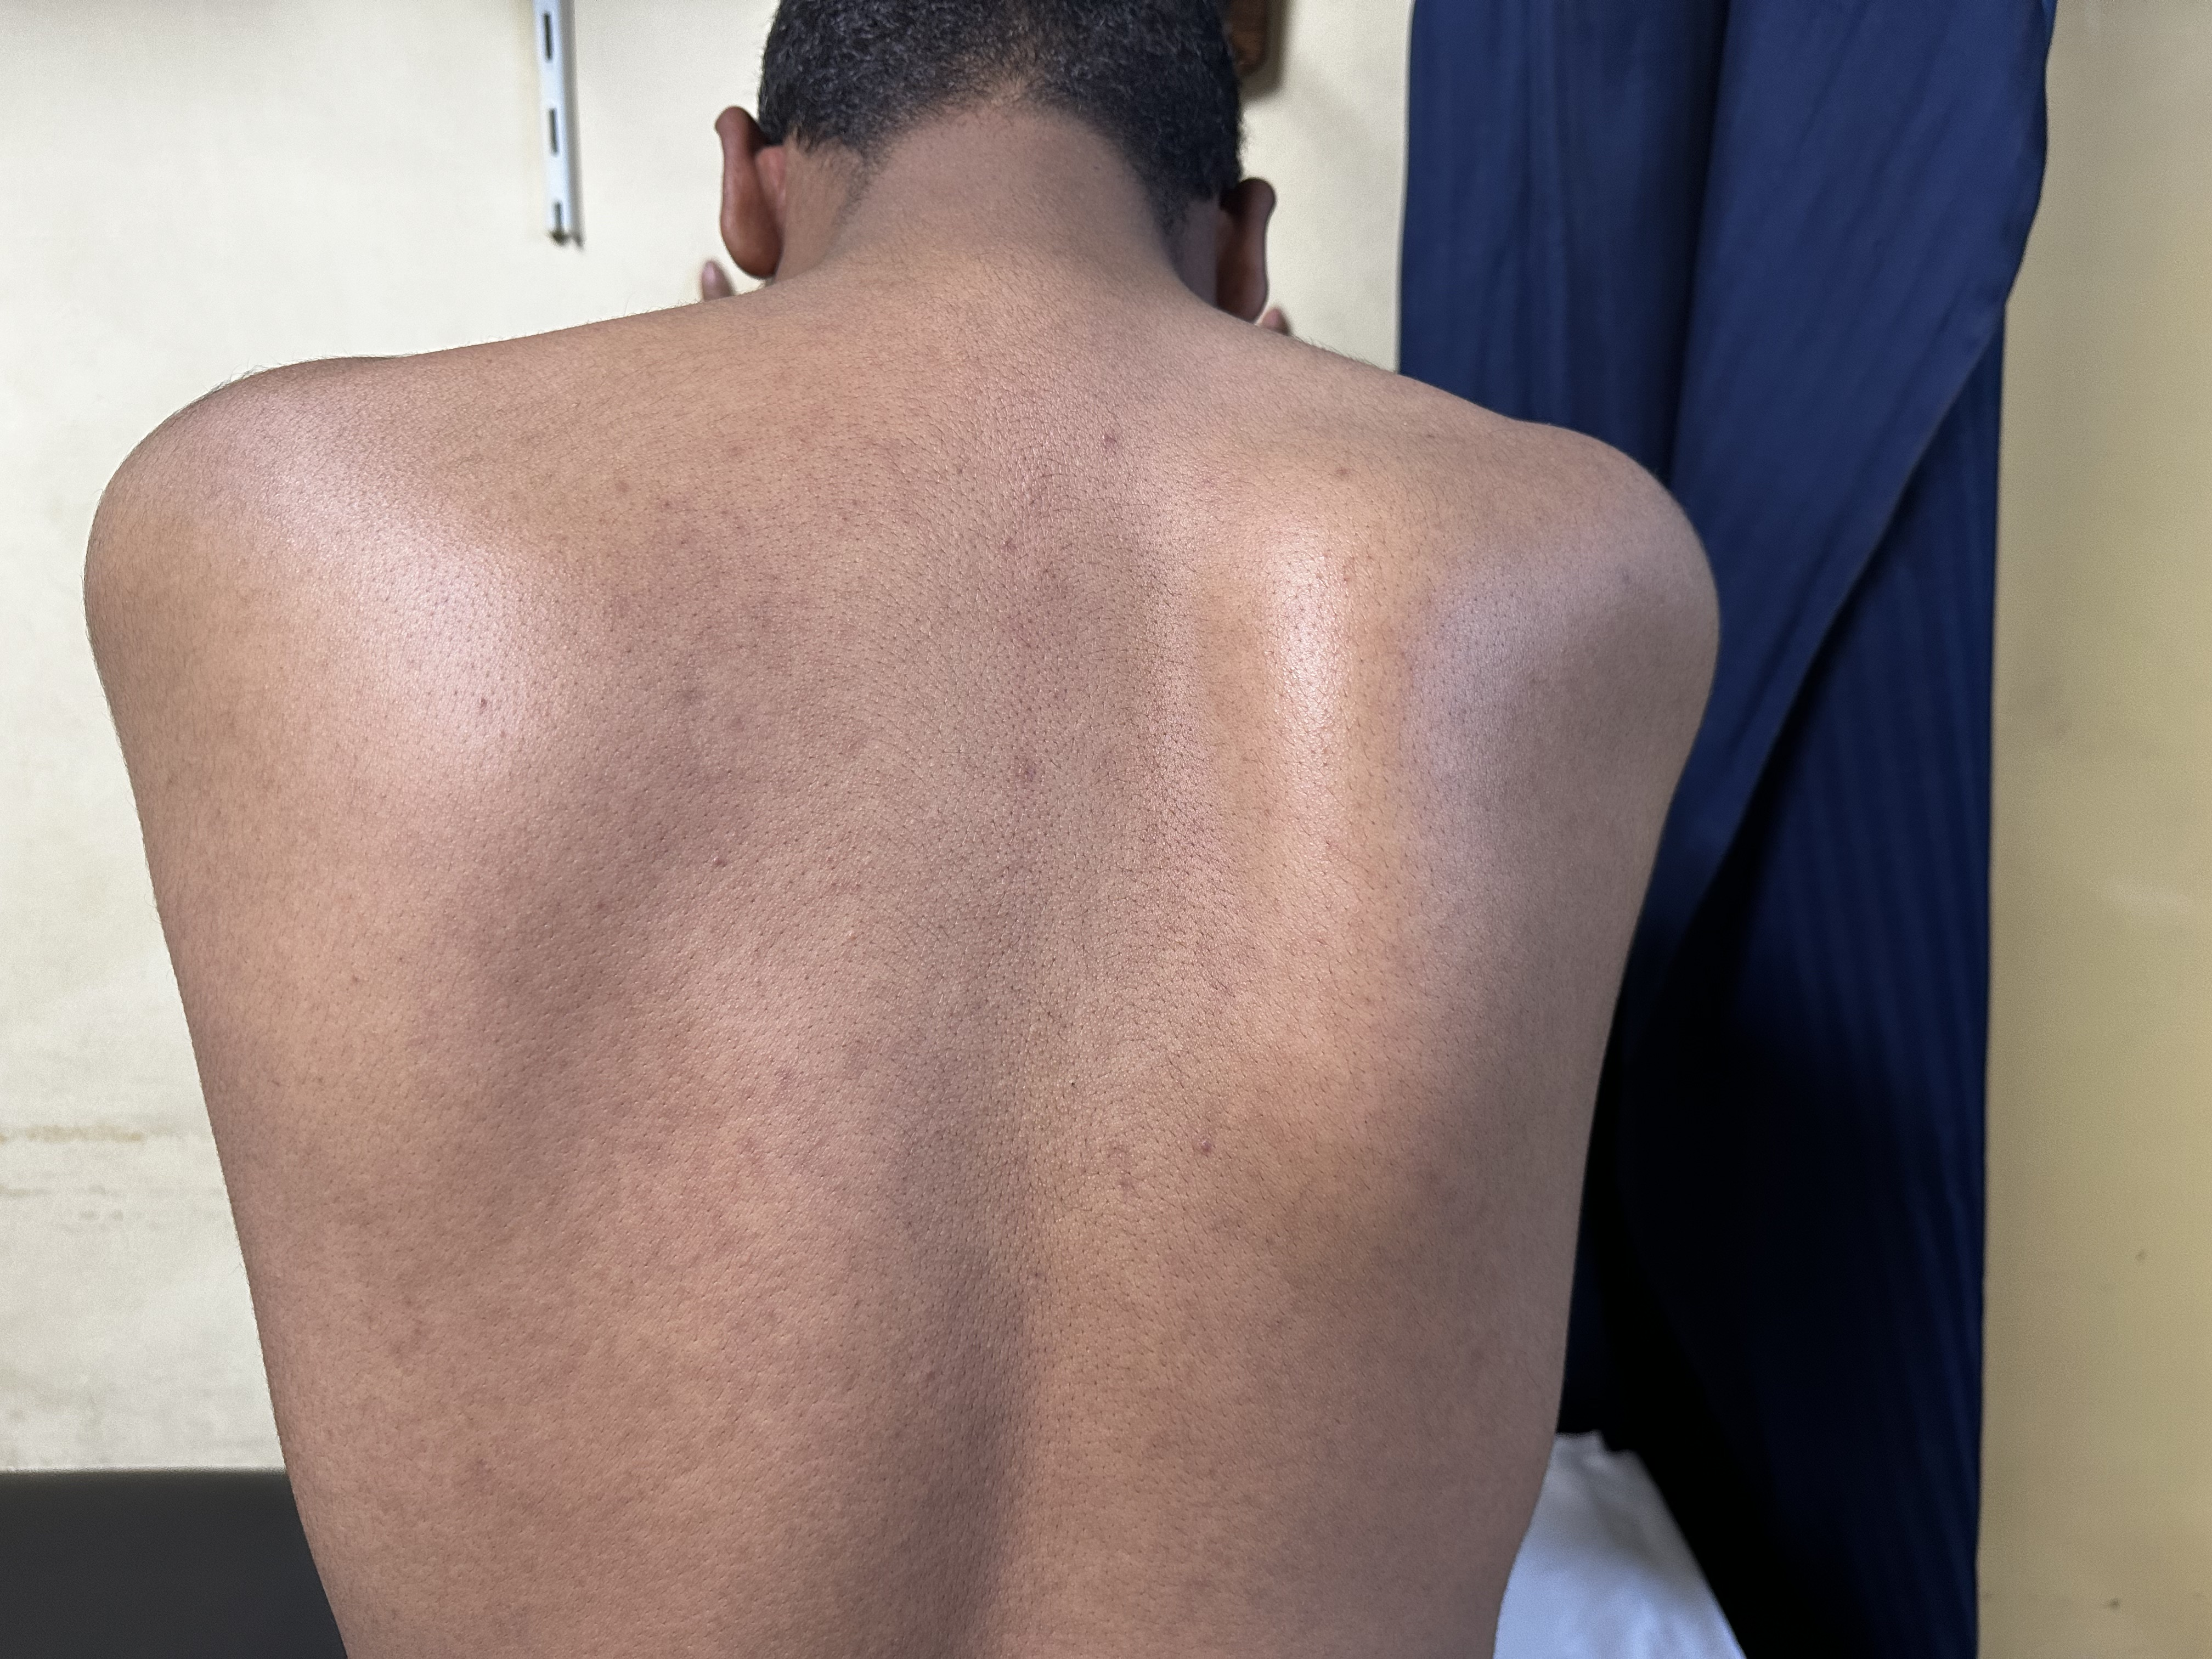
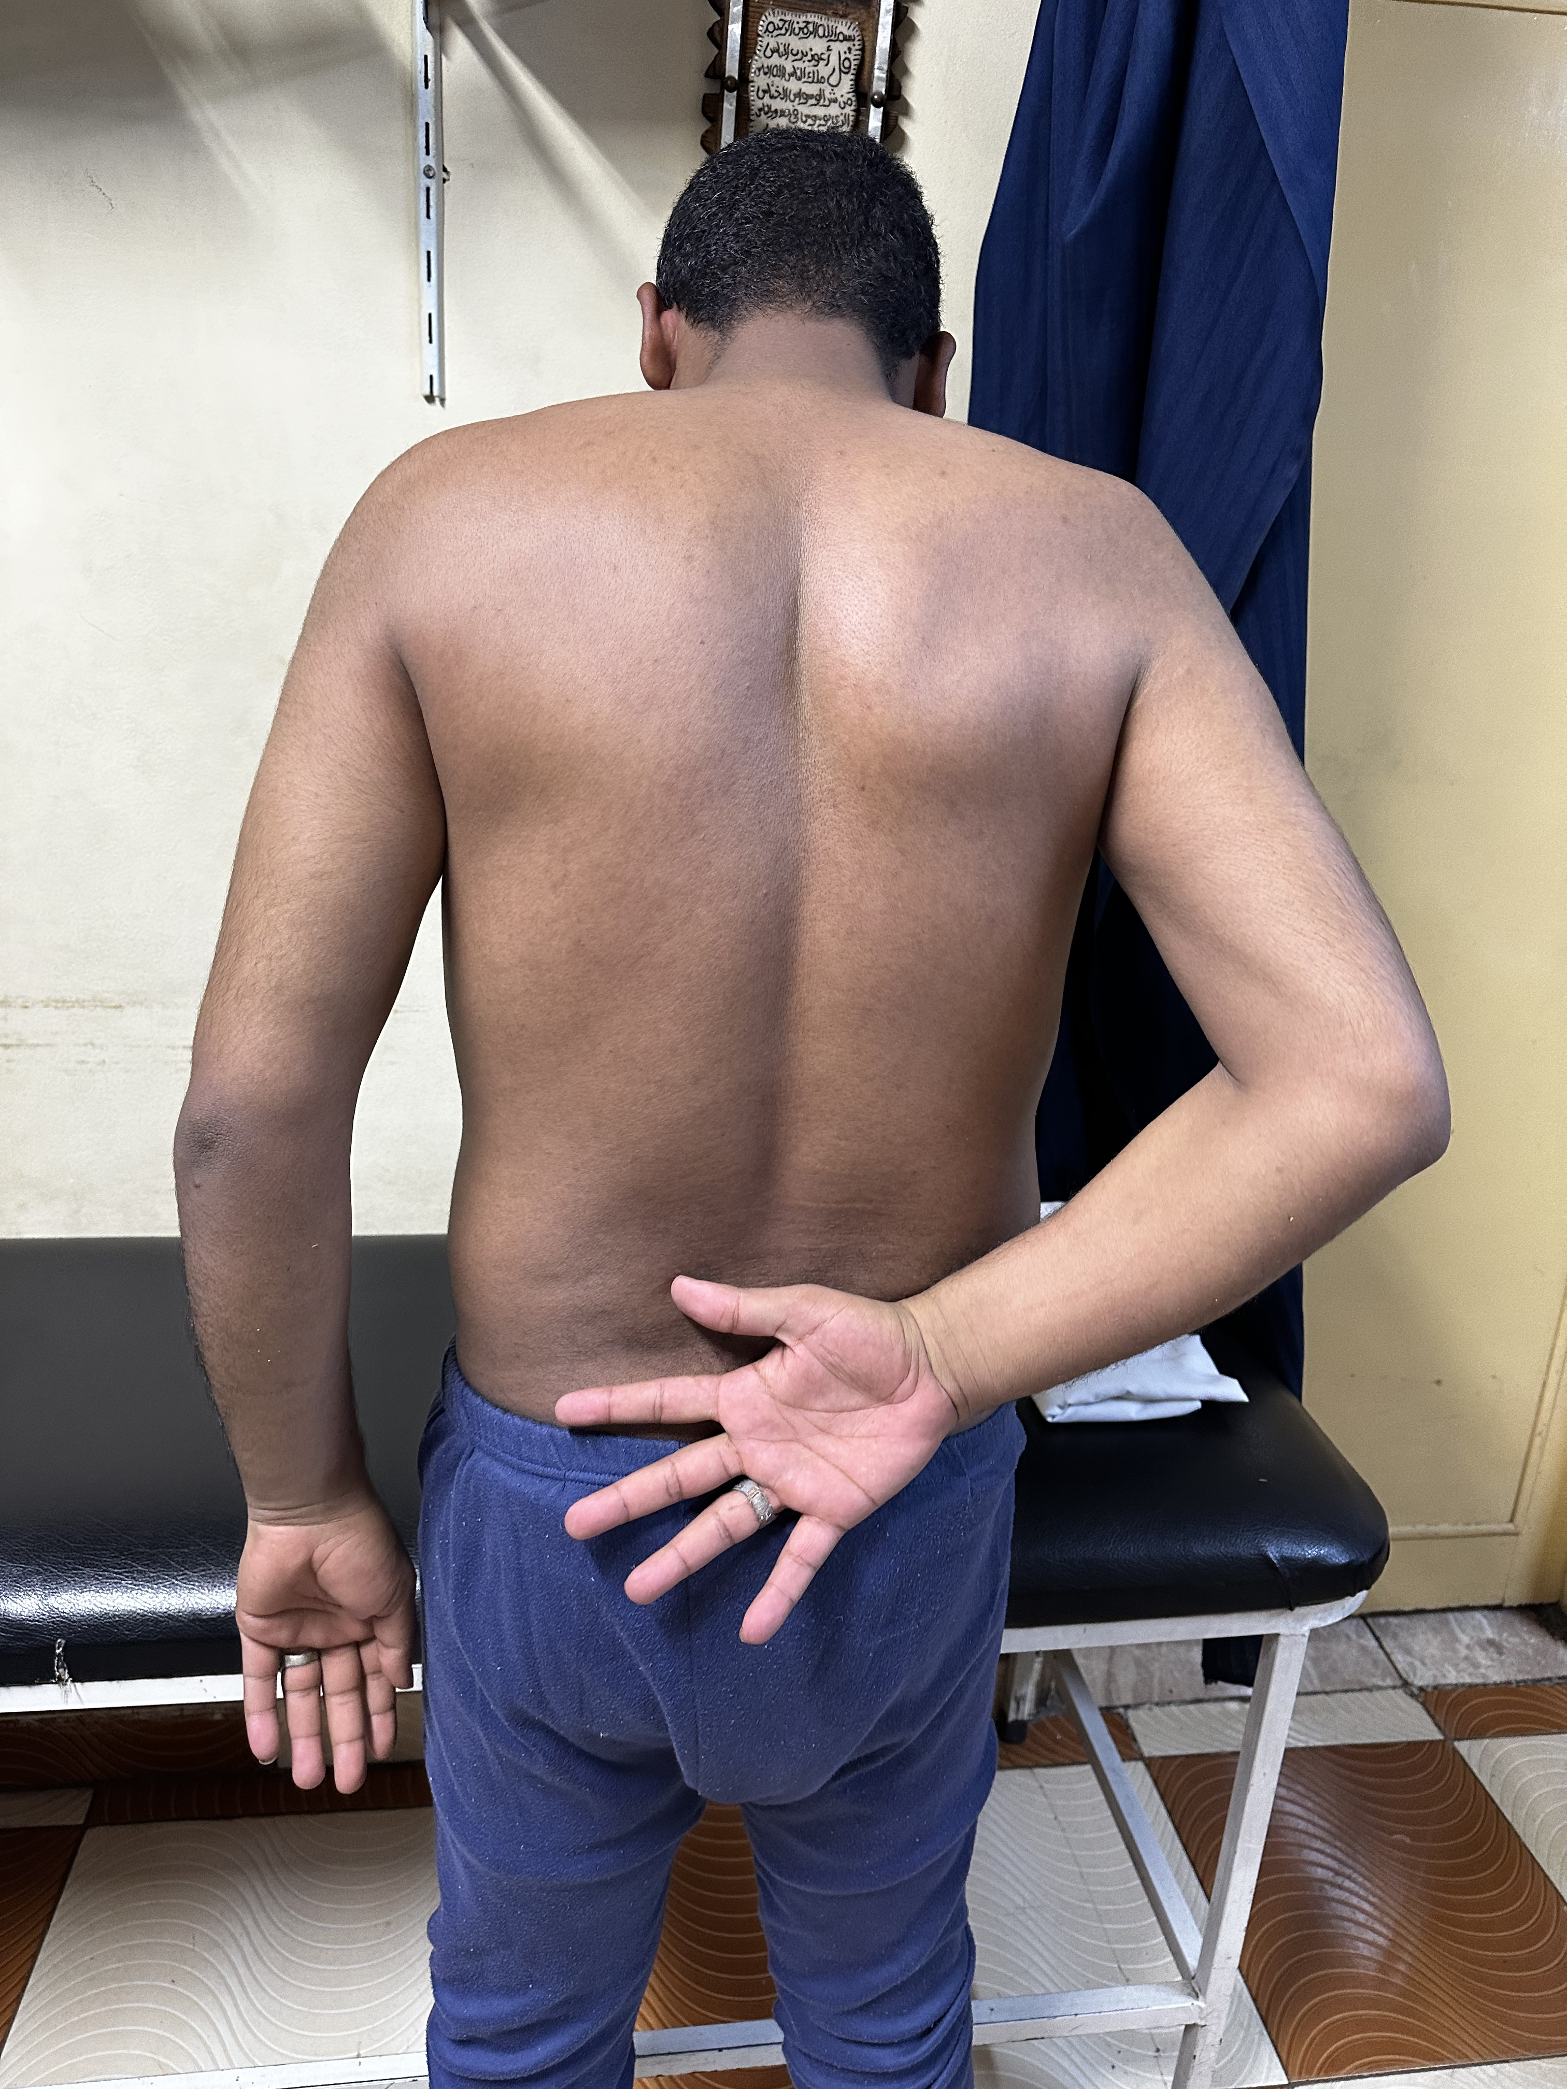
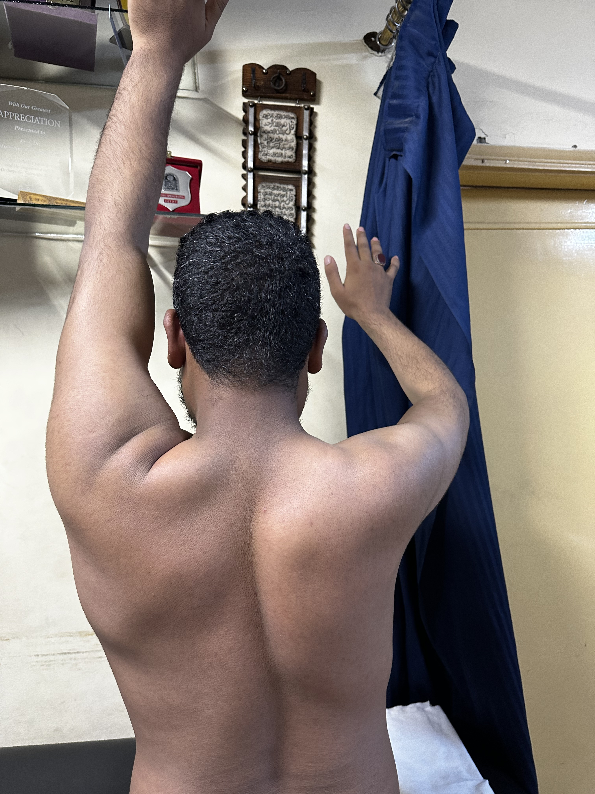
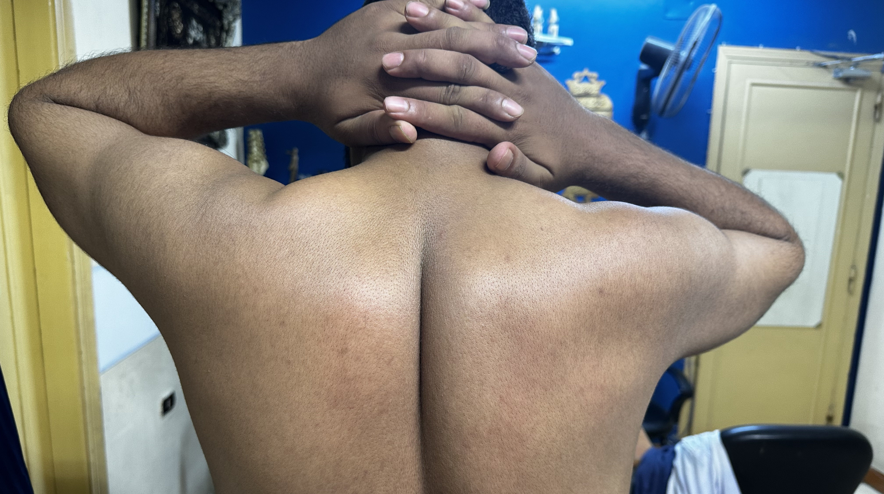
2 months post op

Slide 14
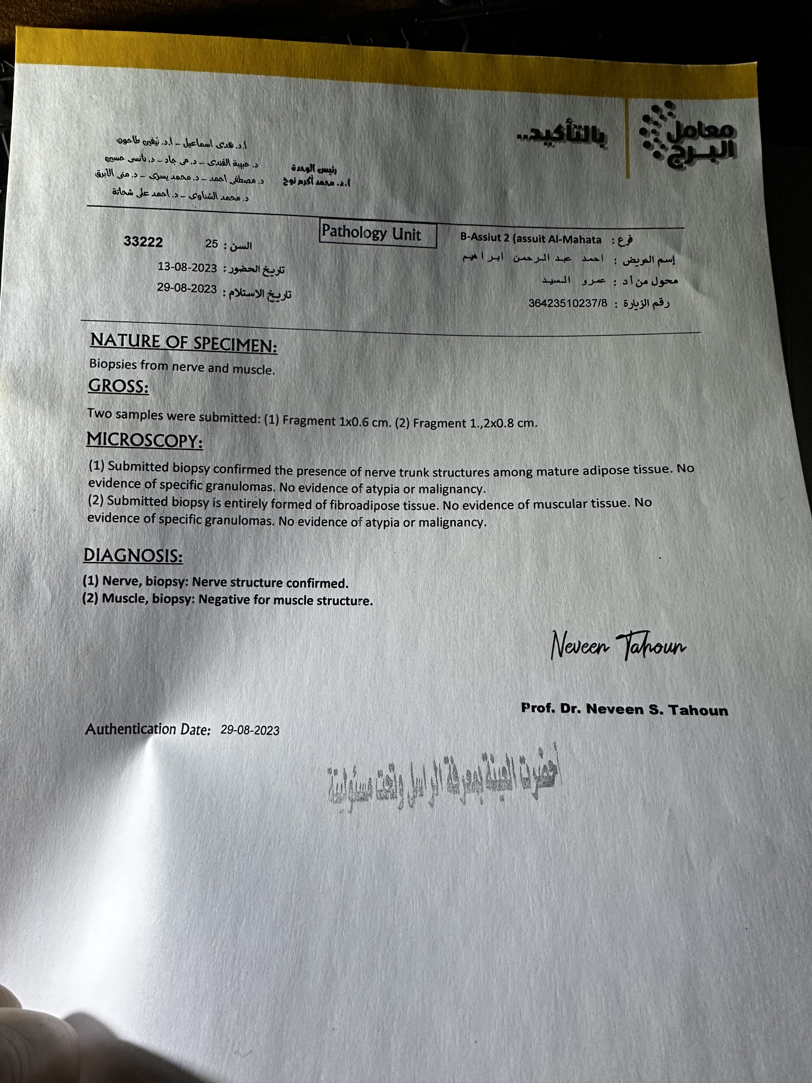

Slide 15
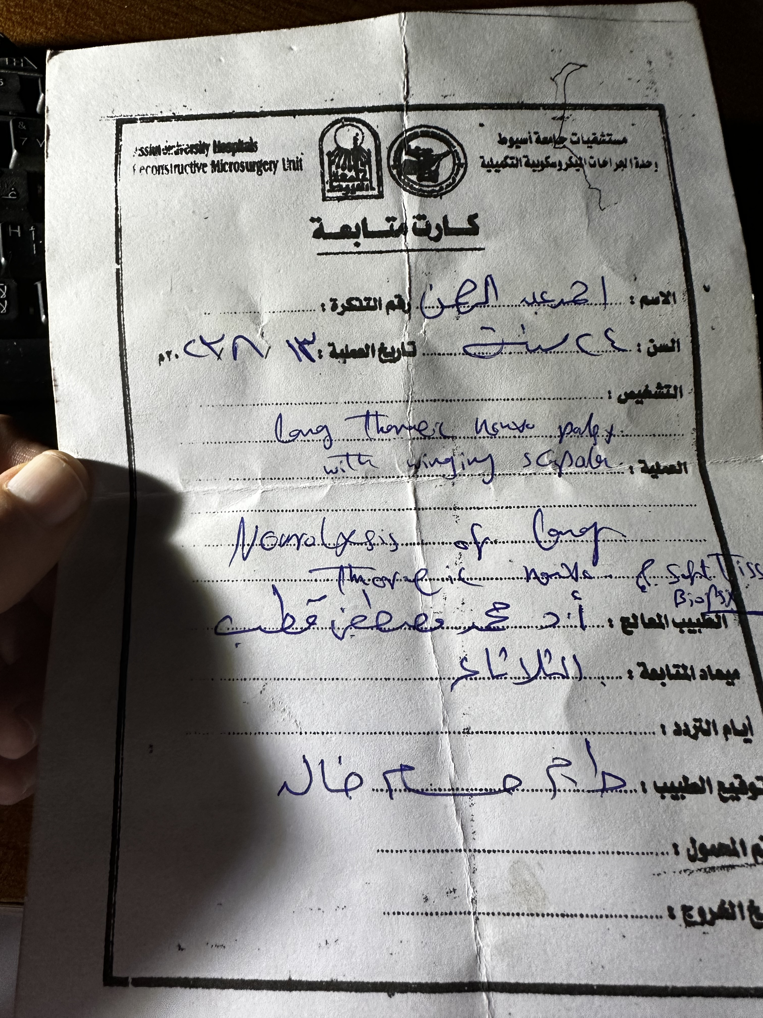

Slide 16




