Slide 1
Importance of Scapular stabilizers for a happy shoulder
Kholoud Hassan
Senior Physiotherapist At Kaser Al-Ainy Hospitals

Slide 2
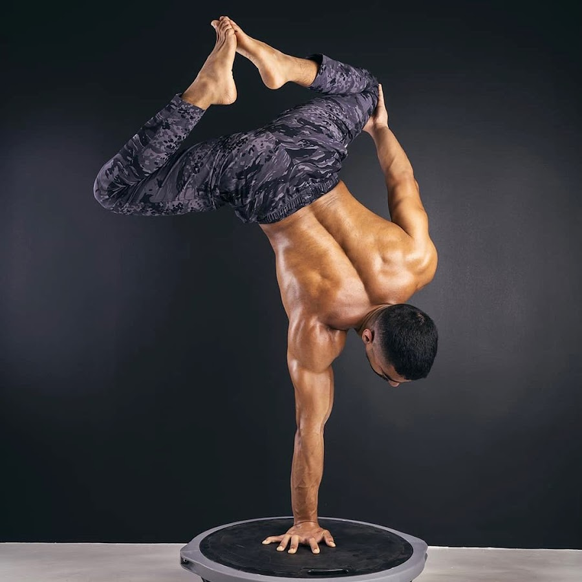
What Is A HAPPY SHOULDER?
NOTE:
To change images on this slide, select a picture and delete it. Then click the Insert Picture icon
in the placeholder to insert your own image.
It depends, my happy shoulder may not be yours
Ibrahim Alshaeri

Slide 3
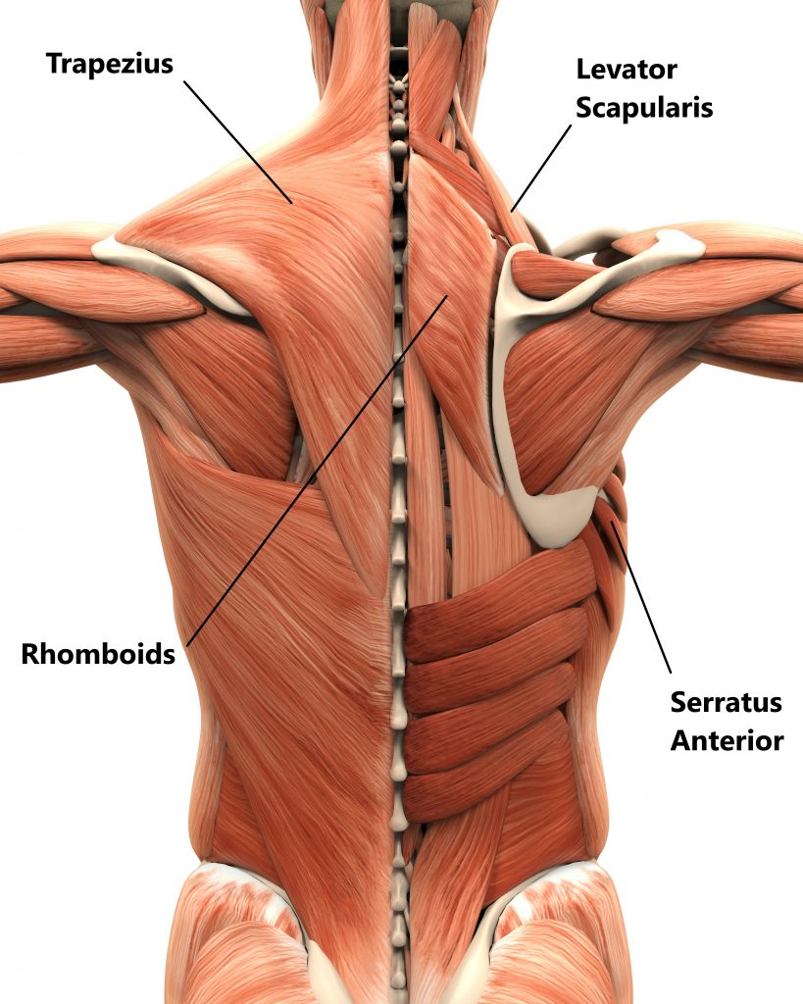
Scapular Stabilizers
17 Different Muscle attachment
The main stabilizers are:
Serratus anterior
Levator scapulae
Rhomboids
Trapezius

Slide 4
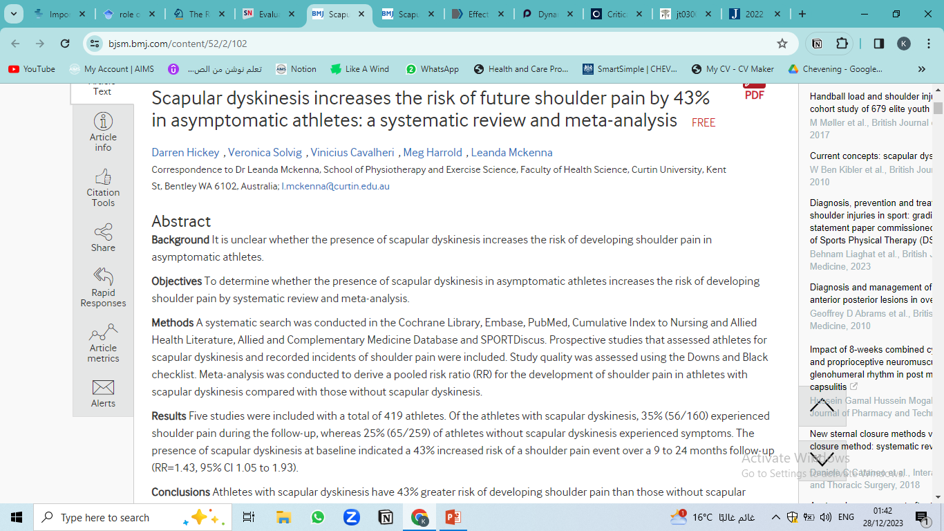
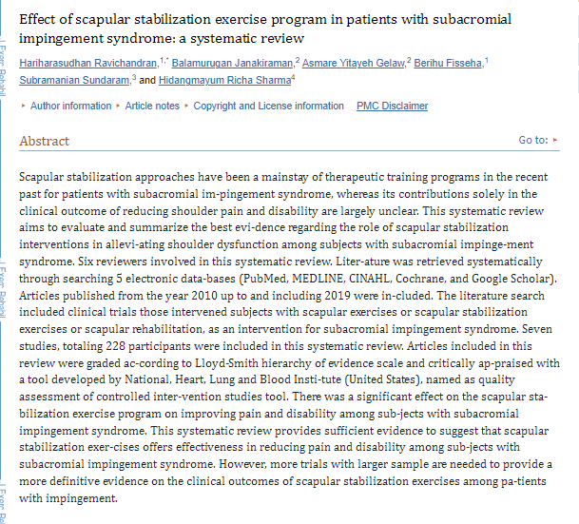
Supporting Evidence in Athletes and Non-Athletic individuals
2018
2020
BJM

Slide 5
Scapular muscle weakness or imbalance in overhead athletes has been shown to negatively affect the muscle's performance as well as neuromuscular control.
RCTs in swimmers and handball athletes have demonstrated that a shoulder injury prevention program using a combination of (rotator cuff strength, scapular stability, kinetic chain mobility) can be effective in reducing the incidence of shoulder pain.
Long term effects show that scapular stability and rehab program positively influence performance levels and throwing speed
Is Scapular Stabilization Exercise Effective for Managing Nonspecific Chronic Neck Pain?: A Systematic Review in 2020
SSE improved pain and dysfunction in patients with nonspecific chronic NP

Slide 6
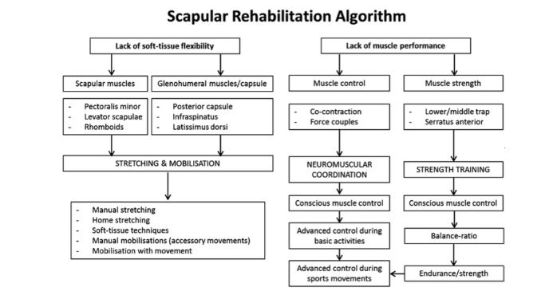

Slide 7
3 Phases of Stabilization Exercises:
Phase 1: Conscious muscle control.
In this phase the patient is learning to orientate their scapula.
The clinician palpates the coracoid process and asks the patient to move their shoulder blade away from their finger
in a backwards movement. This is combined with postural correction of the cervical and thoracic spine.
Phase 2: Muscle control & strength necessary for daily activity.
Phase 3: Advanced control during sporting activities.

Slide 8

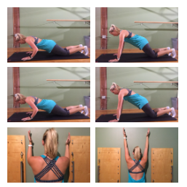
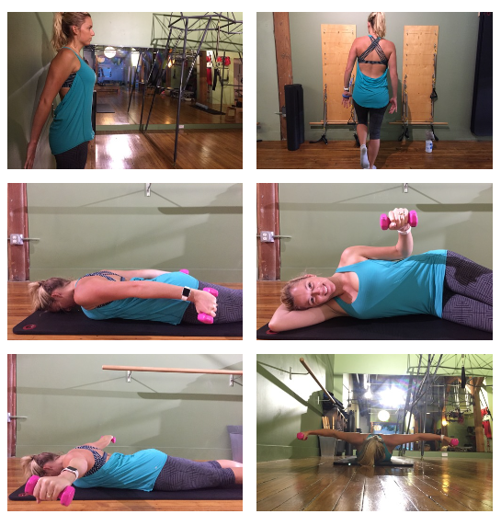

Slide 9
Prevention is better than Care all athletes should receive injury prevention exercise programs, irrespective of whether or not they have a history of shoulder injury.
Screening is not always accurate
There is an absence of evidence to support screening for predicting which athletes will suffer a shoulder injury. Screening for scapular dyskinesia in athletes without shoulder symptoms may provide little to no value. Dyskinesia is present in 53% of healthy people and 61% of overhead athletes. be sport Specific in your training and address the athletes demands
(number of throws, playing position, type of training, and intensity of training all affects the shoulder
It is normal to admin conflicting evidence in one topic
Our Happy Shoulder is Different
Take Home Message

Slide 11

Any Questions?
Scan ME
Scan ME
2022 Bern Consensus Statement on Shoulder Injury Prevention, Rehabilitation, and Return to Sport for Athletes at All Participation Levels

Slide 12
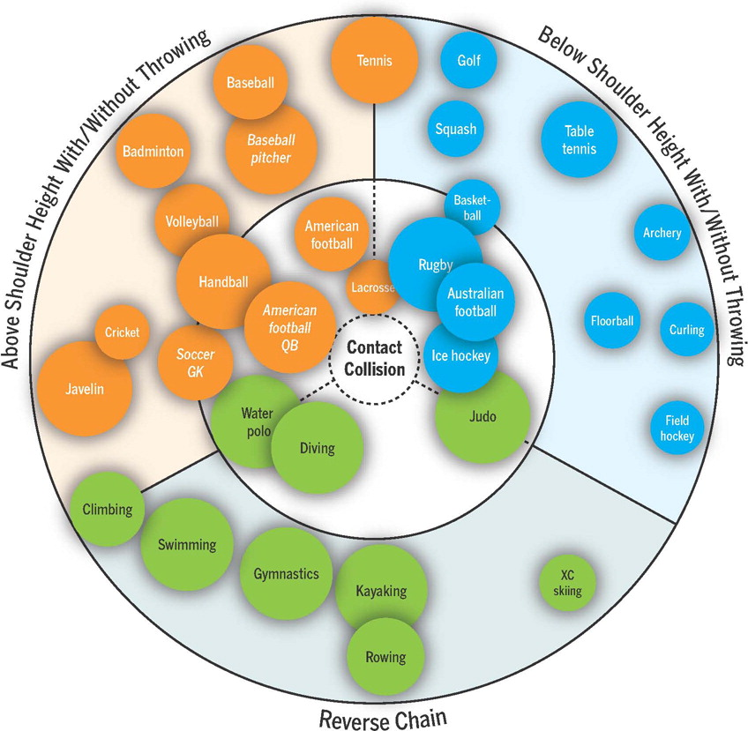

Slide 13
Why Scapular Stabilizers are Important?
Poor scapula stabilizer strength has been linked to
increased risk of rotator cuff compression
decreased neuromuscular performance of the shoulder
increased stress to the anterior shoulder capsule
We need a strong and stable Scapula for:
To Maintain the dynamic stability with controlled mobility at the glenohumeral joint
Overhead throwing motions

