Slide 1
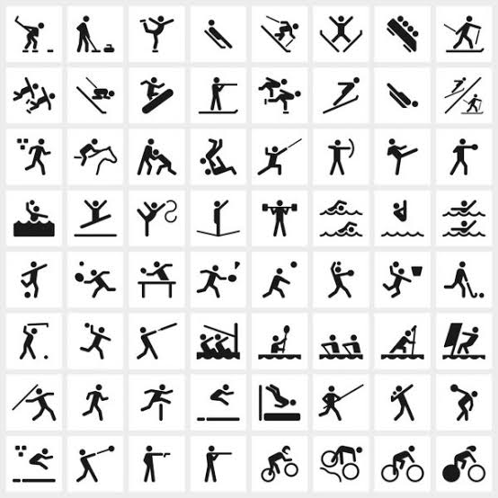

Axillary Nerve Injuries;
Treatment Options
Prof Mohamed M Kotb
Assiut University

Slide 2
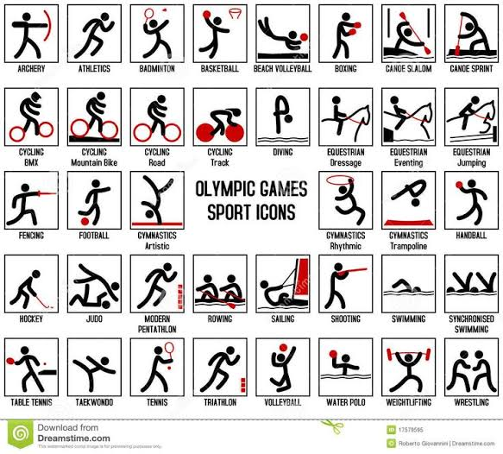

Slide 3
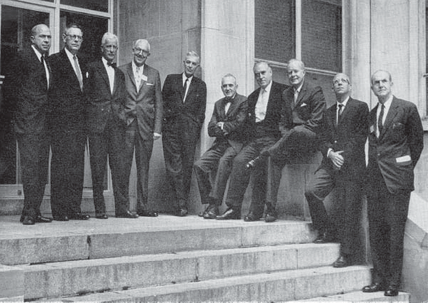
The first Symposium on Surgery of the Shoulder Region was held in Montreal in 1963,
The faculty of the Symposium on
Surgery of the Shoulder Region held in
Montreal in 1963. Left to right:
Charles S.Neer, II, M.D.;
Thomas B. Quigley, M.D.;
Professor R. Merle d’Aubigne;
Julius S. Neviaser, M.D.;
Harrison L. McLaughlin, M.D.;
Alexander P. Aitken, M.D.;
H. Fred Moseley, D.M.;
James E. Bateman, M.D.;
Anthony F. DePalma, M.D.; and
Carter R. Rowe, M.D.
Absent:
Ernest Gardner, M.D. and
John V. Basmajian, M.D.
(Reproduced by permission from Surg Clin N Am 1963;43:1462. WB Saunders Company/Elsevier)

Slide 4
Objectives
Introduction
Relevant Anatomy
Incidence
Iatrogenic nerve injuries
Types of injuries
Prognosis
Surgical management

Slide 5
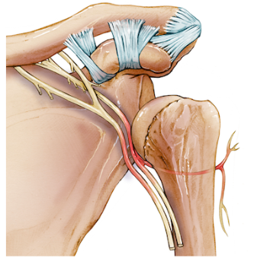
Introduction
Most common peripheral nerve injury of the shoulder
Commonly arises from
glenohumeral joint dislocation,
humerus fracture, or
direct trauma to the deltoid muscle.
Mostly part of a combined brachial plexus injury

Slide 6
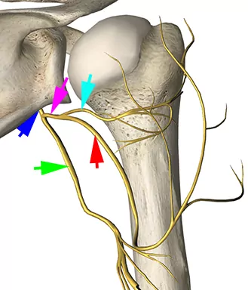
Axillary (C5,6)
Anterior branch
  Anterior and medial portions of the deltoid
  +/- posterior portion
  No cutaneous sensory branch.
The larger posterior branch
  posterior deltoid and
  teres minor.
  superior lateral brachial cutaneous nerve, innervating the skin of the proximal lateral arm

Slide 7
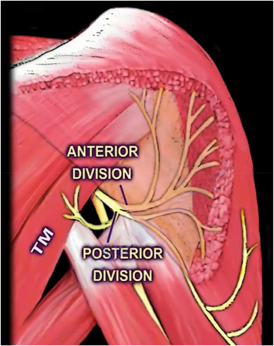
Axillary (C5,6)
Anterior branch
  Anterior and medial portions of the deltoid
  +/- posterior portion
  No cutaneous sensory branch.
The larger posterior branch
  posterior deltoid and
  teres minor.
  superior lateral brachial cutaneous nerve, innervating the skin of the proximal lateral arm

Slide 8
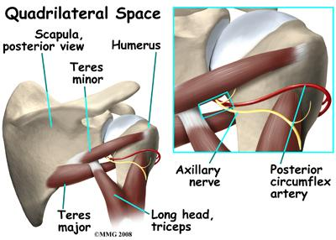
Axillary (C5,6)
Relative fixation points at
Posterior cord of the brachial plexus,
Quadrilateral space, and
as it enters the deltoid muscle.
+ short length, → vulnerable to stretch particularly during shoulder dislocation

Slide 9
INCIDENCE
Anterior and inferior shoulder dislocations
Over 50 years of age.
Associated with a proximal humerus fracture or
Unreduced dislocation over 12 hours.
Over head activities (Squash, weight lifting, Rugby, Weightlifting, Wrestling
Iatrogenic (ORIF proximal humerus, Shoulder replacement)

Slide 10
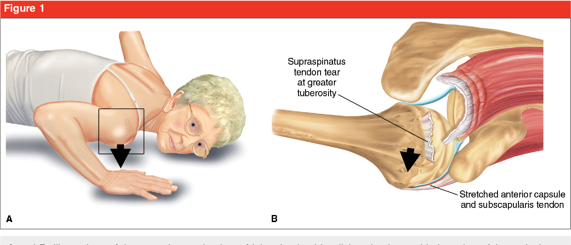
Terrible Shoulder
Triad
Tetrad
Traumatic anterior shoulder dislocation,
Rotator cuff tears or displaced humeral greater tuberosity fracture,
Brachial plexus injury (Axillary, SSN)
Traumatic anterior shoulder dislocation,
Rotator cuff tears or displaced humeral greater tuberosity fracture,
Brachial plexus injury (Axillary, SSN)
Large glenoid rim defeciency

Slide 11
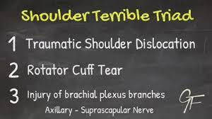

Slide 12

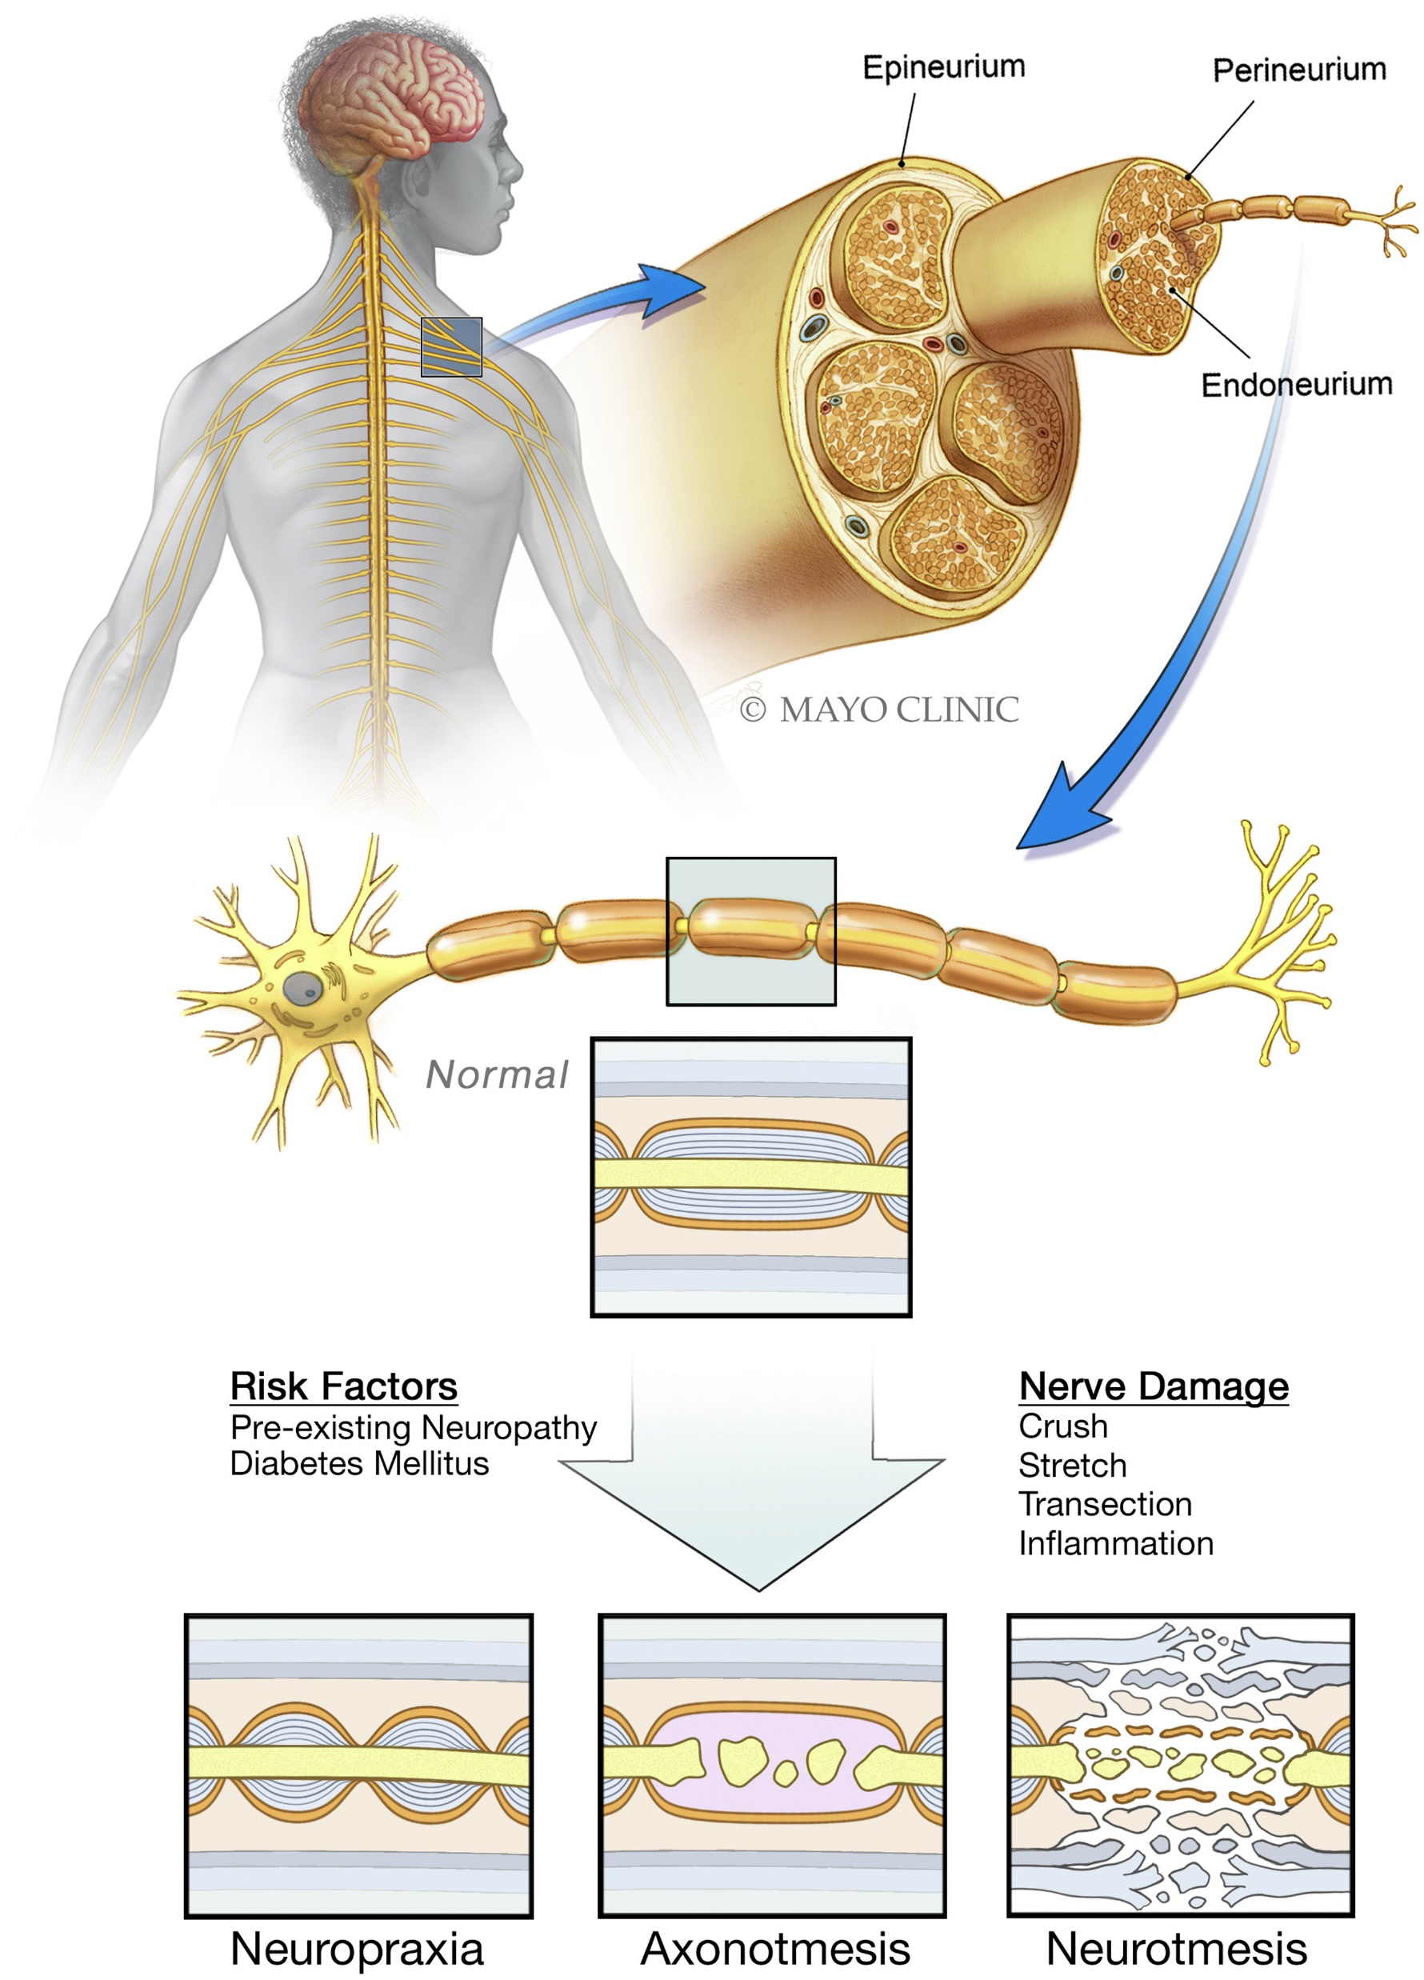
Iatrogenic peripheral nerve injuries from orthopedic surgery can occur via many scenarios, including :
Direct injury to the nerve during surgery,
Indirect injury via retraction or compartment syndrome, and
Injury from nonsurgical treatments such as injections and splinting
J Am Acad Orthop Surg 2019;27: e838-e848

Slide 13

Characteristics
Iatrogenic neuropathy, however,
has more psychological complications,
because the recognition of nerve injury is often missed or belated.
The onset of neuropathic pain can be delayed for
days, weeks or, rarely, months.
Doctor and patient may erroneously attribute early onset neuropathic pain to the expected “normal” post-operative pain. The operation was technically successful and there were no infections or other obvious complications.
Delayed recognition may also be the consequence of immobilization by postoperative cast, bed rest, reduced activity or sedation due to anesthetic or analgesic medication.
Iatrogenic Causes of Neuropathy Encyclopedia of Pain pp 949–951

Slide 14
Symptoms
Painful iatrogenic neuropathy often originates from injury confined to a sensory nerve, without evidence of muscle wasting and weakness.
Occasionally, the nerve injury is the consequence of progressive entrapment in the surgical scar. Such entrapment, unlike anatomical entrapment syndromes, is rarely focal, usually being more homogeneously distributed along the scar.
The clinical equivalence is that the positive symptoms of pain, paresthesia and dysesthesia may appear without striking negative phenomena (hypo-anesthesia).
Iatrogenic Causes of Neuropathy Encyclopedia of Pain pp 949–951

Slide 15
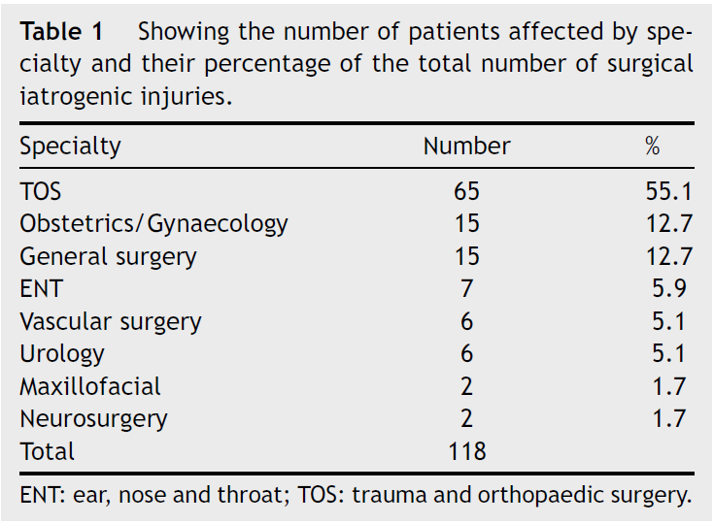
Iatrogenic PNI: by specialty
Revista Espaٌola de Cirugيa Ortopédica y Traumatologيa 65 (2021) 264---271

Slide 16
Iatrogenic PNI: by specialty
Orthopedics 174
General surgery 70
Vascular surgery 11
Obs / Gynae 9
Plastic surgery 7
Cardiothoracic 5
ENT surgery 5
Anaesthetics 4
Neurosurgery 4
Maxillofacial surgery 2
Total 291

Slide 17
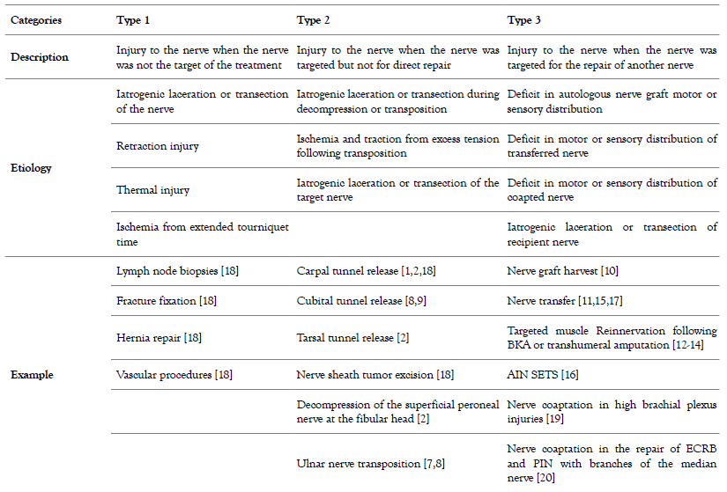
Iatrogenic Nerve Classification System and Possible Etiologies.
Biol Med (Aligarh), Vol.12 Iss.3 No:464

Slide 18
Iatrogenic Nerve Injuries
Drill-bits can penetrate or avulse nerves, especially when the course of the nerve runs unsighted behind the segment of bone being operated upon.
Wires can tether nerves reducing physiological glide.
Implants can impinge peripheral nerves.
Thermal injury may follow electrocautery and polymerization of bone cement.
Retraction of nerves, especially for prolonged periods, causes compression damage.
Sutures and bone fragments can cause nerve compression or tether.
Haematoma may compress nerves.
Nerves can be entrapped within fractures.
External fixation pins can cause direct injury.
Lengthening of bones by arthroplasty can cause stretch injury.
Dislocation for joint surgery or traction for fracture/dislocation reduction can cause nerve entrapment, compression or traction.
Positioning without thought to limb protection in theatre can cause stretch or compression injury.
Cutaneous nerves can be injured with arthroscopy portals and with skin incisions.
Nerve blocks can cause direct nerve trauma, compression, bleeding, intra-neural injection toxicity to nerve.
Spinal surgery can compromise nerve roots.

Slide 19
Common iatrogenic peripheral nerve injuries in orthopaedics
 | Nerve | Risk procedures | Risk-reduction techniques
UPPER LIMB | Brachial plexus (Predominantly C5/6 trunks, upper trunk, lateral cord, suprascapular, supraclavicular) | Clavicle fixation esp. delayed | Early reduction (< 48 hrs) of displaced clavicle fractures.²⁴
 | Axillary | Proximal humerus ORIF | Pass proximal humerus plate deep to axillary nerve to allow visualization above.²
 |  | Shoulder manipulation for dislocation | Assess fully for neurological deficit prior to reduction. Perform reduction within 12 hrs of injury.²⁵
 |  | Scapular ORIF | The use of inter-muscular windows in the Judet approach.²⁶
 |  | Shoulder stabilization
 | Radial | Humeral shaft ORIF | Exposure and protection of nerve throughout ORIF.² Variety of exposures provided by posterior approaches.
 |  | External fixation of humerus | Observe lateral fixation ‘safe zone’. Place pins less than 100 mm from lateral epicondyle and as posterior as possible.²⁷
 | Superficial sensory branch of radial | Distal radius ORIF | Avoid transverse incisions in the anatomical snuffbox between 2.5 and 3.9 cm from Lister’s tubercle.^{11,28}
 |  | DeQuervain’s release | Literature divided though most suggest longitudinal incision techniques safer.²⁹
 | Ulnar | K-wire fixation of supracondylar humerus fractures Elbow arthroscopy | Direct visualization of ulnar nerve during insertion and removal of K-wires/metalwork.²
 | Dorsal branch of ulnar nerve | Ulnar head fixation | Ulnar late placement between 10 and 12 o’clock on the right wrist and 12 and 2 o’clock on the left in relation to the ulnar styloid.³⁰
 |  | Wrist arthroscopy | Avoid setting 6U portal under traction with arm passively pronated.³¹
 | Median | K-wire fixation of supracondylar humerus fractures | Placement of medial wire through mini-medial approach.^{32,33}
 |  | Carpal tunnel release | Expertise knowledge of anatomy, normal variants and optimal skin incisions.¹
 | Palmar branch of median | Volar plate fixation of distal radius | Knowledge of relevant anatomy and variants. Careful placements of retractors.³⁴
 | Musculocutaneous | Latarjet procedure | A protocol to reduce peri-operative nerve stretch has been suggested.³⁵
 | Posterior inter-osseous | Proximal radius ORIF Biceps reattachment Elbow arthroscopy | Boyd approach by subperiosteal elevation of supinator protects the nerve.
LOWER LIMB | Sciatic | Total hip replacement (posterior approach) | Correct identification of high-risk (hip dysplasia, revisions) patients. Caution during joint manoeuvres to avoid excessive strain. Attention to drill-bit depth.
 | Femoral | Total hip replacement (anterior approach)
 | Common peroneal | Lateral meniscal repair Total Knee Replacement | Use inside techniques. Identify and protect nerves if outside assisted sutures required
 | Tibial | Total Knee Replacement
 | Infrapatellar br. of saphenous | Knee arthroscopy Hamstring tendon harvest | Oblique or transverse portal incisions with the knee in flexion.²
 | Superficial peroneal | Ankle arthroscopy | Attempt to palpate on passive flexion of 4th toe – identify for planning portal incisions.²
 |  | Distal fibula ORIF | Safe incision 12 mm posterior to anterolateral border of fibula at 100 mm proximal to the tip to 10 mm posterior to the anterolateral border at 5 cm proximal to the tip.³⁶
 | Sural | Percutaneous Achilles tendon repair | Cautious stab incisions and adequate exposure of nerve during procedure.³⁷
 |  | Calcaneus ORIF | Higher risk of injury if sinus tarsi approach used within 6 days of injury.³⁸
 | Medial dorsal cutaneous | Hallux valgus correction | A mid-medial incision at the junction of plantar and dorsal skin.³⁹

Slide 20
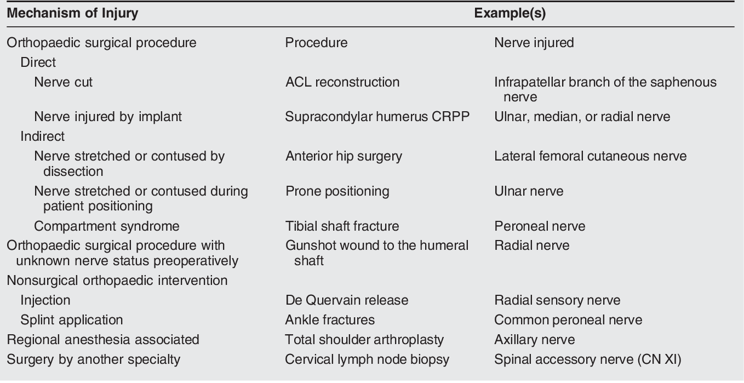
Common Causes of Iatrogenic Nerve Injuries
J Am Acad Orthop Surg 2019;27: e838-e848

Slide 22
The majority Neurapraxia or Axonotmesis,
Improve and demonstrate satisfactory functional recovery.
Neurapraxia should show full recovery within three months,
Low-grade axonotmesis should show indications of reinnervation within three months, and established recovery by six to seven months.
Deep muscle tenderness will often precede any electrophysiological evidence of muscle reinnervation,
PROGNOSIS FOR SPONTANEOUS NERVE RECOVERY
Shoulder dislocation
Direct Blow
Axillary nerve injury resulting from a to the anterolateral shoulder, however, has a less optimistic prognosis for recovery of nerve function.

Slide 23
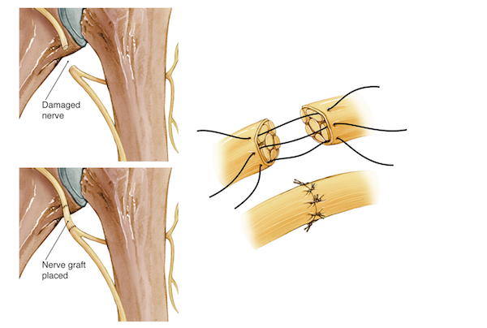
INDICATIONS AND TYPES OF SURGERY
According to recovery and nature of injury
Closed, no recovery 4–6 months after injury.
Neurolysis, neurorrhaphy, nerve grafting, and nerve transfer.
More than one year after injury muscle transfer
For axillary nerve neurotization using the triceps fascicles of the radial nerve,

Slide 24
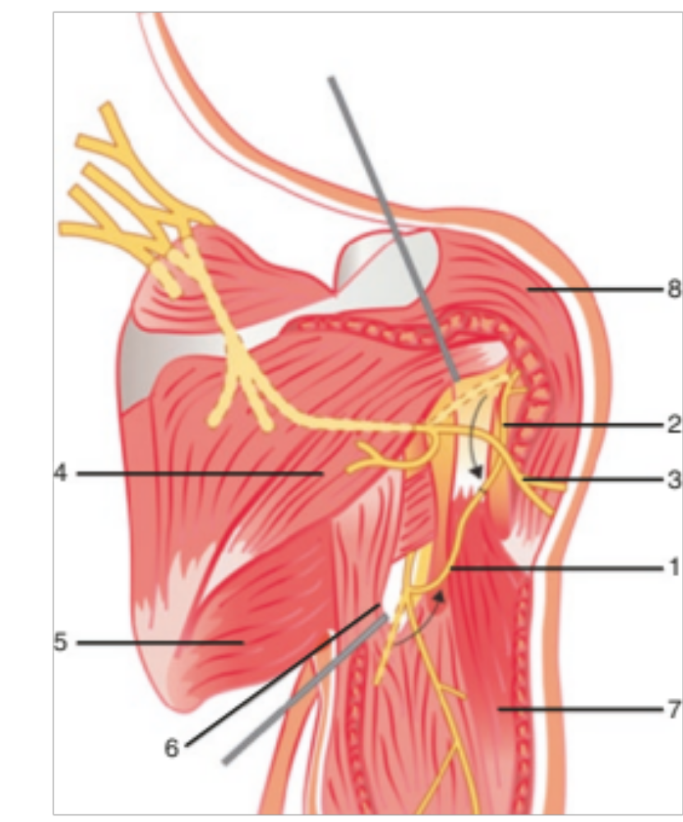
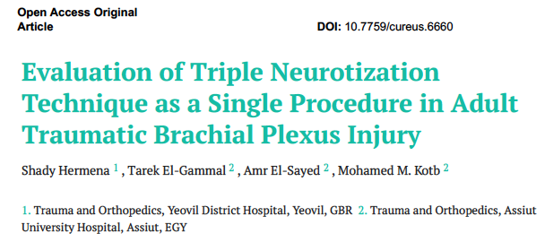

Slide 25
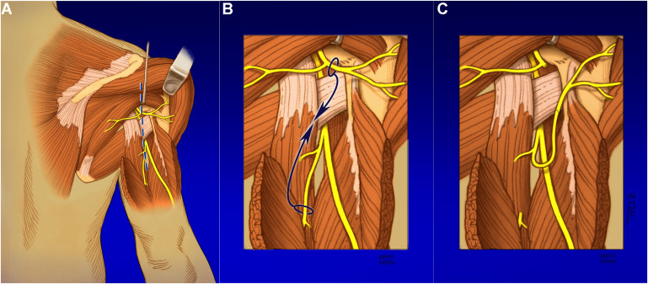
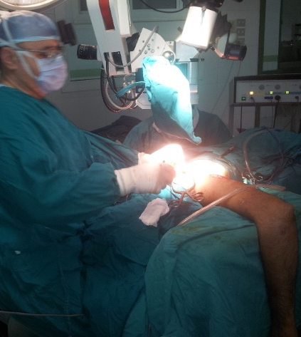
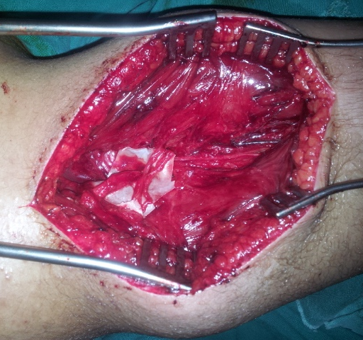
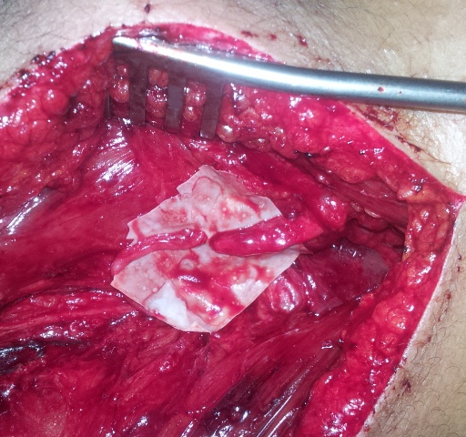
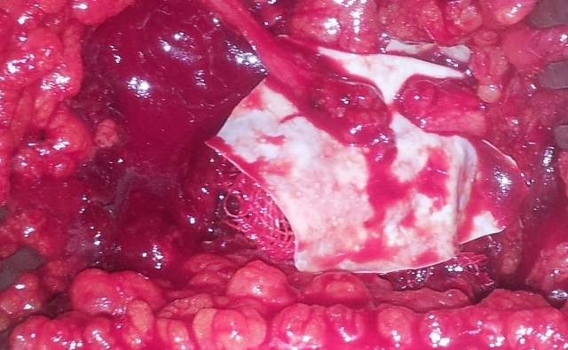

Slide 26
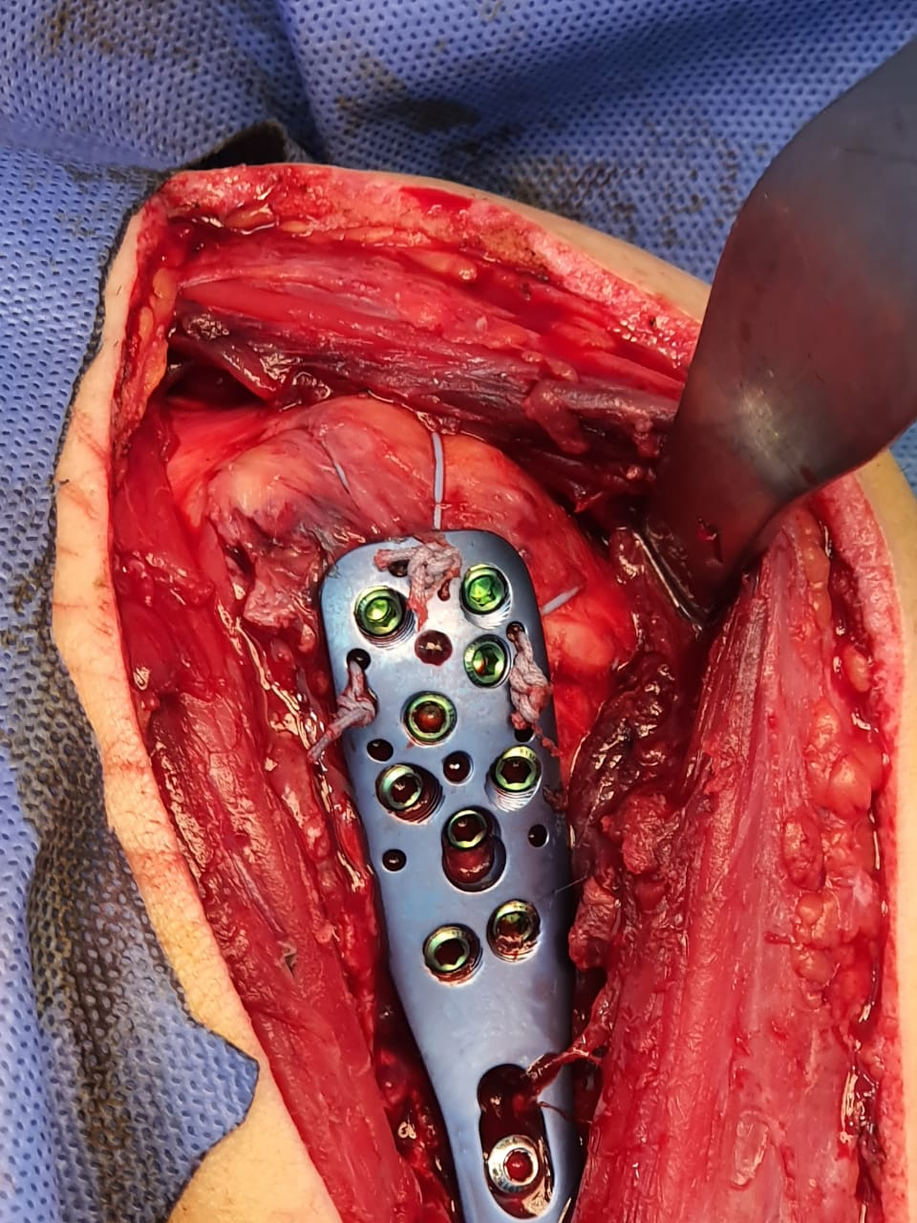
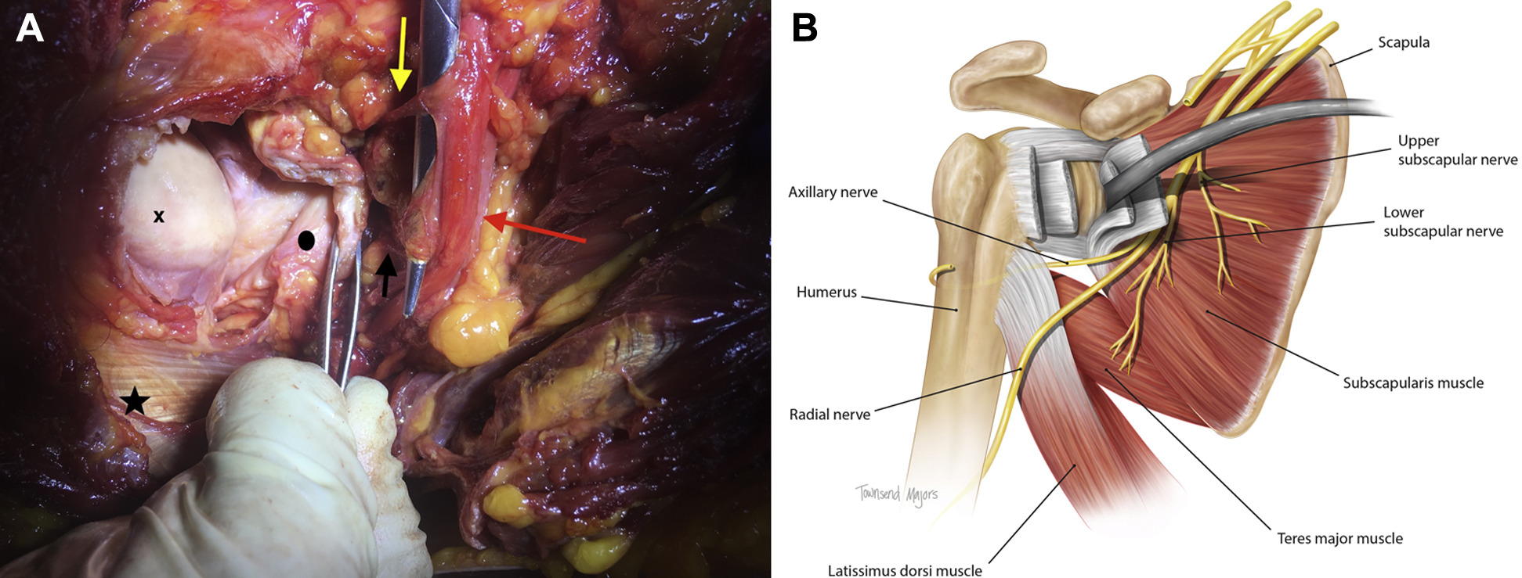
Iatrogenic Axillary Nerve Palsy

Slide 27
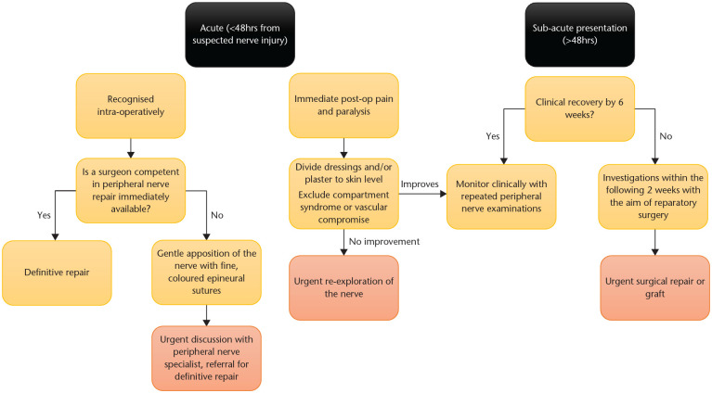

Slide 28
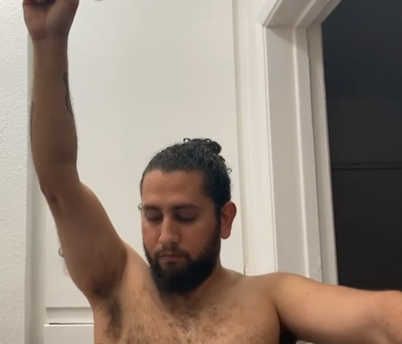
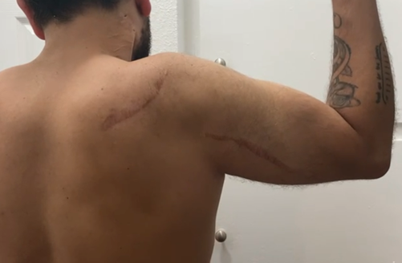
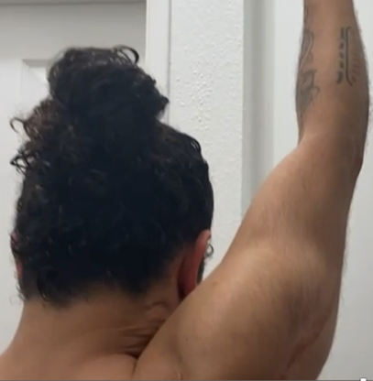
Results
A
B
C
A 20-year-old male with right upper trunk brachial plexus injury. Five months after injury, he had neurotization of both the suprascapular nerve and the anterior division of the axillary nerve using the spinal accessory nerve and the long head of triceps motor nerve, respectively. through posterior approach. Four years postoperative photographs show full external rotation (A), recovery of the deltoid muscle mass (B), and full abduction (C).

Slide 29
TENDON TRANSFER
Neglected cases (>1 year without any attempt for reconstruction)
Partial or complete failure of recovery after primary nerve reconstruction.

Slide 30
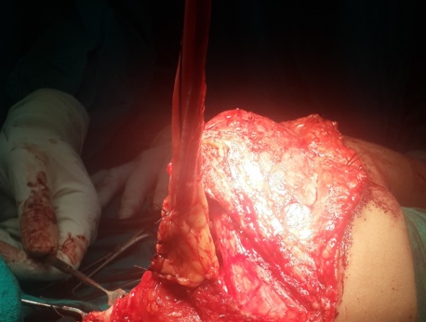
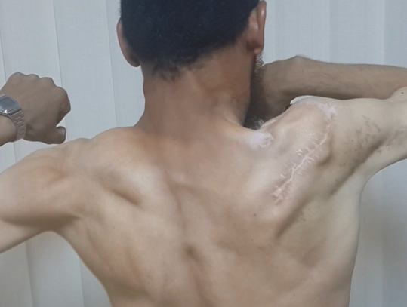
TENDON TRANSFER

Slide 31
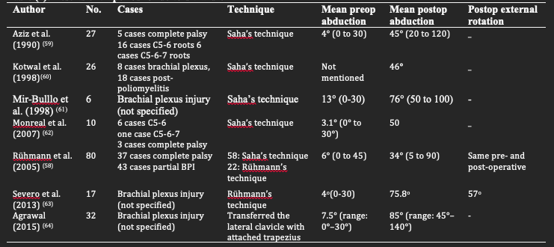
TENDON TRANSFER

Slide 32
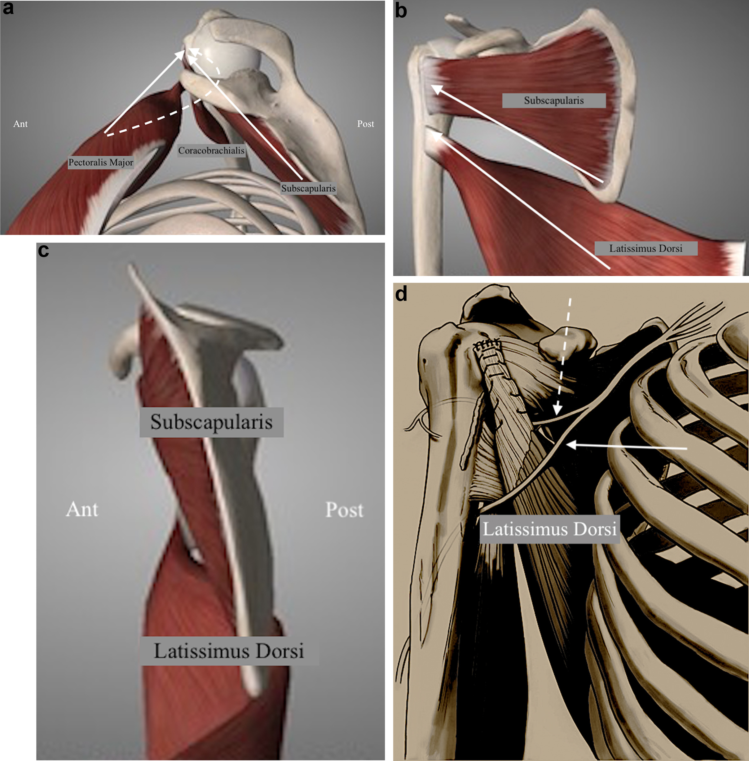
Ssc

Slide 33
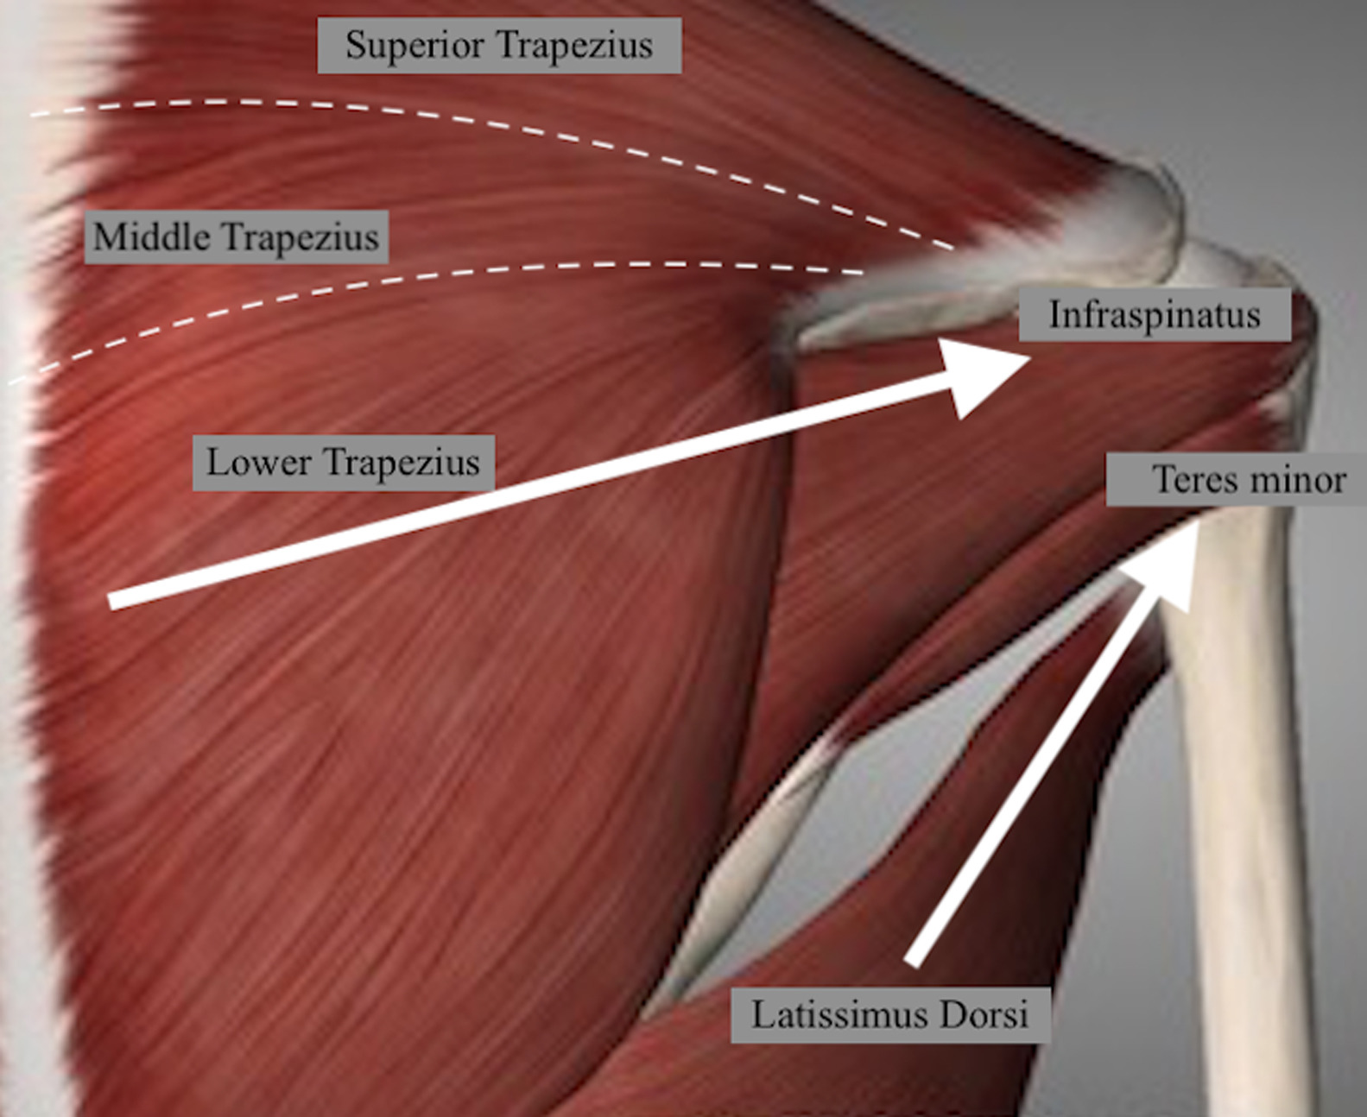
IS

Slide 34
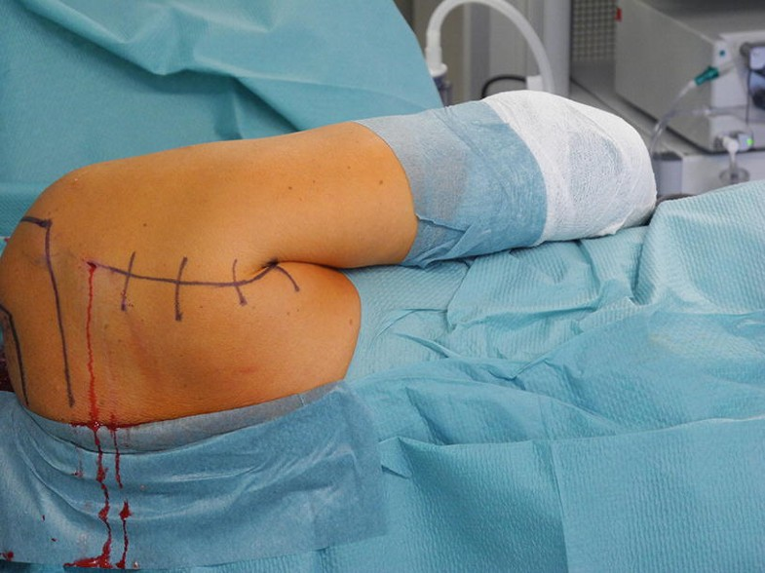

Slide 35
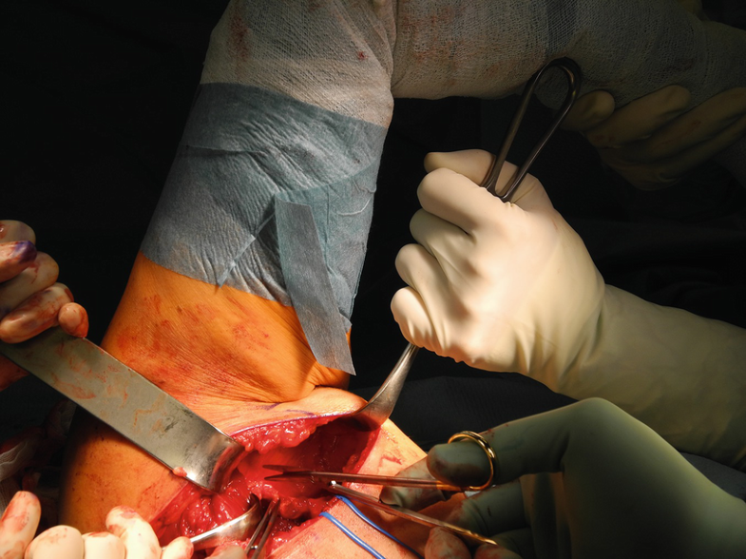

Slide 36
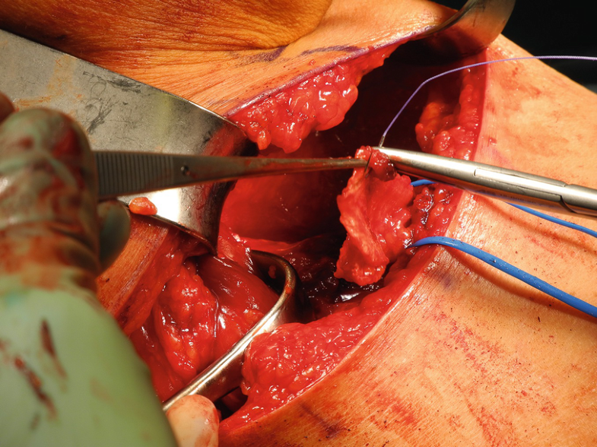

Slide 37
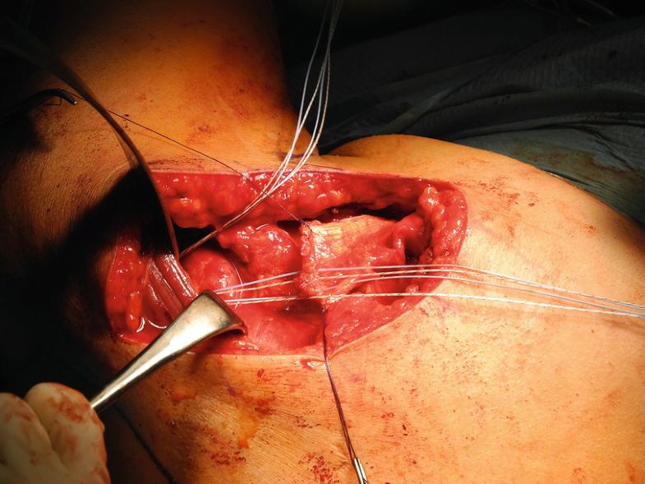

Slide 38
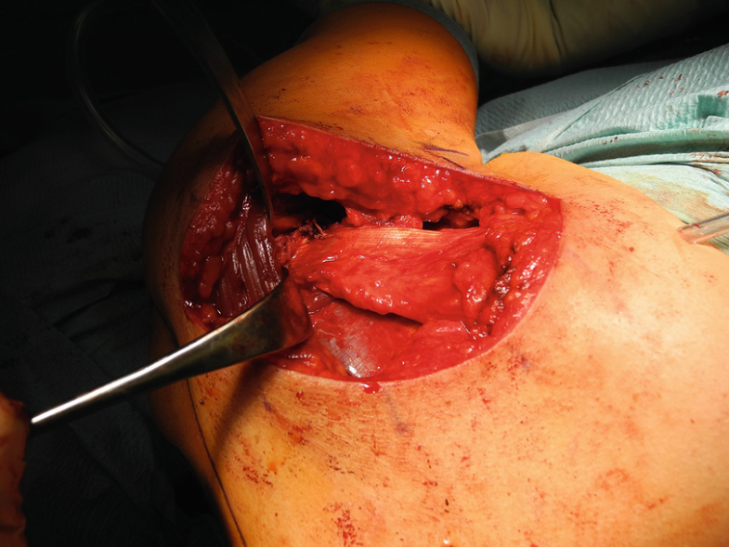

Slide 39
Surgical step | Pitfalls | Pearls
Diagnostic arthroscopy | Missing concomitant lesions | Performing a thorough and standardized examination allows for identification of concomitant lesions
Deltoid-splitting approach | The axillary nerve runs transversely 5–7 cm distal to the edge of the lateral acromion | The split should not be extended further than 5 cm to avoid injury to the axillary nerve
Posterolateral approach and harvest of the tendon | Insufficient mobilization of the tendon and muscle belly | The muscle-tendon unit is mobilized until the tendon can reach the acromion. The neurovascular pedicle is identified and thoroughly freed
Passage of the latissimus dorsi tendon/patch unit | Insufficient space under the deltoid muscle and posterior of the teres minor muscle | A dilator is used to create a soft-tissue tunnel and a passing suture is placed through the dilator
Fixation of the latissimus dorsi tendon/patch unit | Insufficient length of latissimus dorsi tendon leading to over-tensioning | Augmentation of the transferred tendon with a 3-mm ArthroFlex patch

Slide 40
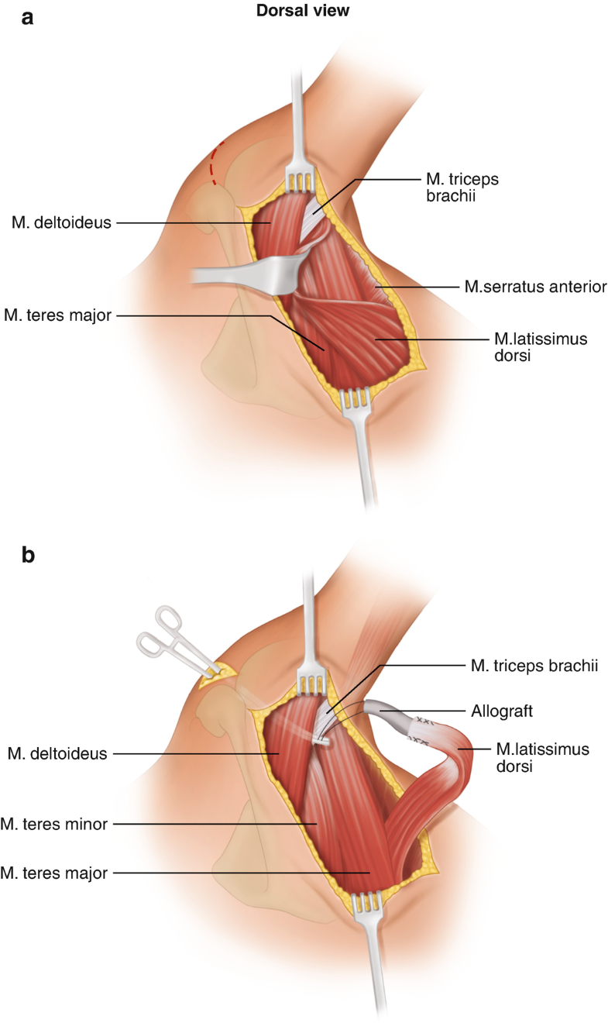

Slide 41
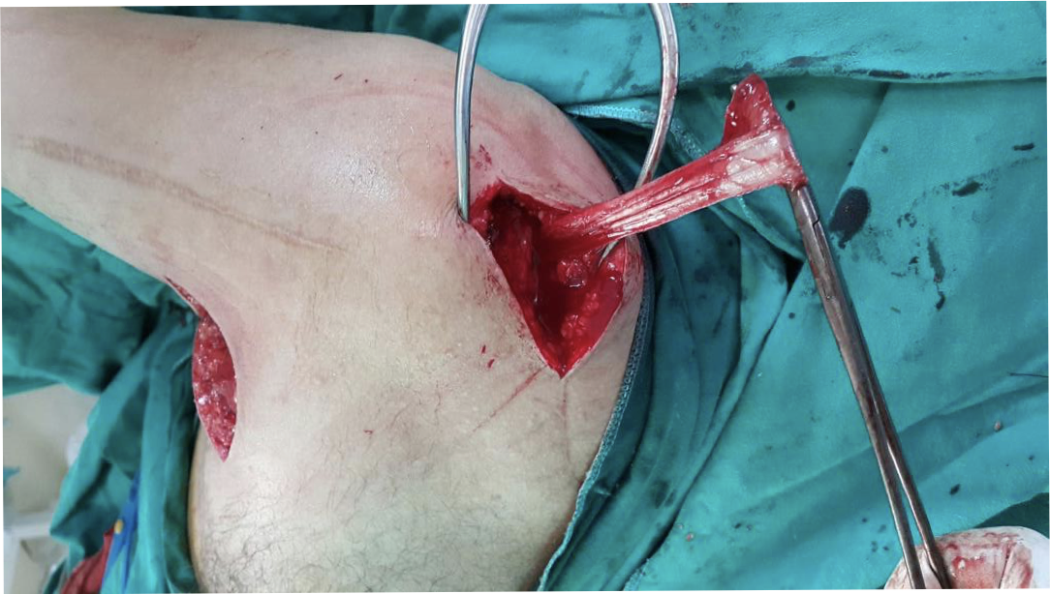
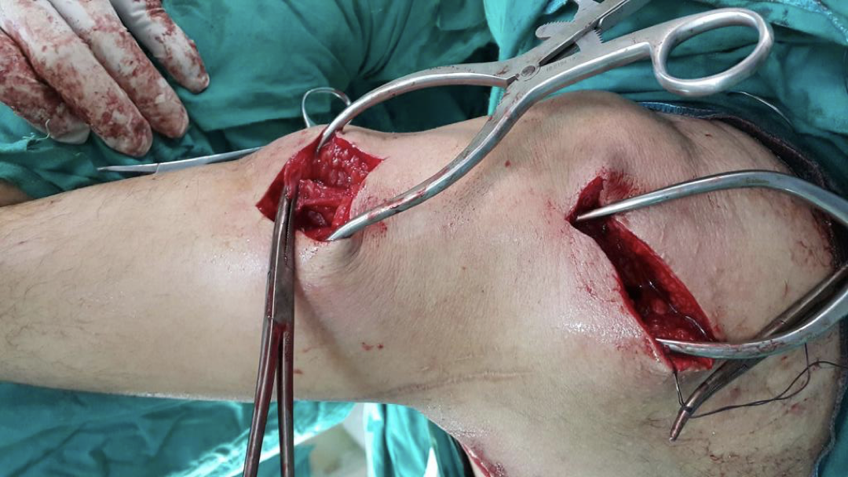

Slide 42
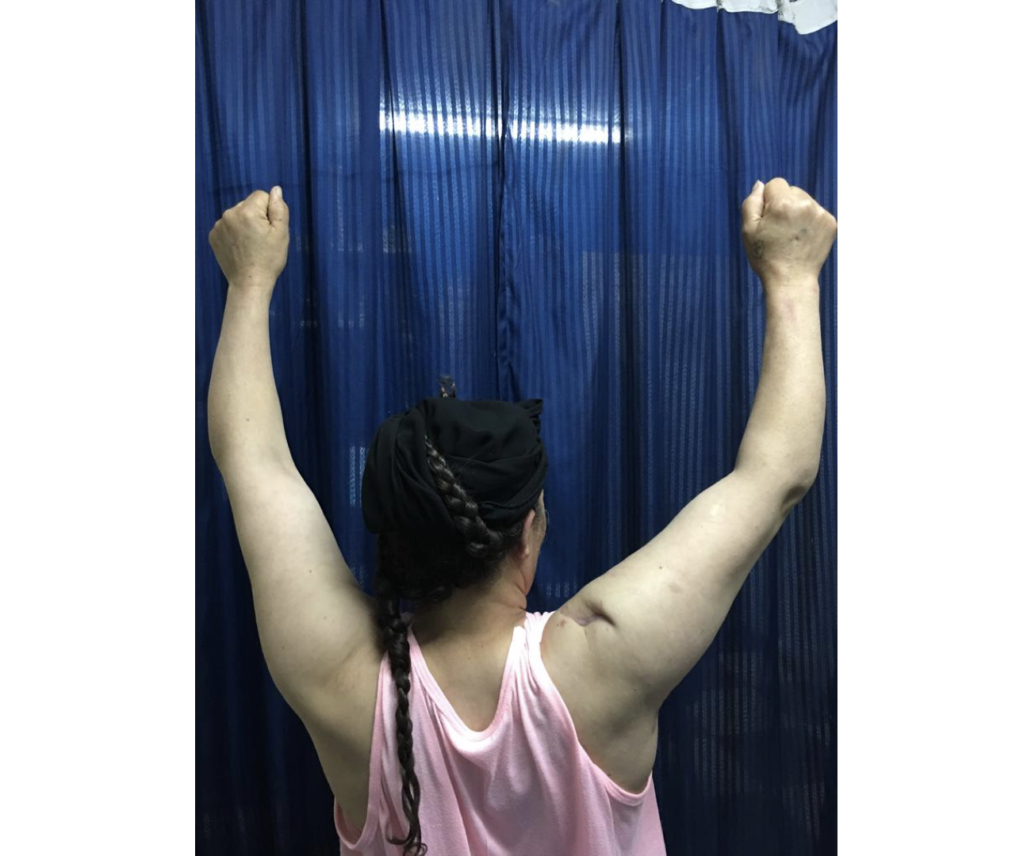

Slide 43
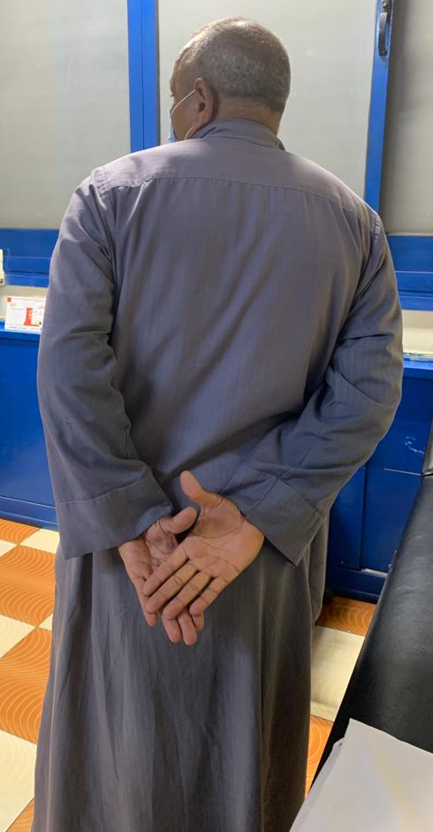
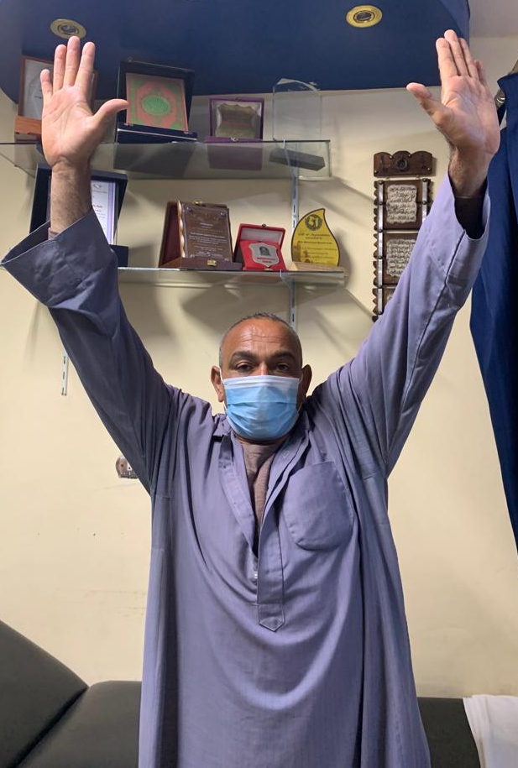
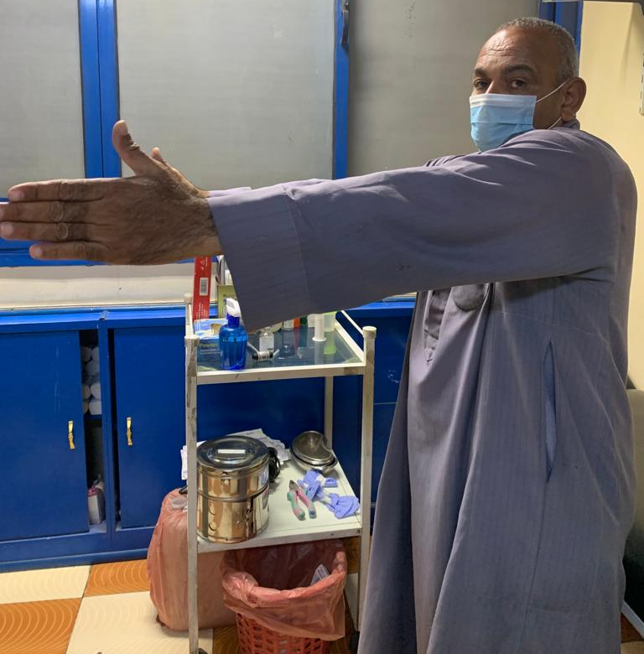
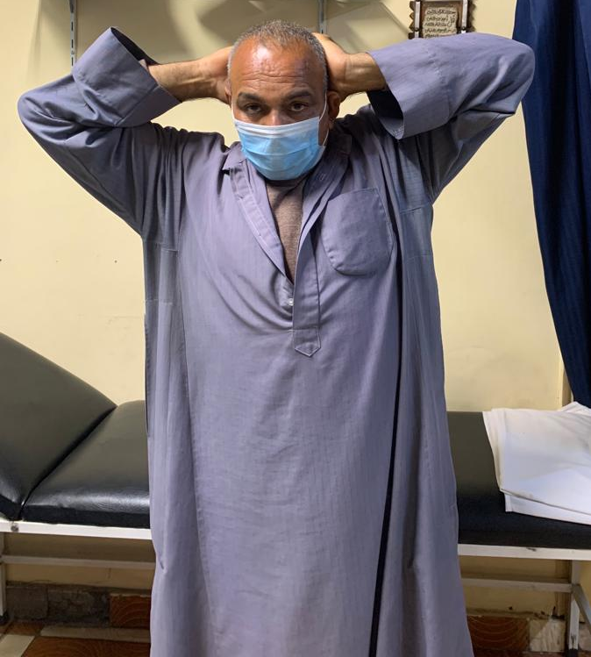
Upper trapezius transfer

Slide 44
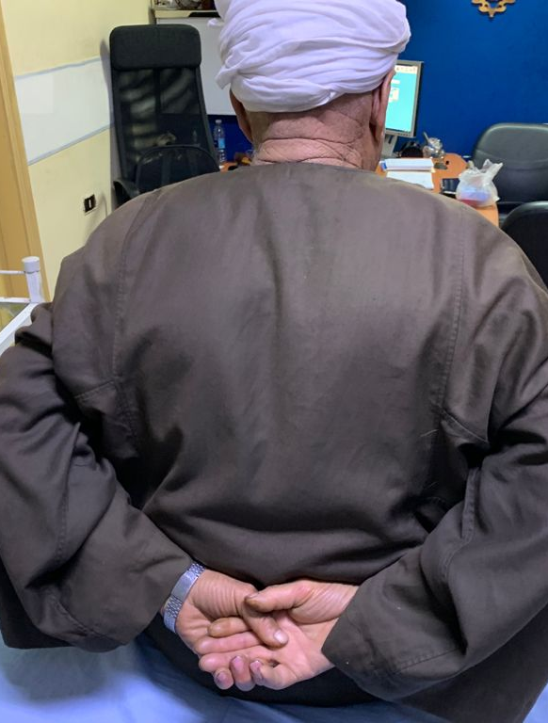
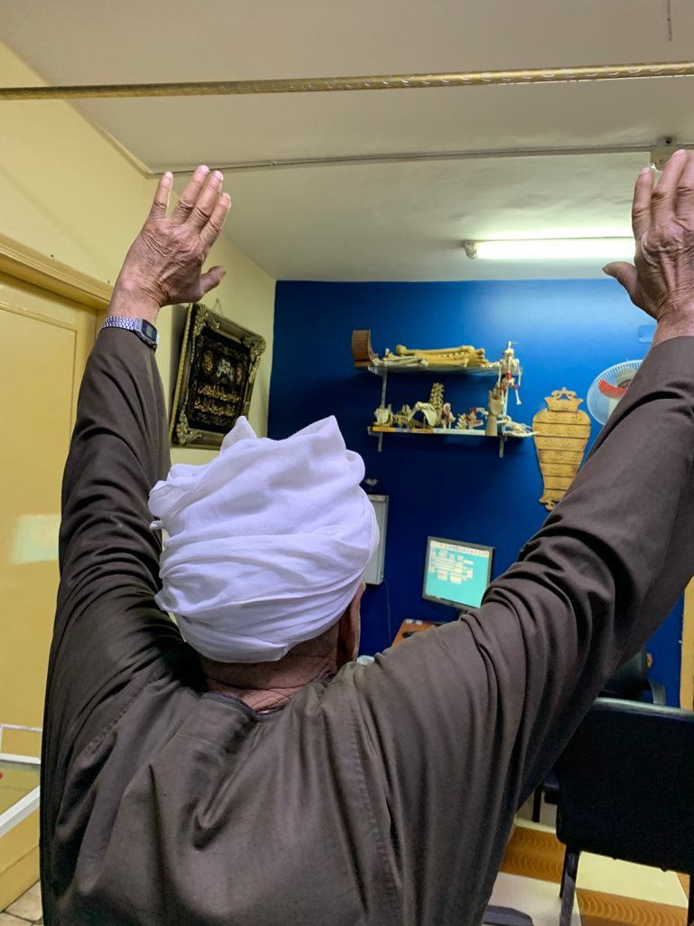
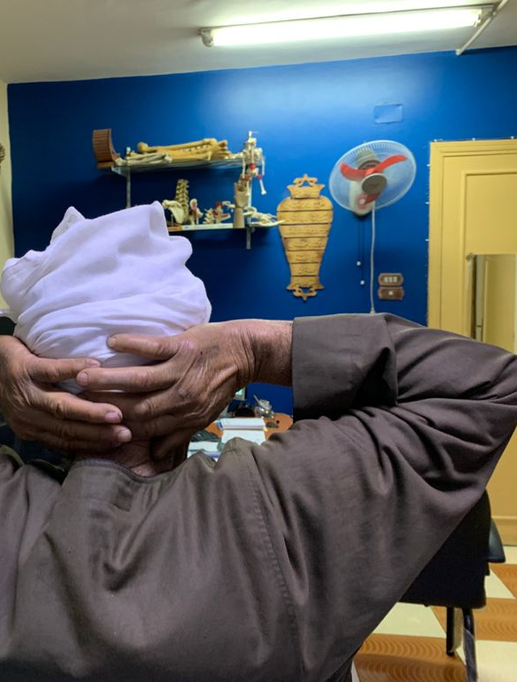
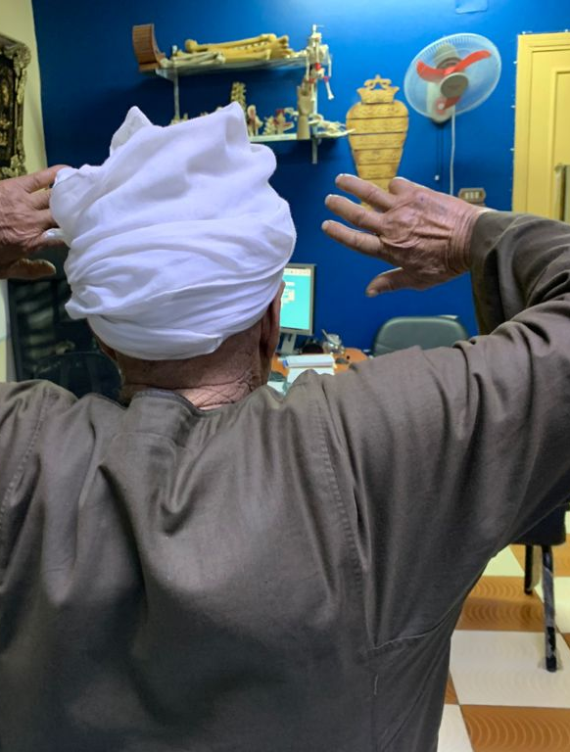
Upper trapezius transfer

Slide 45
How to avoid…..
Proximal humerus ORIF | Pass proximal humerus plate deep to axillary nerve to allow visualization above.
Shoulder manipulation for dislocation | Assess fully for neurological deficit prior to reduction. Perform reduction within 12 hrs of injury.
Scapular ORIF | The use of inter-muscular windows in the Judet approach.
Shoulder stabilization
Humeral shaft ORIF | Exposure and protection of nerve throughout ORIF. Variety of exposures provided by posterior approaches.

Slide 46
Take home message
Axillary nerve palsy (traumatic, iatrogenic)
Open traumatic -> Immediate exploration
Closed traumatic -> Surgical exploration if failed conservative 3 months
Iatrogenic -> Surgical repair if recognised intraoperative, If not follow traumatic cases
Surgery (Neurolysis, Direct repair, Nerve graft, Nerve transfer)
Surgical repair results 46-86 % MRC 3 or more
Tendon transfer for late cases (>1 yr)
Tendon transfer results 36-66 % Satisfactory abduction
PREVENTION IS BETTER THAN CURE

Slide 47

