Slide 1


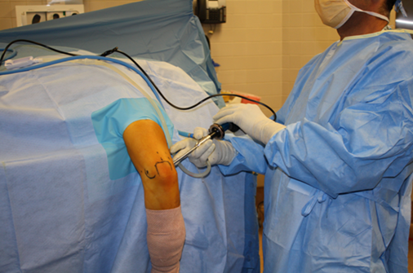

Arthroscopic release of post-traumatic stiff elbow
By Ahmed Abdel Sattar Ibrahim
lecturer at Upper limb and Microsurgery unit.
MD. Orthopedics surgery, Cairo university

Slide 2
Points to be covered
-Background and literature review.
-Patients and methods.
-Results.
-Discussion.
-Summary and conclusion.

Slide 3
Introduction

Slide 4
Introduction
The normal arc of motion of the elbow is from 0 to 145 degrees of flexion ,but arc of motion between 30 and 130 degrees is enough to perform 90% of the activities of daily living excluding sports and work activities.
The normal range of forearm supination averages about 85 degrees. This is approximately 5 to 10 degrees more than the mean normal range of pronation, which averages about 80 degrees.

Slide 5
Most activities of daily living can be accomplished with 100 degrees of forearm rotation (50 degrees of pronation and 50 degrees of supination).
Stiff elbow has been defined as an elbow with a reduction in extension greater than 30 degrees and/or a flexion less than 130 degrees.

Slide 6
Relevant Anatomy and biomechanics

Slide 7
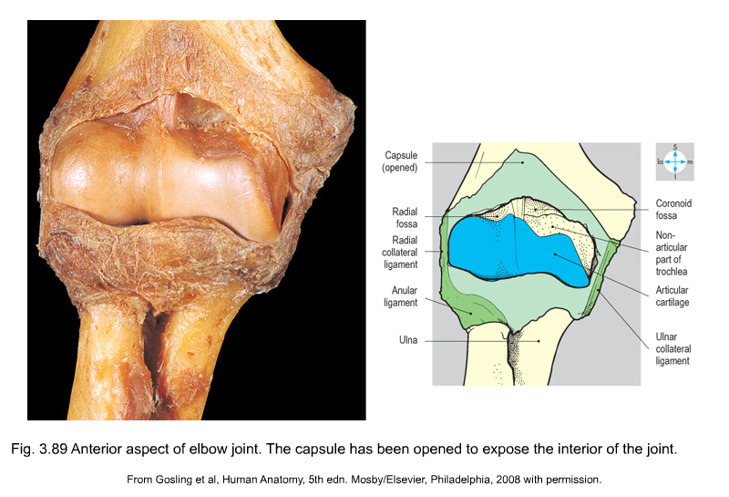
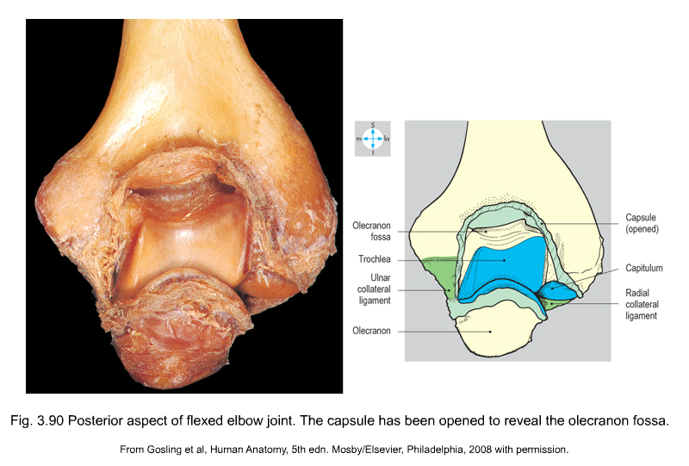
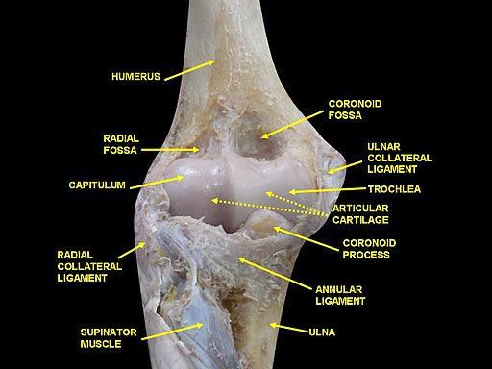
Relevant Anatomy
Troche-ginglymoid joint:
A- Bony anatomy:

Slide 8
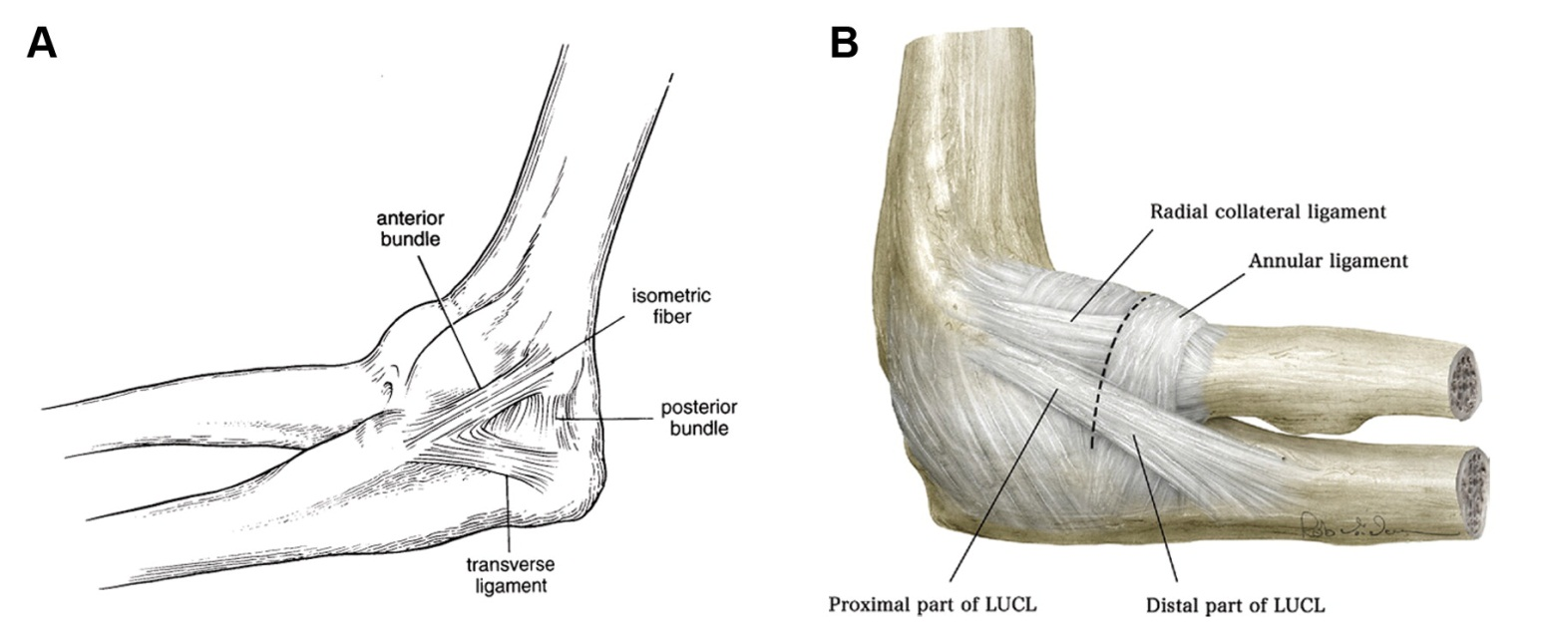
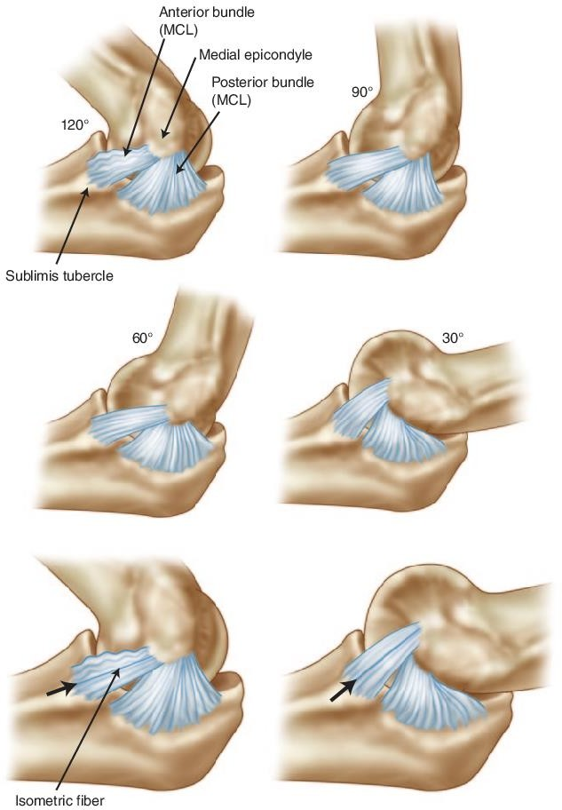

B-Capsule-ligamentous Anatomy:
1- Medial collateral ligament:
2-Lateral collateral ligamentous complex:

Slide 9
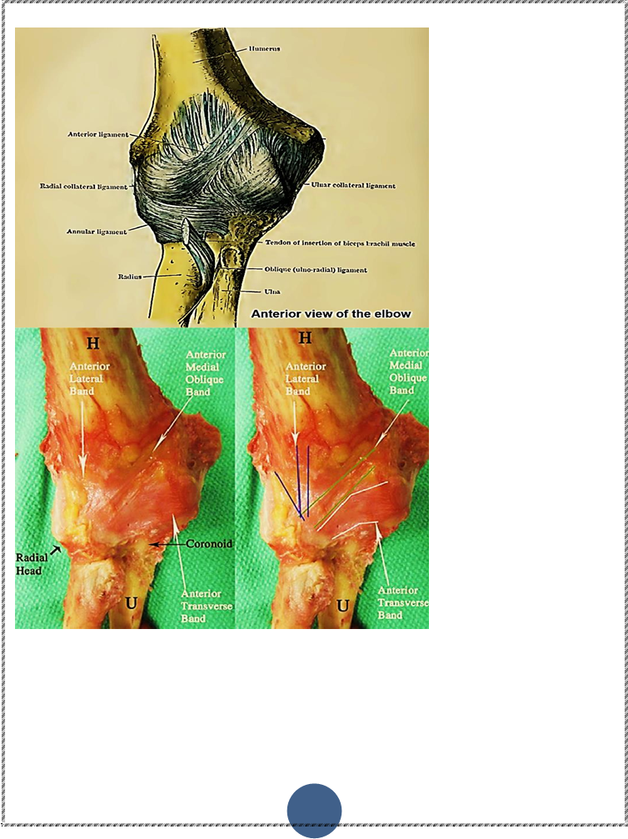
Anatomy of the capsule

Slide 10
Arthroscopic anatomy of elbow joint and portals

Slide 11
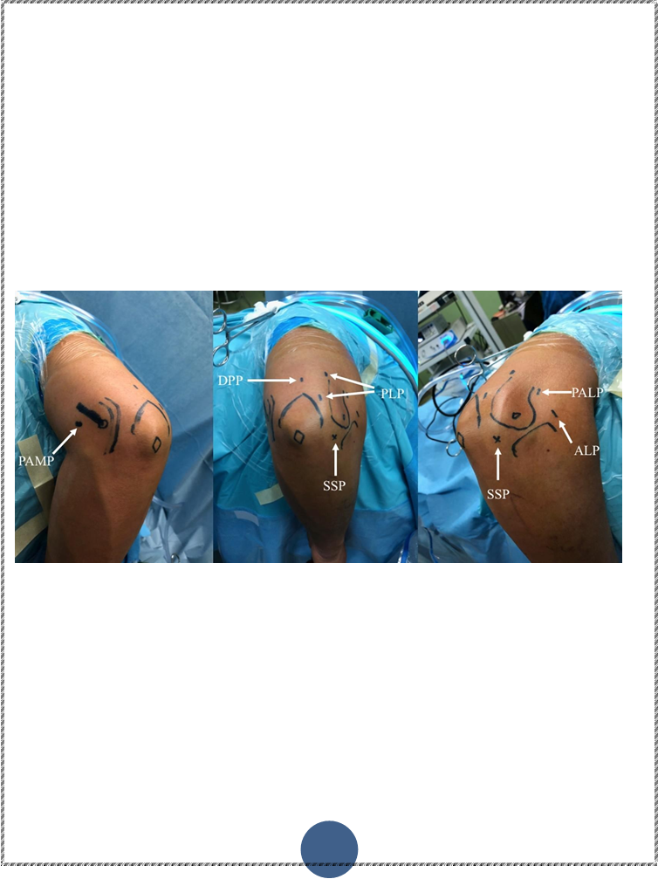
Accessing the Anterior Elbow:

Slide 12
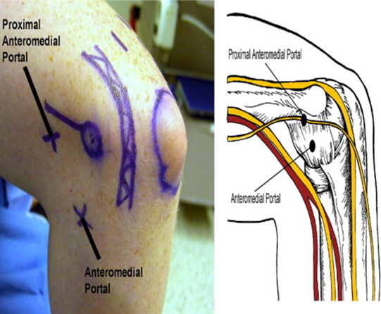
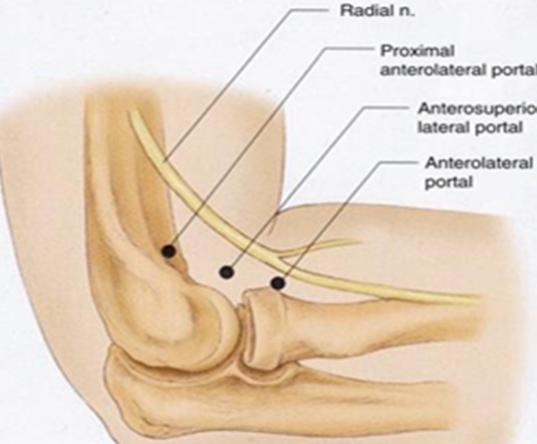

Slide 13
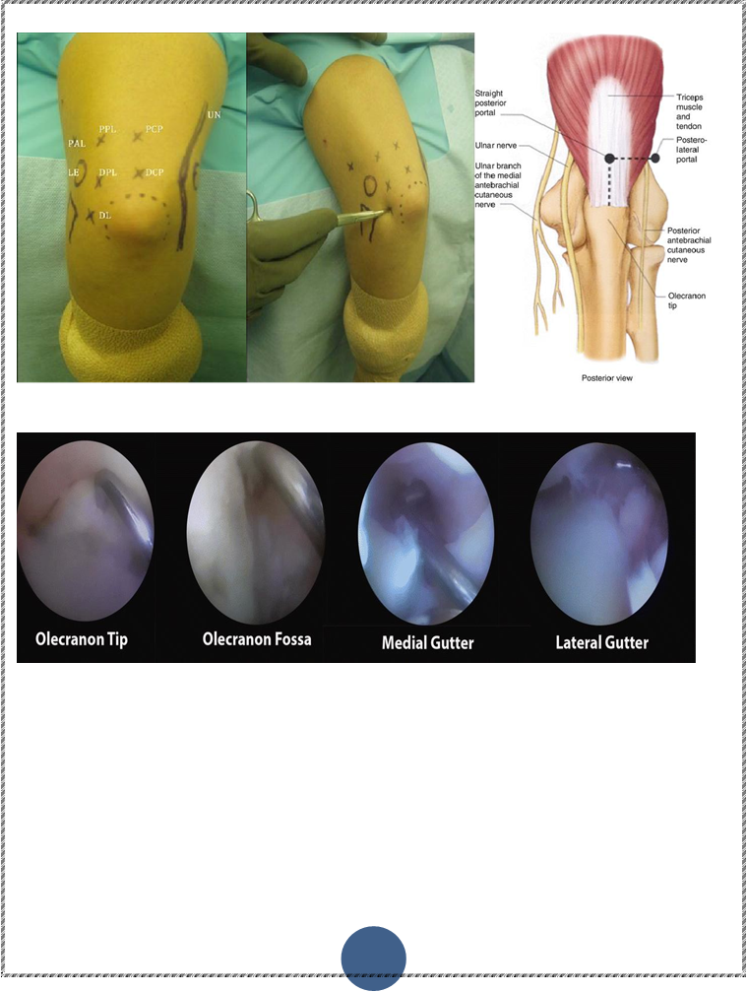
Posterior compartment

Slide 14
Patho-etiology of elbow stiffness

Slide 15
Patho-etiology of elbow stiffness
Both intrinsic and extrinsic factors
Intrinsic causes :
-Inherent to the elbow articulation(range from articular incongruities from the initial trauma to impinging osteophytes from subsequent arthrosis).
-Post-traumatic or post-surgical immobilization may result in intra- articular adhesions that limit motion.

Slide 16
Extrinsic causes :
Heterotopic ossification.
Retained hardware.
Capsular contractures.

Slide 17
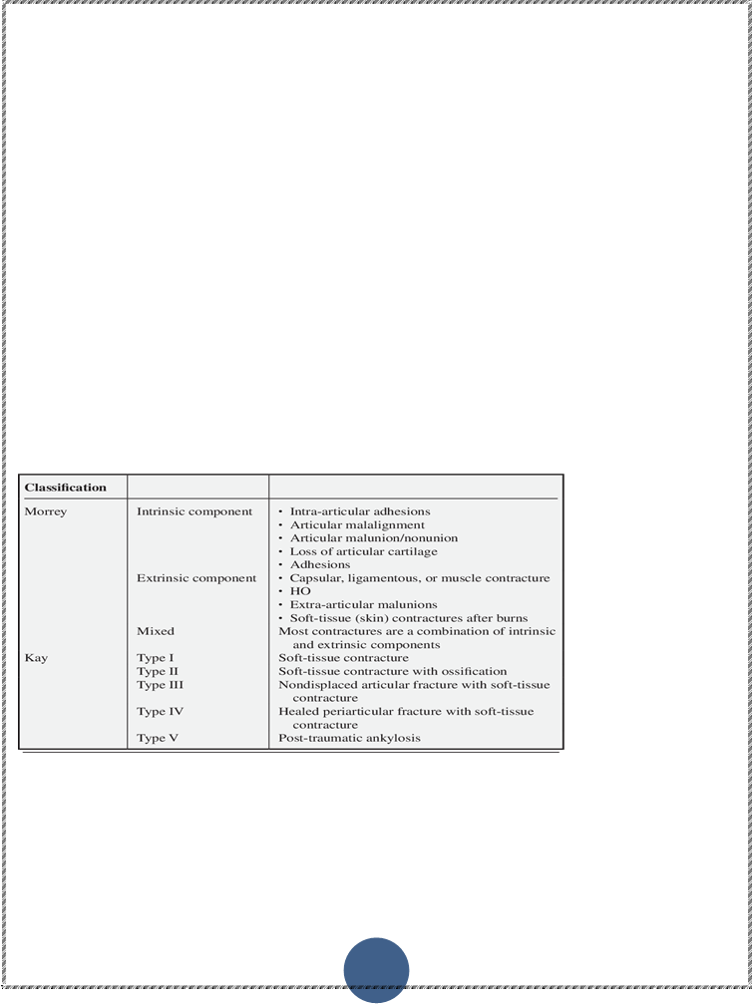
Classification of elbow stiffness
-Fan’s classification :
A) Four types of flexion-extension dysfunction:
-Tethers alone.
-Tethers with blocks.
Articular malformation.
Bony ankylosis.
B) Three types of forearm rotation dysfunction:
- Contracture alone.
-Radial head malunion or nonunion.
- Proximal radio-ulnar bony ankylosis
Mansat’s classification:
Based on ROM:
-Mild: ROM > 90°.
-Moderate: 60°< ROM ≤ 90°.
-Severe: 30°< ROM ≤ 60.
-Very severe: ROM ≤ 30°.

Slide 18
Prevention

Slide 19
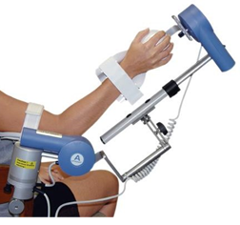
Treatment of a stiff elbow can be a difficult challenge for the orthopedic surgeon , So prevention of its onset is of key importance.
-Continuous passive motion (CPM)
-HOs could be prevented by using low doses of radiation within 72 hours of trauma .
-Indomethacin in combination with radiation therapy is considered safe and effective in the prevention of HOs.

Slide 20
Management of elbow stiffness

Slide 21
Clinical assessment:
History:
Patient history and co-morbidities as important in assessment of pathology and plan of management .
Comorbidities as RA, SLE can present with joint stiffness, haemophilic patients .
History of trauma or not and duration of condition can predict prognosis and possible intra-operative or post –operative complications.
Examination:
A) General examination:
To exclude general causes for example: Haemophilia , Septicemia , SLE, RA.
B) Regional examination:
-Look: Posture, scars, ulnar nerve sublaxation, alignment and skin condition.
-Feel: Bony and soft tissue landmarks, points of tenderness and temperature.
-ROM: (active, passive),(painful or painless.)
-Type of mechanical block(bony, leathery , springy, empty).
-Ulnar nerve examination is integral entity in stiff elbow examination.

Slide 22
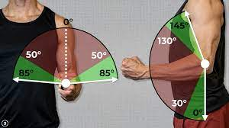
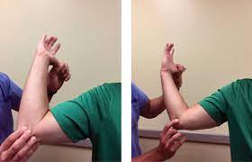

Slide 23
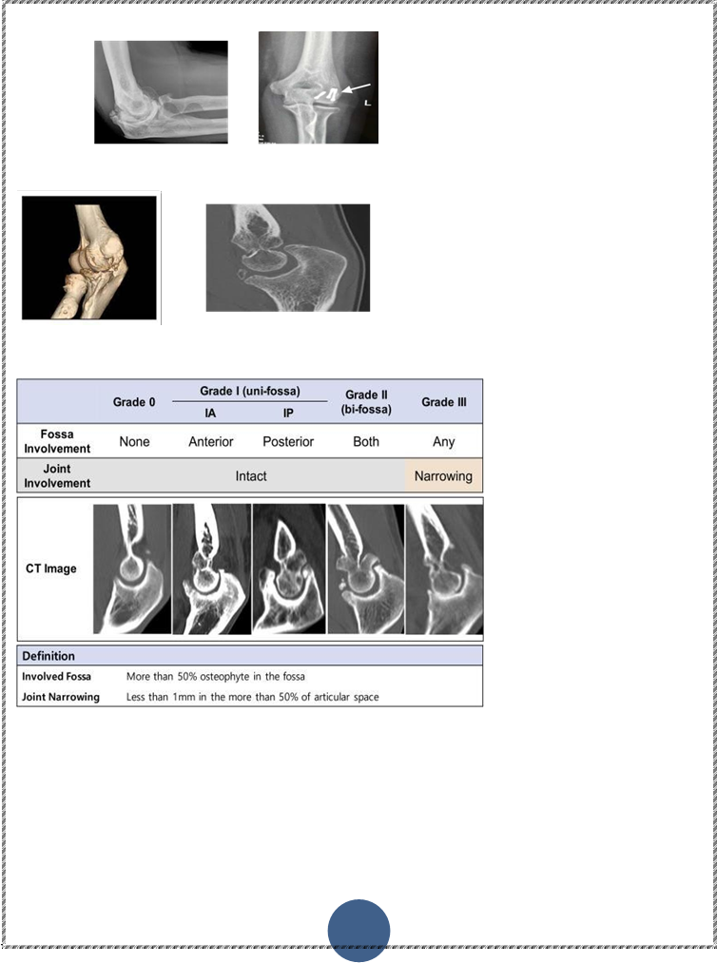
Radiological assessment:
X-ray :
To identify articular congruity, causes of mechanical block, heterotrophic ossifications , osteophytes.
CT:
Represent site and size of mechanical bone block, articular congruity and identification of radiological classification of bony blocks.

Slide 24
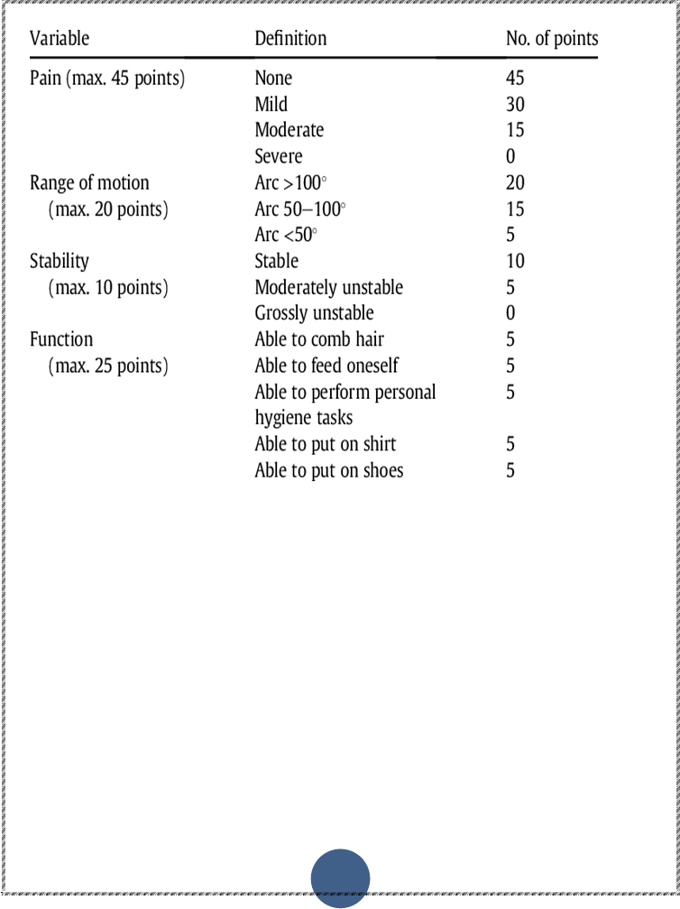
Functional assessment
Mayo Elbow Performance score

Slide 25
Treatment
Pain-free, functional, stable elbow joint is our goal in treatment of stiff elbow.
stiff elbow
Conservative. operative
No bony block less than 6 months MUGA Distraction arthro-diastasis open release arthroscopic release

Slide 26
Regarding our study

Slide 27
From April 2021 to December 2022,
a single- arm clinical trial study
At Kasr El-Ainy faculty of medicine Cairo University.
A total of 35 patients who met inclusion criteria .

Slide 28
Inclusion criteria:
Exclusion criteria:
Prior documented anterior transposition of ulnar nerve.
Infection.
Bony ankylosis.
Arthritic elbow
Symptomatic stiff elbow.
Failed conservative management more than 6 months.
Extra-articular causes.
Previous fixation of fracture around elbow.
Intra-articular causes.

Slide 29
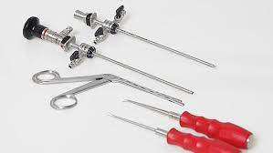
Preoperative Management Protocol
Pre-operative assessment:
Clinical assessment
A )Examination:
1-General examination.
2-Regional examination.
B )Radiological assessment.
C )Functional assessment.
Arthroscopy setting:
A 4.0-mm 30° arthroscopy and a 3.5-mm full-radius arthroscopic shaver were used. An arthroscopic pump of low pressure (30-35) will be used to improve visualization and to avoid joint over distension.

Slide 30
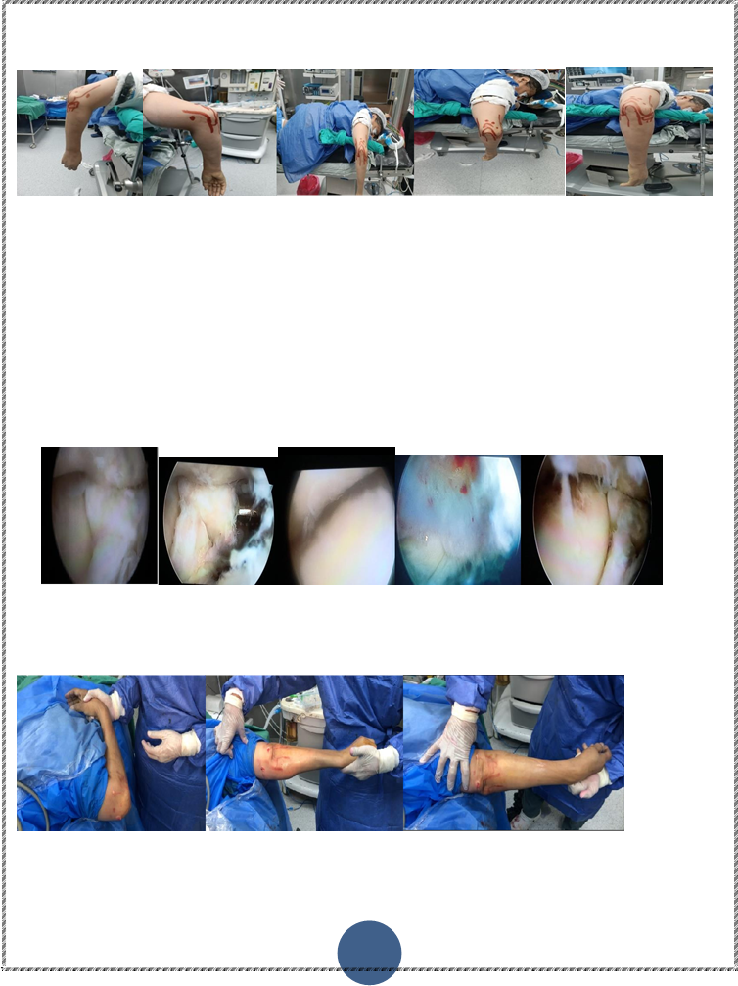
Operative technique
Anesthesia:
All patients were anesthetized general anesthesia.
Prophylactic broad-spectrum antibiotic.
Hypotensive anesthesia was asked.
Position: prone position.

Slide 31

Identification of bony landmarks and surface anatomy of portals

Slide 32
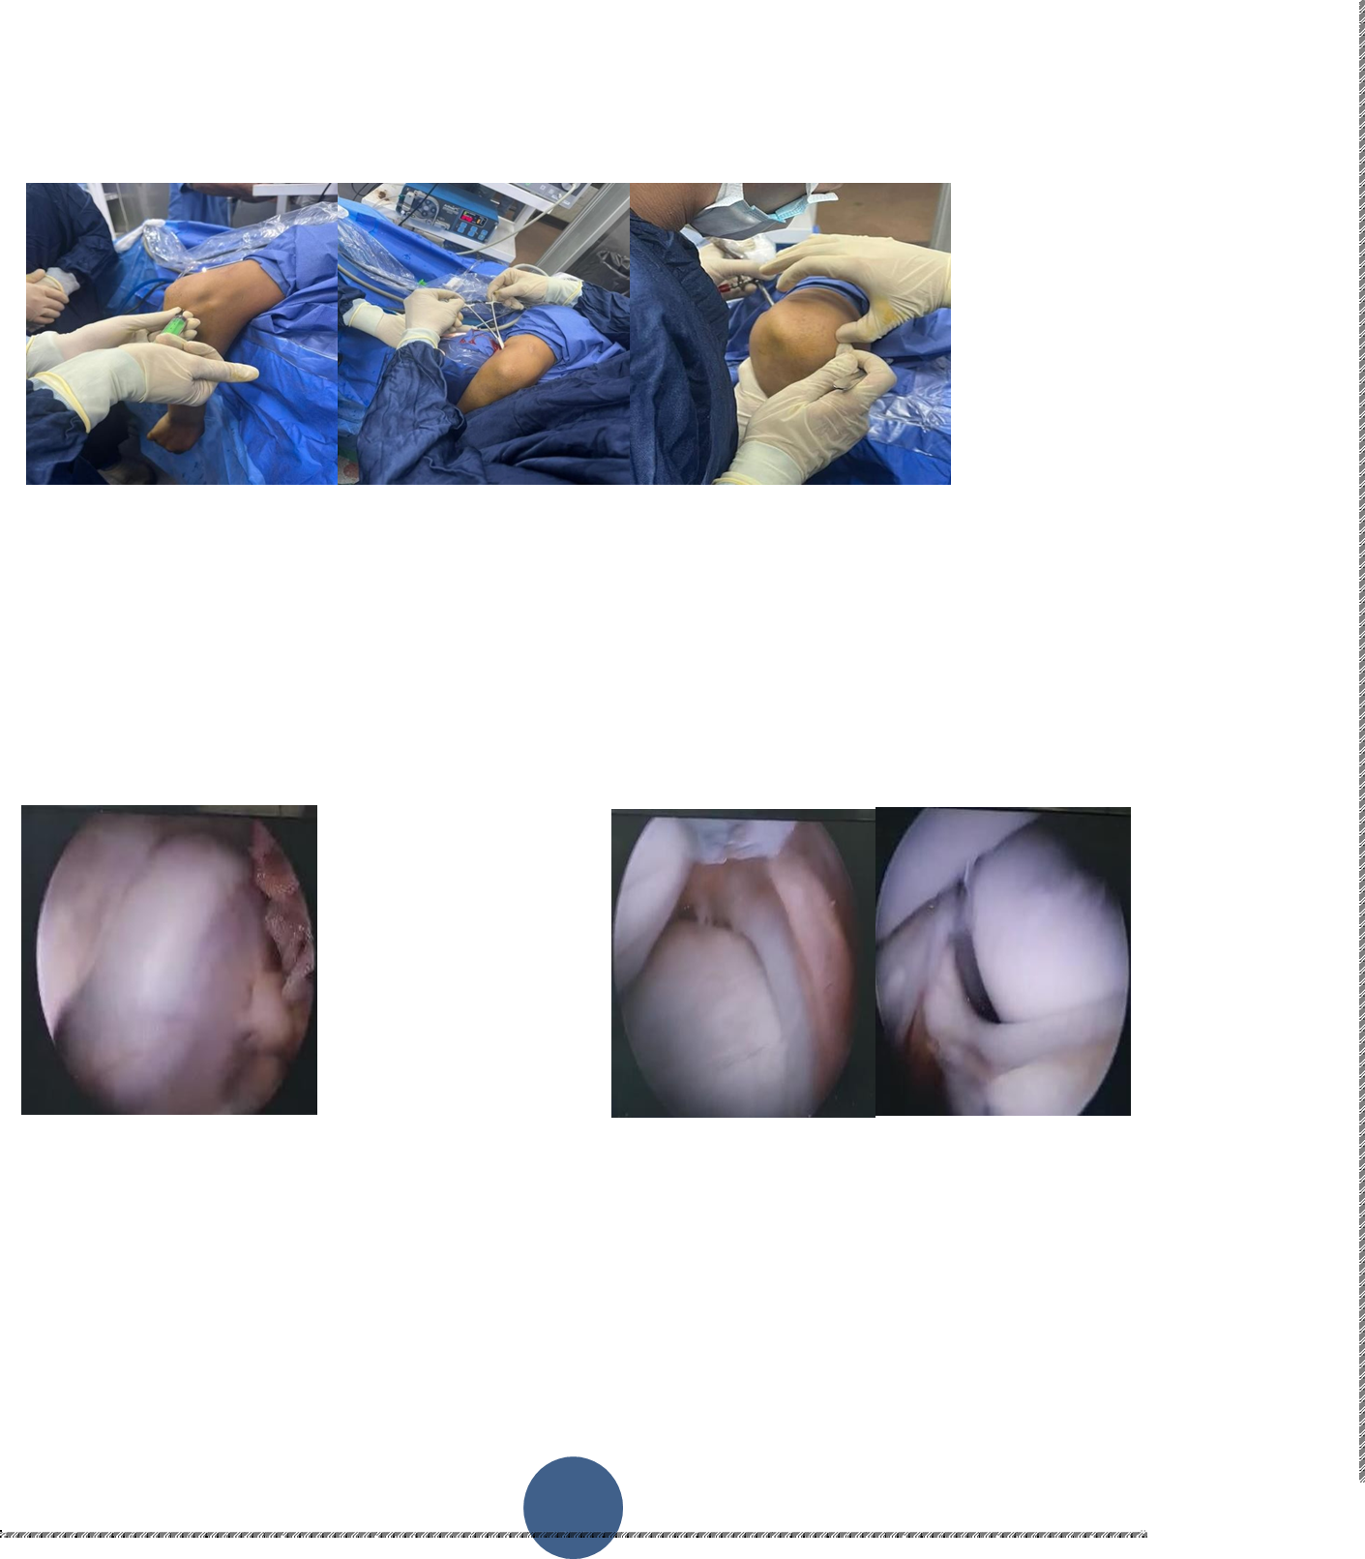
Capsular inflation with 30 ml saline through Soft spot and started with PAMP

Slide 33
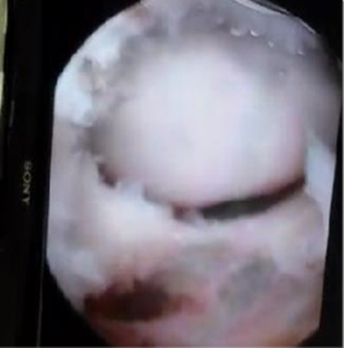
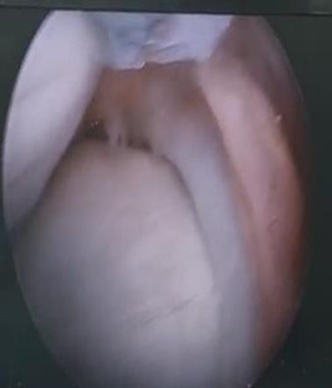
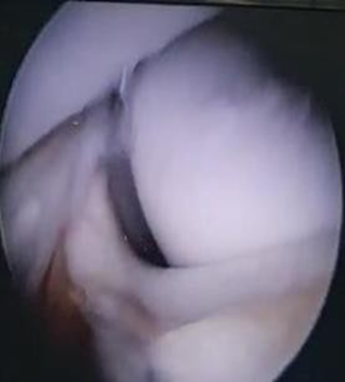
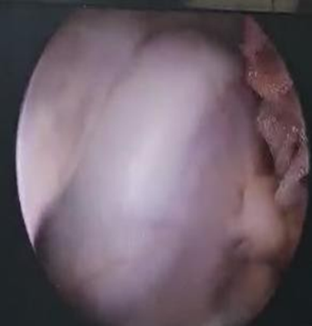
Viewing PAMP

Slide 34
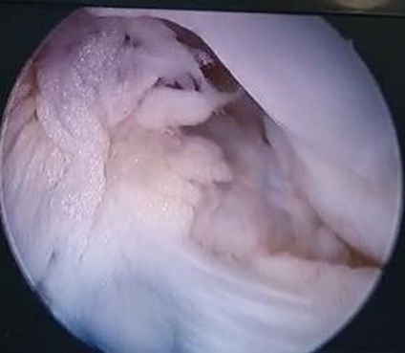
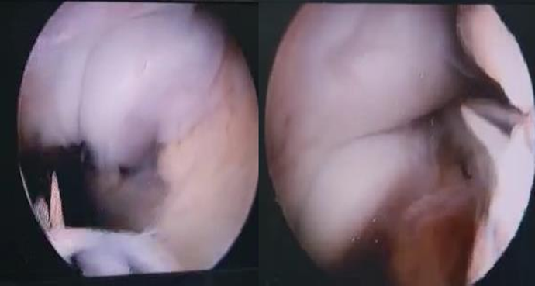
we started switching portal to viewing antro-lateral portal for visualization of medial compartment and debridement of capsule.

Slide 35
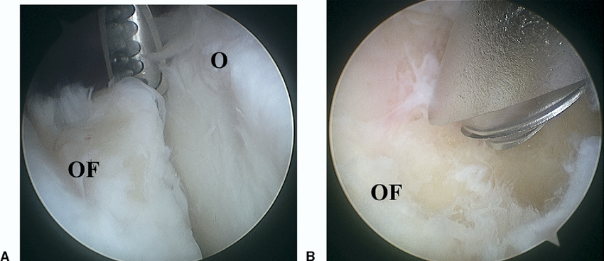

Once maximum extension through anterior capsular release has been achieved ,a posterior central portal is established.

Slide 36
-After completion of procedure, in-situ ulnar nerve decompression was done at same session for the patients who manifested, with manifestation of ulnar nerve entrapment.
-Immediate post-operative ROM assessed and documented.
-Incision covered by sterile dressing with application of arm sling.
-Anesthesia typically provided a nerve block after or before surgery.

Slide 37
Post-Operative Care
-Cold fomentation
-Arm sling was placed
-Sutures removed at first post-operative visit
-Physiotherapy:
Phase I: Early ROM (0 to 4 weeks):
Phase II: Restore Function (>4 weeks):
-Follow up evaluation:
A)Functional follow up.
B)Clinical follow up.
C)Complications.

Slide 38
Results

Slide 39
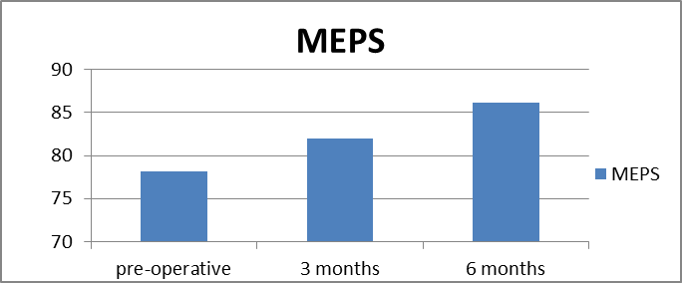
Functional Analysis Data
 |  | Pre-operative Mayo score | 3 months post-operative | 6 months post operative
N | Vaild | 35 | 35 | 35
N | Missing | 0 | 0 | 0
Mean |  | 78.14 | 82.00 | 86.14
Std deviation |  | 6.427 | 5.841 | 5.569
Minimum |  | 65 | 70 | 20
Maximum |  | 90 | 95 | 95

Slide 40
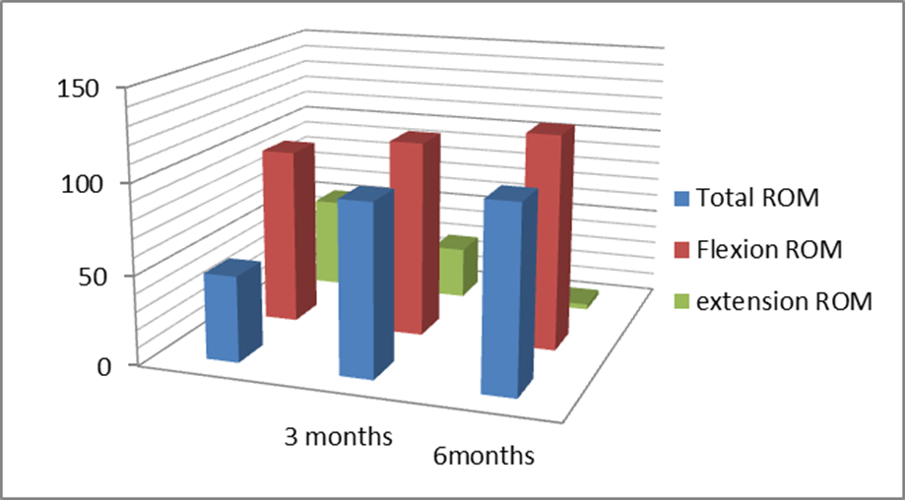

Slide 41
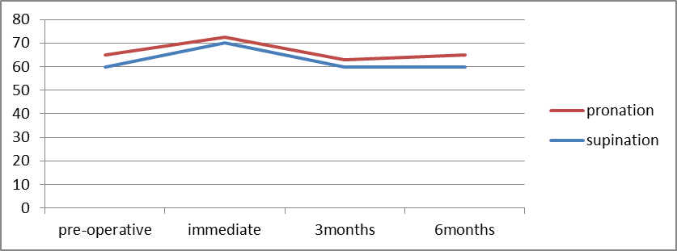
SUPINATION-PRONATION ROM

Slide 42
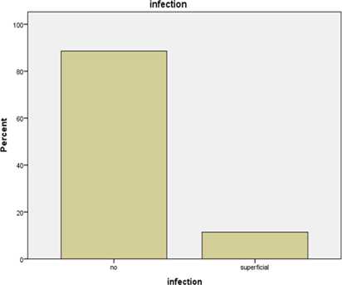
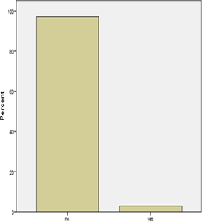
Complications Data

Slide 43
Statistically positive significant correlations
There is statistical significant positive correlation between total pre ROM and total post ROM 6 months.
There is statistically significant difference between pre-operative and 3, 6 months post-operatively regarding MEPS.

Slide 44
Statistically negative significant
There is statistical significant negative correlation between pre –operative total range and operative time.
Mean pre flexion rom degree is statistically significant lower in nerve entrapment.

Slide 45
No statistically signifigance
Duration of stiffness has no statistical significant effect on Pre-ROM , Immediate post ROM , post –ROM 6 months and Mayo elbow performance score at 6 months.
No statistical significant difference between location of cause and pre- operative flexion ROM p=0.762, pre- operative extension ROM p=0.184, and total pre- operative ROM p=0.212.
No statistical significant difference between location of cause and post- operative flexion ROM p=0.923, post-operative extension rom p=0.123, and total post- operative ROM p=0.244.
There is no statistically significance between pre-operative, immediate P=0.122, 3months P=0.235 and 6 months post-operative P=0.452 regarding supination-pronation ROM.

Slide 46
Case Presentation

Slide 47
22 years old male patient presented with RT-sided post-traumatic stiff elbow after fracture radial head fixation since 2019, patient is right-handed, student.
Clinical examination:
- Scar on lateral aspect of elbow healed with primary intension,
-Ulnar nerve examination: No signs of ulnar nerve entrapment, no ulnar nerve snapping.
-Mayo elbow performance score was 70.

Slide 48
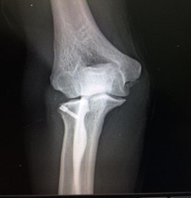
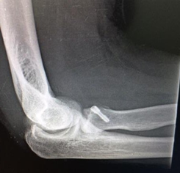
Radiological assessment:

Slide 49
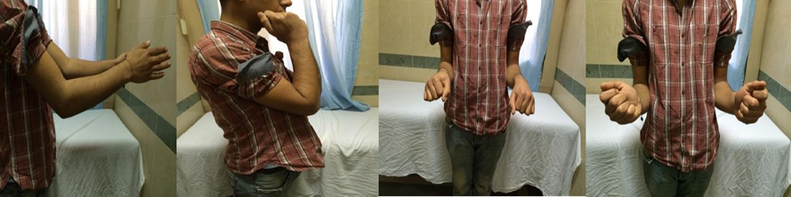
Clinical pre-operative photos:
Active supination was 40 degrees | Active pronation was 50 degrees | Active flexion was 110 degrees | Active extension was 70 degrees
passive supination was 50 degrees | passive pronation was 60 degrees | passive flexion was 120 degrees | passive extension was 60 degrees

Slide 50
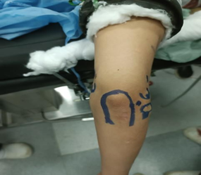
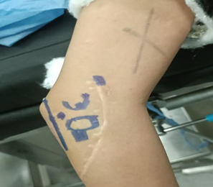
Surgical procedure

Slide 51
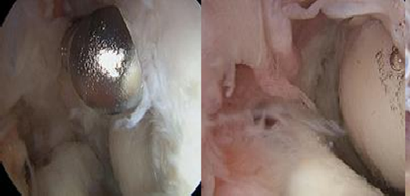
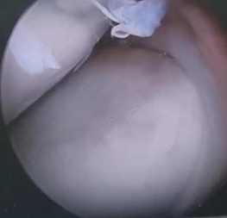
PAMP:

Slide 52
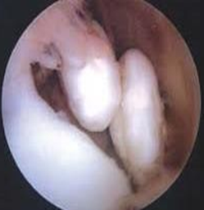
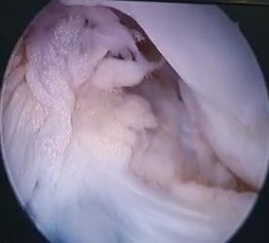
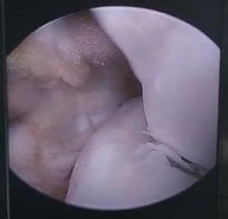
PALP:

Slide 53
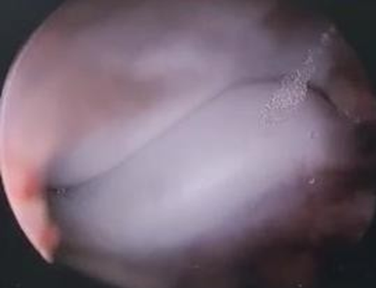
PLP:

Slide 54
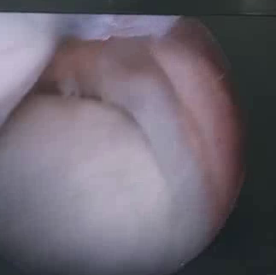
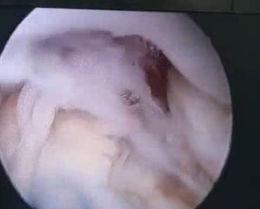
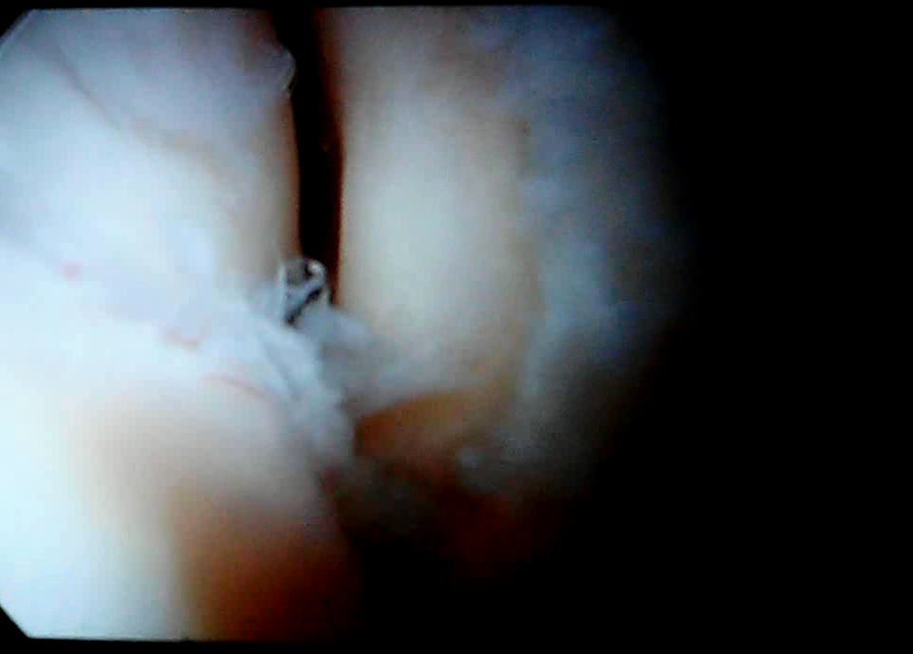

Slide 55
Follow up:
 | Total ROM | Flexion ROM | Extension ROM | Supination ROM | Pronation ROM |  | MEPS
immediate | 110( passive) | 130 | 20 | 60 |  | 70
3 Months | 100(passive) 100(acive) | 120(passive) 110(active) | 20(passive) 10 (Active) | 50(passive) 50(active) |  | 50(passive) 50(active) | 85
6 Months | 130(passive) 120(active) | 130(passive) 130(active) | 0 (passive) 10(active) | 70(passive) 70(active) |  | 60(passie) 60(active) | 95

Slide 56
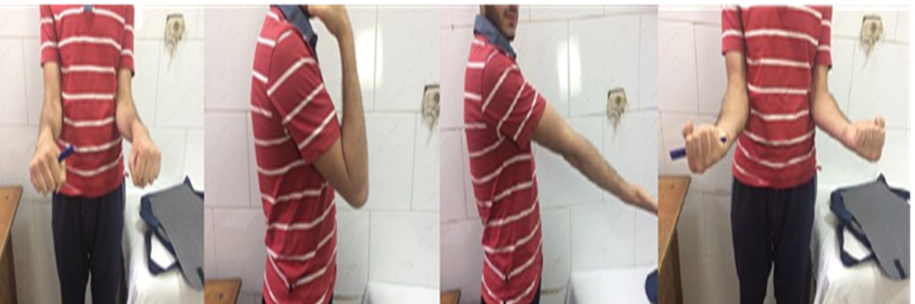
Clinical photos for ROM after 6 months

Slide 57
Conclusion

Slide 58
-This study demonstrates that satisfactory outcomes in terms of ROM and function can be achieved following arthroscopic arthrolysis of the elbow with the use of active and passive exercise in the post-operative period.
-Taking into consideration the satisfactory clinical outcomes and low rate of complications, we conclude that arthroscopic arthrolysis is a good option for the treatment of post-traumatic elbow stiffness as it restores nearly normal elbow function.

Slide 59

