Slide 1
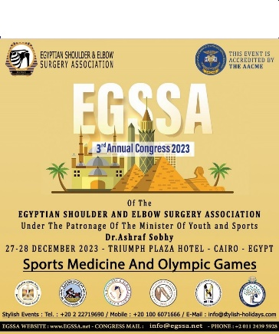

Management of ACUTE Acromioclavicular Dislocations: A Comparative Study of Arthroscopic and Minimally Invasive Approaches
Dr. KAMOUN HAITHEM
ORTHOPEDIC SURGERY DEPARTEMENT
SECURITY FORCES HOSPITAL - TUNISIA

Slide 2
INTRODUTION

Slide 3
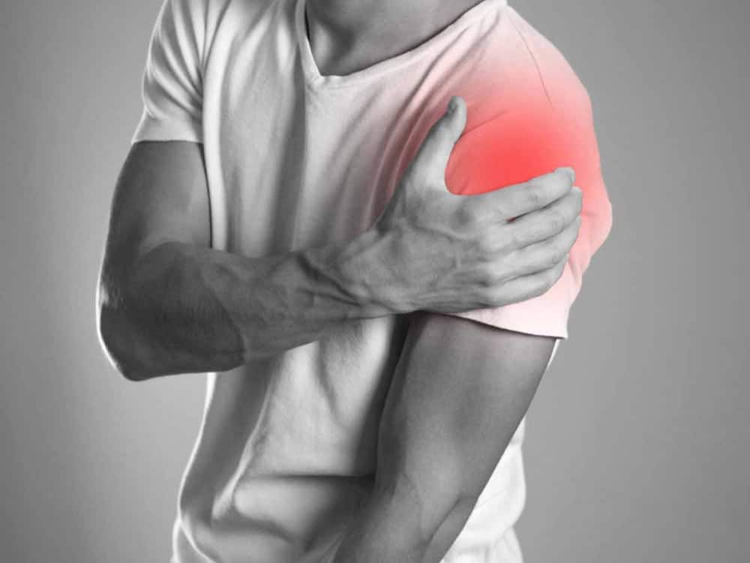
40% of shoulder injuries
Young athletes +++

Slide 4
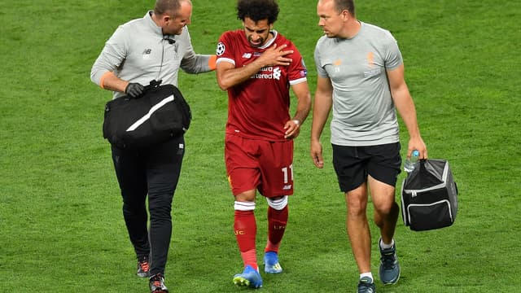
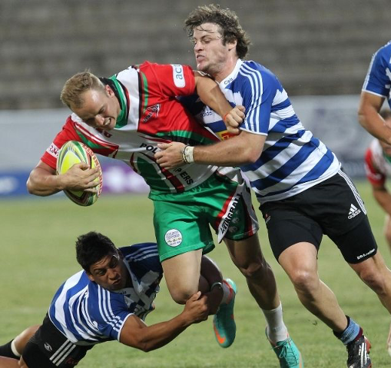

SPORTS ACCIDENT +++
more than 160 surgical techniques: the
source of debate.

Slide 5

PURPOSE

Slide 6
Compare depending on the technique used in management of acute ACVD :
the anatomical and functional
radiological outcomes

Slide 7

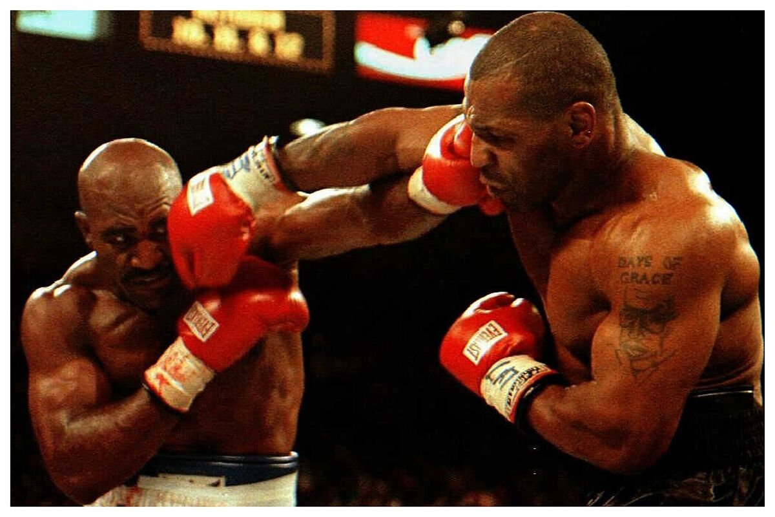
ARTHROSCOPIC
APPROACH
MINI OPEN

Slide 8
METHODS

Slide 9
FROM JANUARY 2013 TO DECEMBER 2021
Retrospective
longitudinal
descriptive study

Slide 10
Inclusion criteria | Exclusion criteria
Patients with acute acromioclavicular disjunction (TYPE III, IV, V) Surgical treatment Minimum follow-up period of 12 months | Pathological history of the homolateral shoulder orthopedic treatment ( TYPE I , II ) More than 21 days between accident and surgery

Slide 11
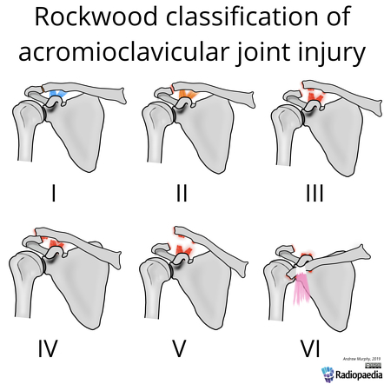
FOR TYPE I AND II :
Mazzocca et al Am J Sport Med 2006
Tamaoki et al Cochrane Database syst Rev 2010
ORTHOPEDIC TREATEMENT WITH BACK TO SPORT AT THE SAME LEVEL

Slide 12
ALL PATIENTS (30)
ARTHROSCOPY
DOUBLE TIGHT ROPE
(15)
MINI OPEN (15)
SINGLE TIGHT ROPE
(10)
HOOK PLATE
(5)

Slide 13
CLINICAL DATA COLLECTION
AGE
GENDER
DOMINANT SIDE
CIRCUMSTANCES

Slide 14

CLINICAL DATA COLLECTION
PROFESSION
TIME TO SURGERY
TIME TO RETURN TO WORK

Slide 15
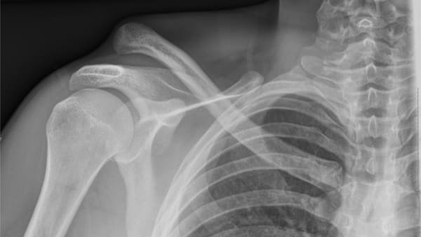
X-RAY
  ACROMIOCLAVICULAR DISTANCE
  JOINT REDUCTION

Slide 16
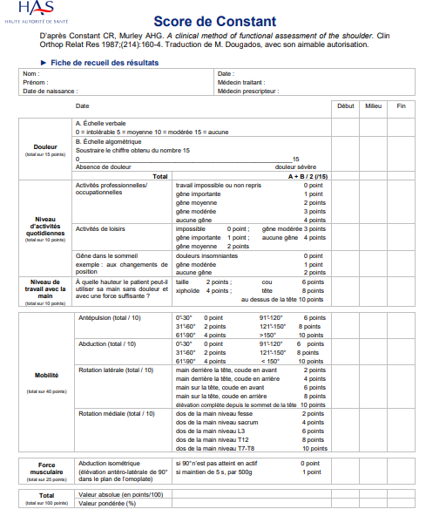
FUNCTIONNAL OUTCOME
CONSTANT SCORE

Slide 17
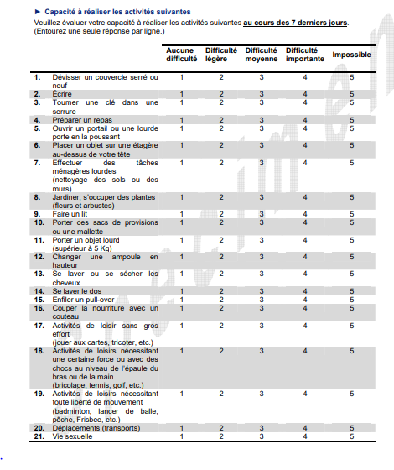
FUNCTIONNAL OUTCOME
QUICK DASH

Slide 18
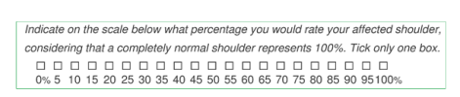
FUNCTIONNAL OUTCOME
SSV

Slide 19
RESULTS

Slide 20
AGE AVERAGE | MALE | FEMALE | RATIO
29 | 21(79%) | 9(21%) | 3,67

Slide 21
MANUEL PROFESSION | DOMINANT SIDE | CIRCUMSTANCES | TIME BETWEEN TRAUMA AND SURGERY
67% | 22(81%) | SPORT 60% | 4 DAYS

Slide 22
Clinical signs | Nb | Percentage
Skin lesions | 17 | 63 %
Protrusion of the clavicle | 17 | 63 %
Anteroposterior clavicle laxity | 19 | 70 %
superior-inferior laxity | 22 | 82 %

Slide 23
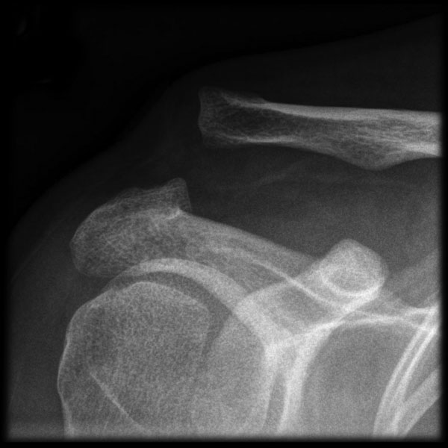
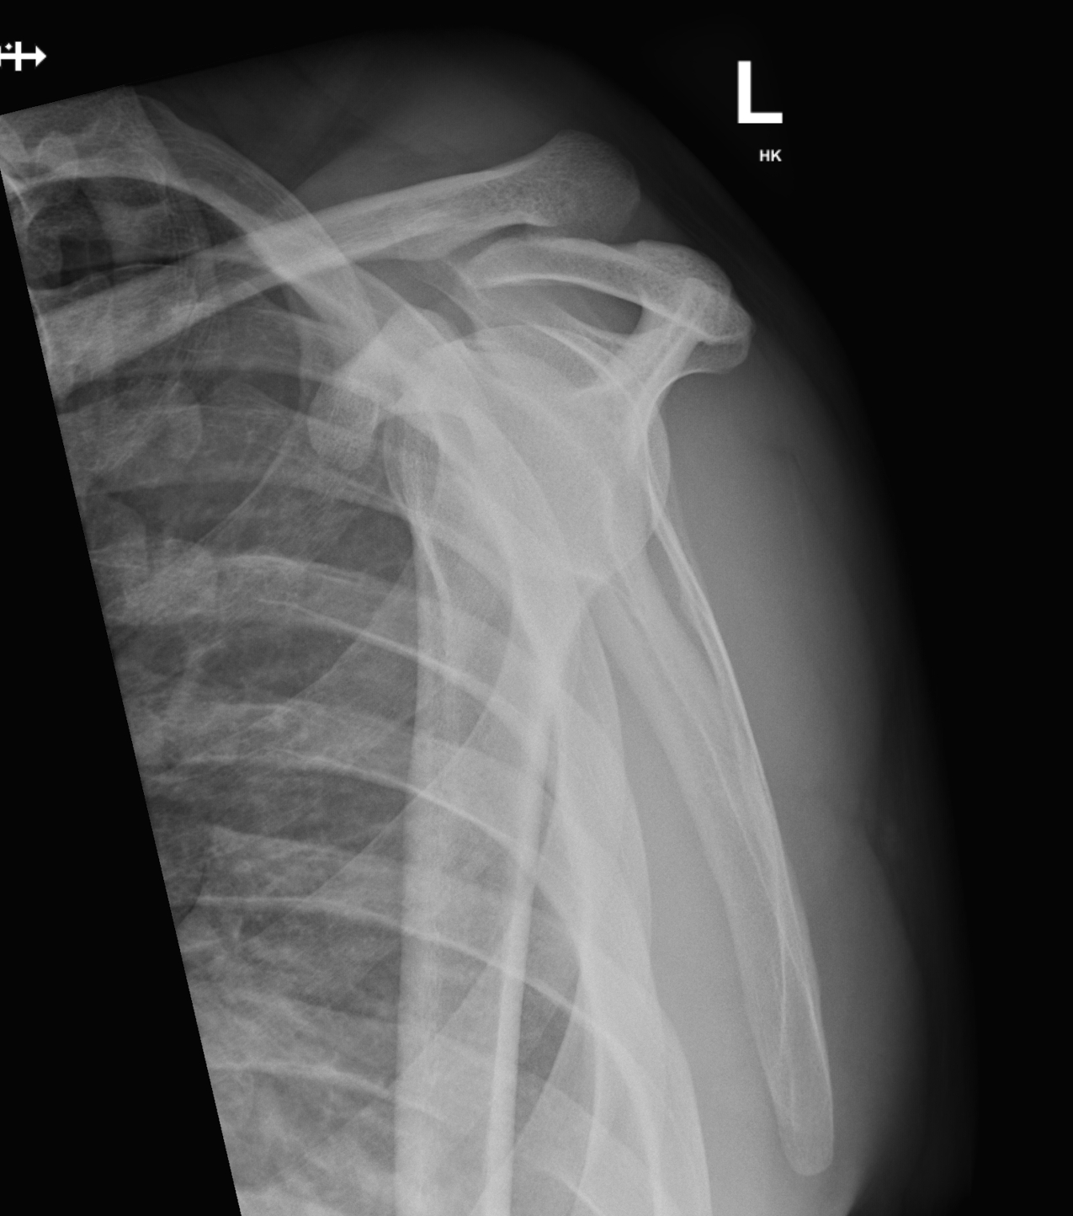
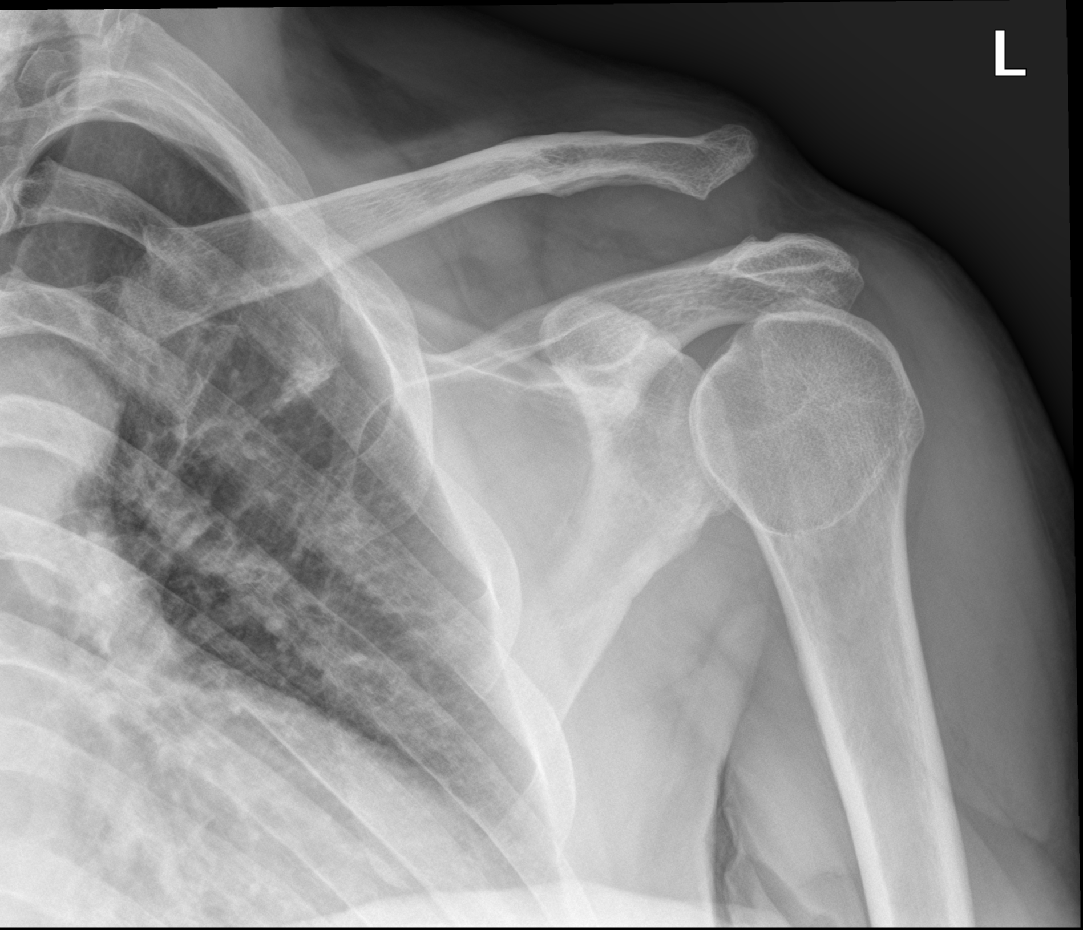
Rx :
Rockwood | Nb
III | 11
IV | 11
V | 08

Slide 24
 | FOLLOW UP | RETURN TO WORK
AVERAGE | 20 MONTHS | 10,2 WEEKS
Notes:
The students returned to school immediately after hospitalization.

Slide 25
CONSTANT SCORE
 | AVERAGE | MIN / MAX
CONSTANT SCORE | 85 | 74 / 96
GOOD OUTCOME | 11%
EXCELLENT OUTCOME | 89%

Slide 26
QUICK DASH
 | AVERAGE | MIN / MAX
QUICK DASH | 10,7 | 0 / 43,2
09 patients had a QuickDash score of zero = absence of discomfort caused by the affected shoulder.

Slide 27
SSV
 | AVERAGE | MIN / MAX
SSV | 89,3 % | 75 / 100 %

Slide 28
INFLUENCE OF TECHINQUE ON JOINT REDUCTION QUALITY ?
REDUCTION QUALITY | OPEN | ARTHRO | TOTAL
Satisfying | 8 | 9 | 17
Medium | 5 | 4 | 9
Bad | 2 | 2 | 4
Total | 15 | 15 | 30
MORE THAN 56 % OF SATISFYING RESULTS

Slide 29
INFLUENCE OF TECHINQUE ON JOINT MATERIAL DISPLACEMENT ?
 | MINI OPEN | ARTHRO
DISPLACEMENT | NO | NO

Slide 30
WHAT ABOUT LOSS OF CORRECTION?
 | MINI OPEN | ARTHRO
LOSS OF CORRECTION | NO | 1 CASE

Slide 31
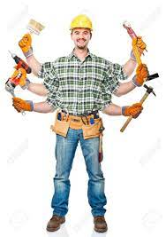
RETURN TO WORK?
TECHNIQUE | Number | Average Return to work ( WEEKS) | MIN / MAX
MINI Open | 15 | 10,9 | 6 / 20
Arthro | 15 | 13,6 | 6 / 22

Slide 32
CONSTANT SCORE
TECHNIQUE | NUMBER | CONSTANT SCORE AVERAGE | MIN / MAX
Open | 15 | 93 | 90-100
Arthro | 15 | 90 | 88-95

Slide 33
QUICK DASH
TECHNIQUE | NUMBER | QUICK DASH AVERAGE | MIN / MAX
MINI OPEN | 15 | 2,8 | 0 / 11,4
ARTHRO | 15 | 9,2 | 0 / 38,6

Slide 34
SSV
TECHNIQUE | NUMBER | SSV AVERAGE | MIN / MAX
MINI OPEN | 15 | 96 | 90 / 100
ARTHRO | 15 | 90 | 86 / 95

Slide 35
DISCUSSION

Slide 36
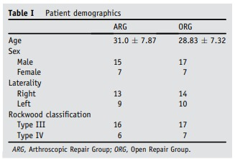
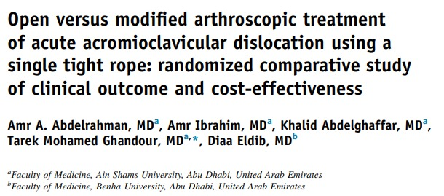
The number of patients, gender ratio, laterality and Rockwood classification were equivalent to ours.

Slide 37
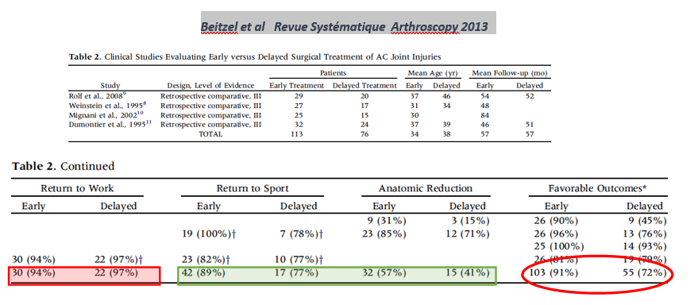
TIME TO SURGERY ?
CLINICAL STUDY IN 2013 COMPARING EARLY VS DEALYED TREATEMENT

Slide 38
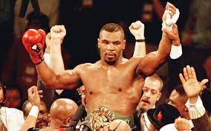
TIME TO SURGERY ?
TREATEMENT | BACK TO SPORT | BACK TO WORK | ANATOMIC REDUCTION | FAVORABLE OUTCOMES
EARLY | + | + | + | +
DELAYED | - | - | - | -
EARLY TREATEMENT ( LESS THAN 21 DAYS ) WINS !

Slide 39
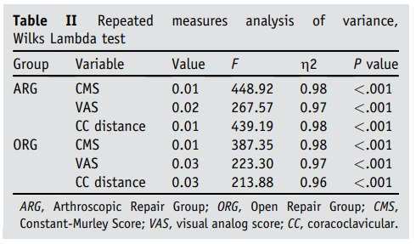
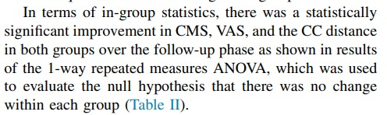
CLINICAL AND FUNCTIONNAL OUTCOME
ARHTROSCOPIC GROUP
VS
OPEN REPAIR GROUP

Slide 40
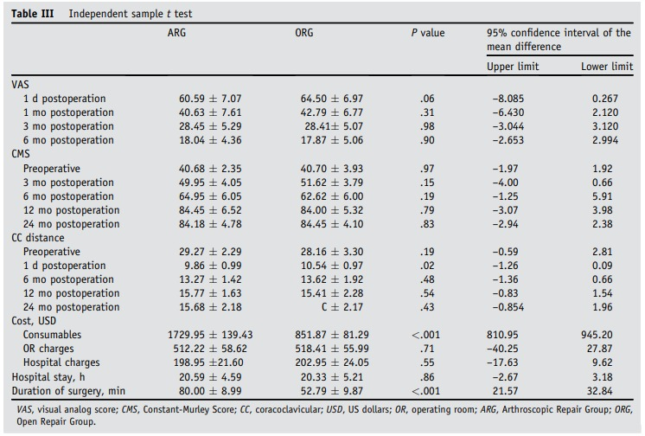

CLINICAL AND FUNCTIONNAL OUTCOME

Slide 41
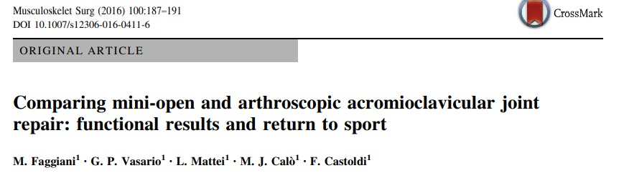
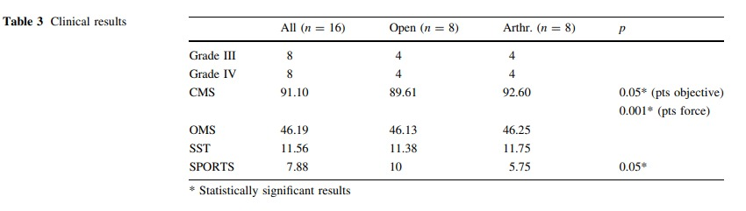
RETURN TO SPORTS

Slide 42

RETURN TO SPORTS

Slide 43

CONSTANT SCORE

Slide 44
OTHER AUTHORS
Salzmann Am j Sport Med 2010
Scheibel Am J Sport Med 2011
Kany Eur J Orthop Traumatol 2012
EQUIVALENT RESULTS

Slide 45

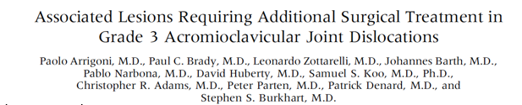
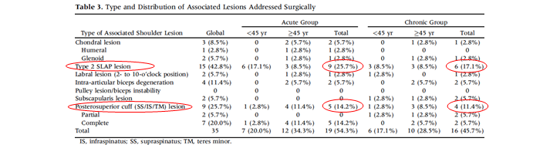
ARTHROSCOPY ADVANTAGES
ARTHROSCOPY 2014
WE NOTICE THAT :
42 PATIENTS OUT OF 98 HAD ASSOCIATED LESIONS
29 LESIONS REQUIRED SPECIFIC SURGICAL MANAGEMENT

Slide 46

BUT

Slide 47

Milewski Am J Sport Med 2012
LOSS OF CORRECTION | CORACOID FRACTURE | IMPLANT DISPLACEMENT | REOPERATION
15 % | 20% | 40% | 26%
NOT TO FORGET ARTHROSCOPY : REQUIERS LEARNING CURVE +++
IS A COSTLY SURGERY

Slide 48
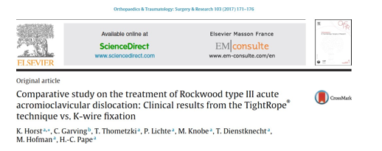
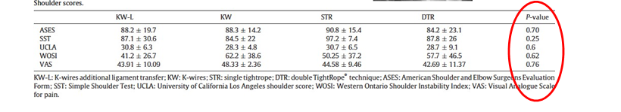
OPEN SURGERY
COMPARATIVE RETROSPECTIVE STUDY OF 4
OPEN TECHNIQUES :
K-WIRE +LIGAMENT TRANSFERT | K-WIRES
DOUBLE TIGHT ROPE | SINGLE TIGHT ROPE
NO DIFFERENCE IN SHOULDER SCORES!!!

Slide 49
TIGHT ROPE
HOOK PLATE

Slide 50
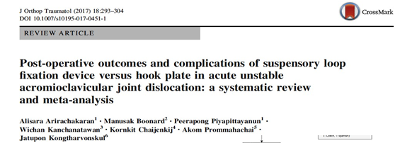
16 TIGHT ROPE STUDY VS 25 HOOK PLATE STUDY
USE OF TIGHT ROPE GIVES :
BETTER SHOULDER FUNCTION
LESS POST OPERATIVE PAIN

Slide 51

TAKE HOME MESSAGE
anatomic restore of coraco and acromio
clavicular ligaments
clinical outcomes are very satisfying for both
techniques

Slide 52
TAKE HOME MESSAGE
Arthroscopic approach are better in identifying
associated lesions which leads to extend surgical
indications

